Slide 1
Evaluating the Impact of Learning Disability Simulation Training on the Confidence of Healthcare Professionals
A Pre- and Post-Test Evaluation at Barts Health NHS Trust
Alvin Ryan Sayat¹ and Ben Taylor²
¹Education Practitioner, Postgraduate Team
²Practice Educator/Clinical Nurse Specialist, Learning Disabilities & Autism

Slide 2
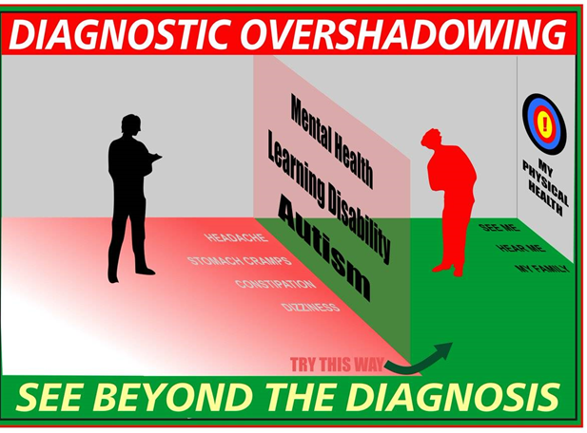
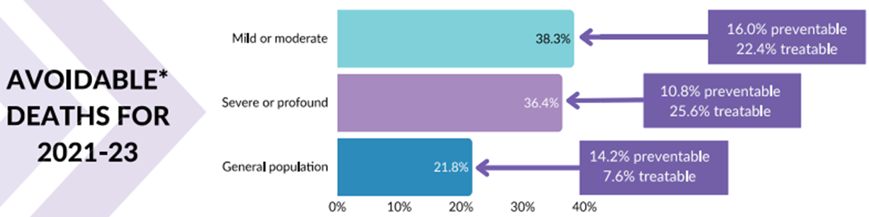
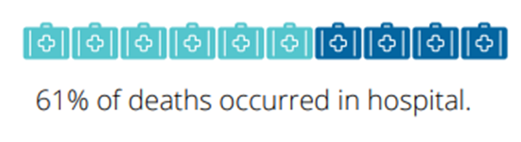
Context and Significance of Learning Disability
Care and Education
Inequality in healthcare for people with learning disabilities and autism isn’t accidental, it’s a consequence of gaps in knowledge, confidence, and training.
1.2 million people with Learning Disability & 700,000 on the autism spectrum¹
LeDeR 2023: 38.5% of deaths among LD patients avoidable²
In receipt of poor equitable care and in deficit of positive health outcomes
Contributing factors:^{2,3}
Insufficient staff training​
Communication breakdowns​
Lack of reasonable adjustments​
Diagnostic overshadowing ​
1. Public Health England (2025) Learning disabilities: Applying All Our Health. Available at: https://www.gov.uk/government/publications/learning-disability-applying-all-our-health/learning-disabilities-applying-all-our-health (Accessed: 10 November 2025).
2. NHS England (2022). NHS England» Learning from lives and deaths – People with a learning disability and autistic people (LeDeR). [online] www.england.nhs.uk. Available at: https://www.england.nhs.uk/learning-disabilities/improving-health/learning-from-lives-and-deaths/.
3. King's College London, University of Central Lancashire and Kingston University London (2025) Learning from Lives and Deaths – people with a learning disability and autistic people [2023 Report], King's College London. Available at: https://www.kcl.ac.uk/news/2023-leder-report-into-avoidable-and-preventable-deaths-of-people-with-learning-disabilities#:~:text=This%20year's%20report%20placed%20a,severe%20or%20profound%20learning%20disability (Accessed: 10 November 2025).
Notes:
Add barts specific statistics
Health inequality- deprived, poorer boroughs, NEL

Slide 3
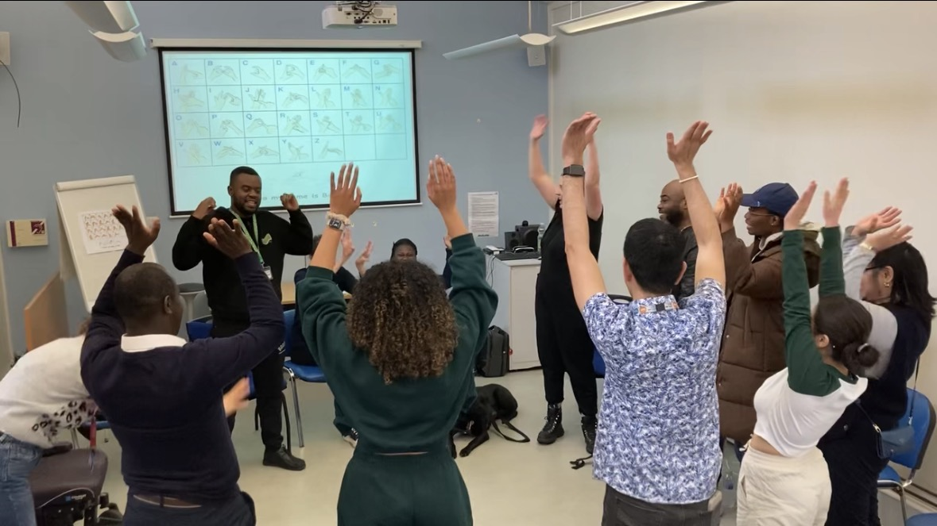

Why Confidence Matters
Confidence in Healthcare = belief in ability + trust in judgment - improvement in patient outcomes^{4,5}
Linked to:^{6,7,8,9}
  Better communication and development of trust
  Improved patient experience & therapeutic relationships
  Enhanced health outcomes for patients
  Better clinical decision-making
  Safer and higher quality of care
4. Tabriz, E.R., Sadeghi, M., Tavana, E., Miri, H.H. and Nabavi, F.H. (2024). Approaches for boosting self-confidence of clinical nursing students: A systematic review and meta-analysis. Heliyon, [online] 10(6), p.e27347. doi:https://doi.org/10.1016/j.heliyon.2024.e27347.
5. Hecimovich, M.D. and Volet, S.E. (2009). Importance of Building Confidence in Patient Communication and Clinical Skills Among Chiropractic Students. Journal of Chiropractic Education, [online] 23(2), pp.151–164. doi:https://doi.org/10.7899/1042-5055-23.2.151.
6. Sharkiya, S. (2023). Quality communication can improve patient-centred health outcomes among older patients: A rapid review. BMC Health Services Research, [online] 23(1), pp.1–14. doi:https://doi.org/10.1186/s12913-023-09869-8.
7. Abu Sharour, L., Bani Salameh, A., Suleiman, K., Subih, M., EL-hneiti, M., AL-Husaami, M., Al Dameery, K. & Al Omari, O. (2021) ‘Nurses’ Self-Efficacy, Confidence and Interaction With Patients With COVID-19: A Cross-Sectional Study’, Disaster Medicine and Public Health Preparedness, 16(4), pp. 1–5. doi:10.1017/dmp.2021.1.
8. Betz, C.L., Zalon, M.L., Caramanica, L. and Arslanian‐Engoren, C. (2020). Nurse competencies for transitions of care: Implications for education and practice. Nursing Forum, 56(2), pp.358–364. doi:https://doi.org/10.1111/nuf.12544.
9. Kim, M.K., Arsenault, C., Atuyambe, L.M., Macwan’gi, M. & Kruk, M.E. (2020) ‘Determinants of healthcare providers’ confidence in their clinical skills to deliver quality obstetric and newborn care in Uganda and Zambia’, BMC Health Services Research, 20(1). doi:10.1186/s12913-020-05410-3.

Slide 4
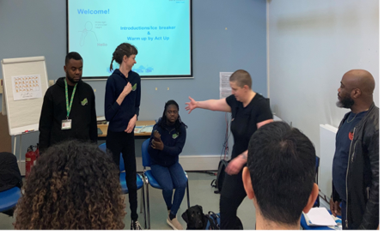

Aim
To evaluate whether LD Simulation Training improves the confidence of nurses, midwives, and allied health professionals (NMAHP) in engaging with LD patients

Slide 5
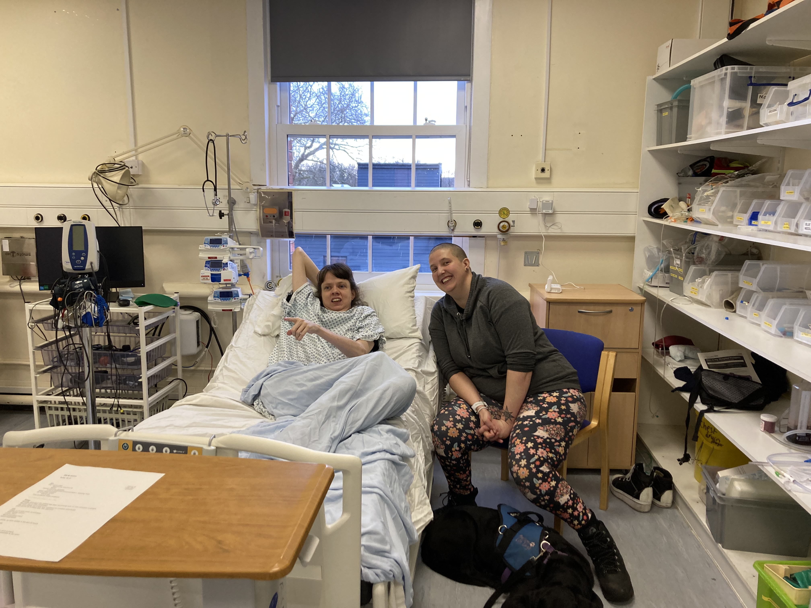
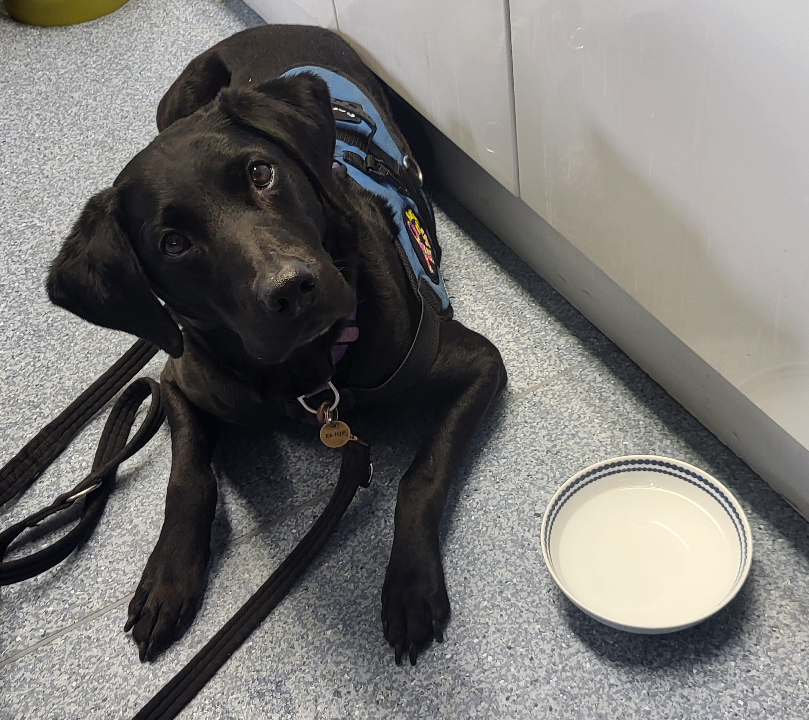
Training Overview
Launch & Audience: July 2025; half-day program open to all NMAHPs in their first two years of service
Co-Facilitation: Delivered with people with lived experience and hospital community members
Program Components:
  2-hour lecture, of theory and practical principles
  Actor-led engaging warm-up
  Simulations co-designed and pilot tested with actors and based on real hospital incidents
Educational Focus:
Communication, therapeutic relationships, reasonable adjustments, clinical judgment, patient safety, and risk management
Debriefing:
Structured using the Describe–Analyze–Apply framework¹⁰
10. Jaye, P., Thomas, L. and Reedy, G. (2015). ‘The Diamond’: a structure for simulation debrief. The Clinical Teacher, [online] 12(3), pp.171–175. doi:https://doi.org/10.1111/tct.12300.
Notes:
Act Up newham-
Lived experience-
Pics
Take photos from the next session

Slide 6
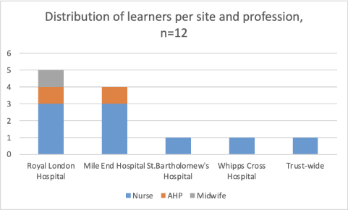
Methods
Design: Retrospective review of data, pre-/post-test, descriptive quantitative
Tool: 4-point Likert scale¹¹
Analysis: Paired t-test¹² (SPSS v31, p < 0.05)
Additional qualitative analysis to triangulate results (ATLAS.ti version 25.0.1)
Data: Anonymous responses from 12 learners
11. Flanagan, J. M., Beck, C. T., and Polit, D. F. (2024) Polit & Beck’s Nursing Research: Generating and Assessing Evidence for Nursing Practice[12th ed.]. Philadelphia: Lippincott Williams & Wilkins.
12. Chicco, D., Sichenze, A. and Jurman, G. (2025). A simple guide to the use of Student’s t-test, Mann-Whitney U test, Chi-squared test, and Kruskal-Wallis test in biostatistics. BioData Mining, 18(1). doi:https://doi.org/10.1186/s13040-025-00465-6.

Slide 7
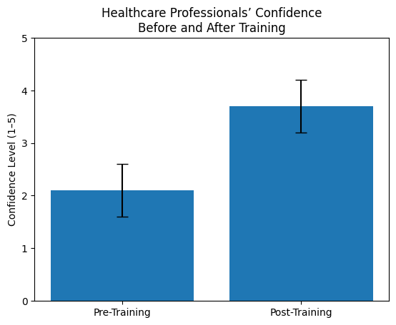
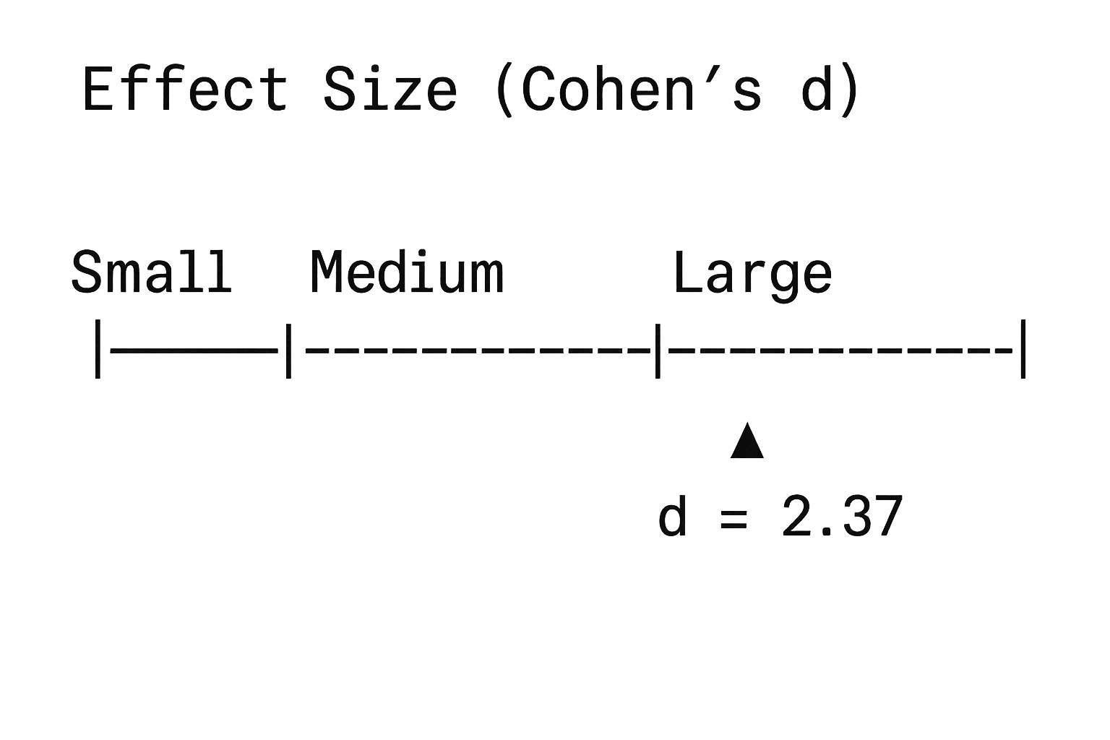
Results: Quantitative
t(11) = 8.2, p < 0.001
Notes:
Pre training M= 2.1 vs 3.7 (post training)

Slide 8

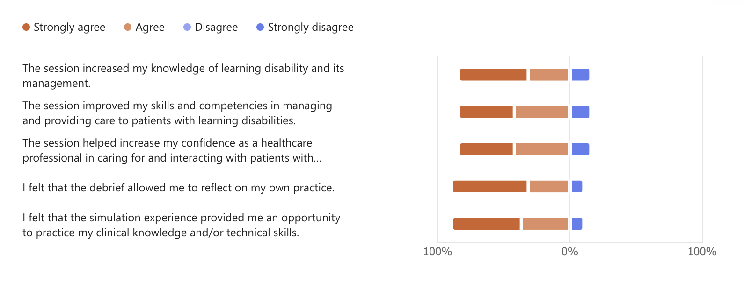
Results: Qualitative
Themes:
  Increased confidence in communication
  Enhanced empathy
  Reflection of current practices
  Awareness of reasonable adjustments
Notes:
Add graphs, images

Slide 9
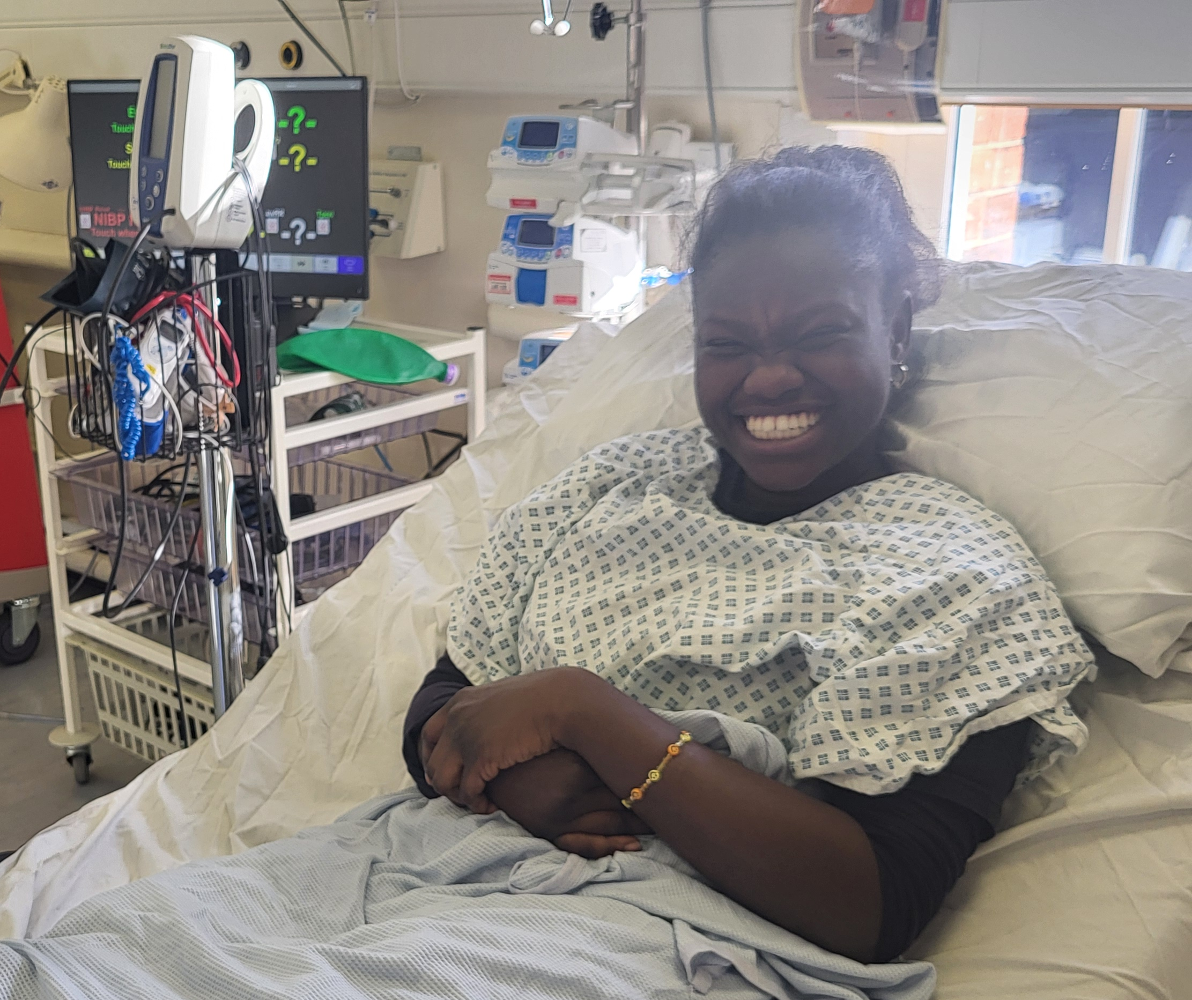
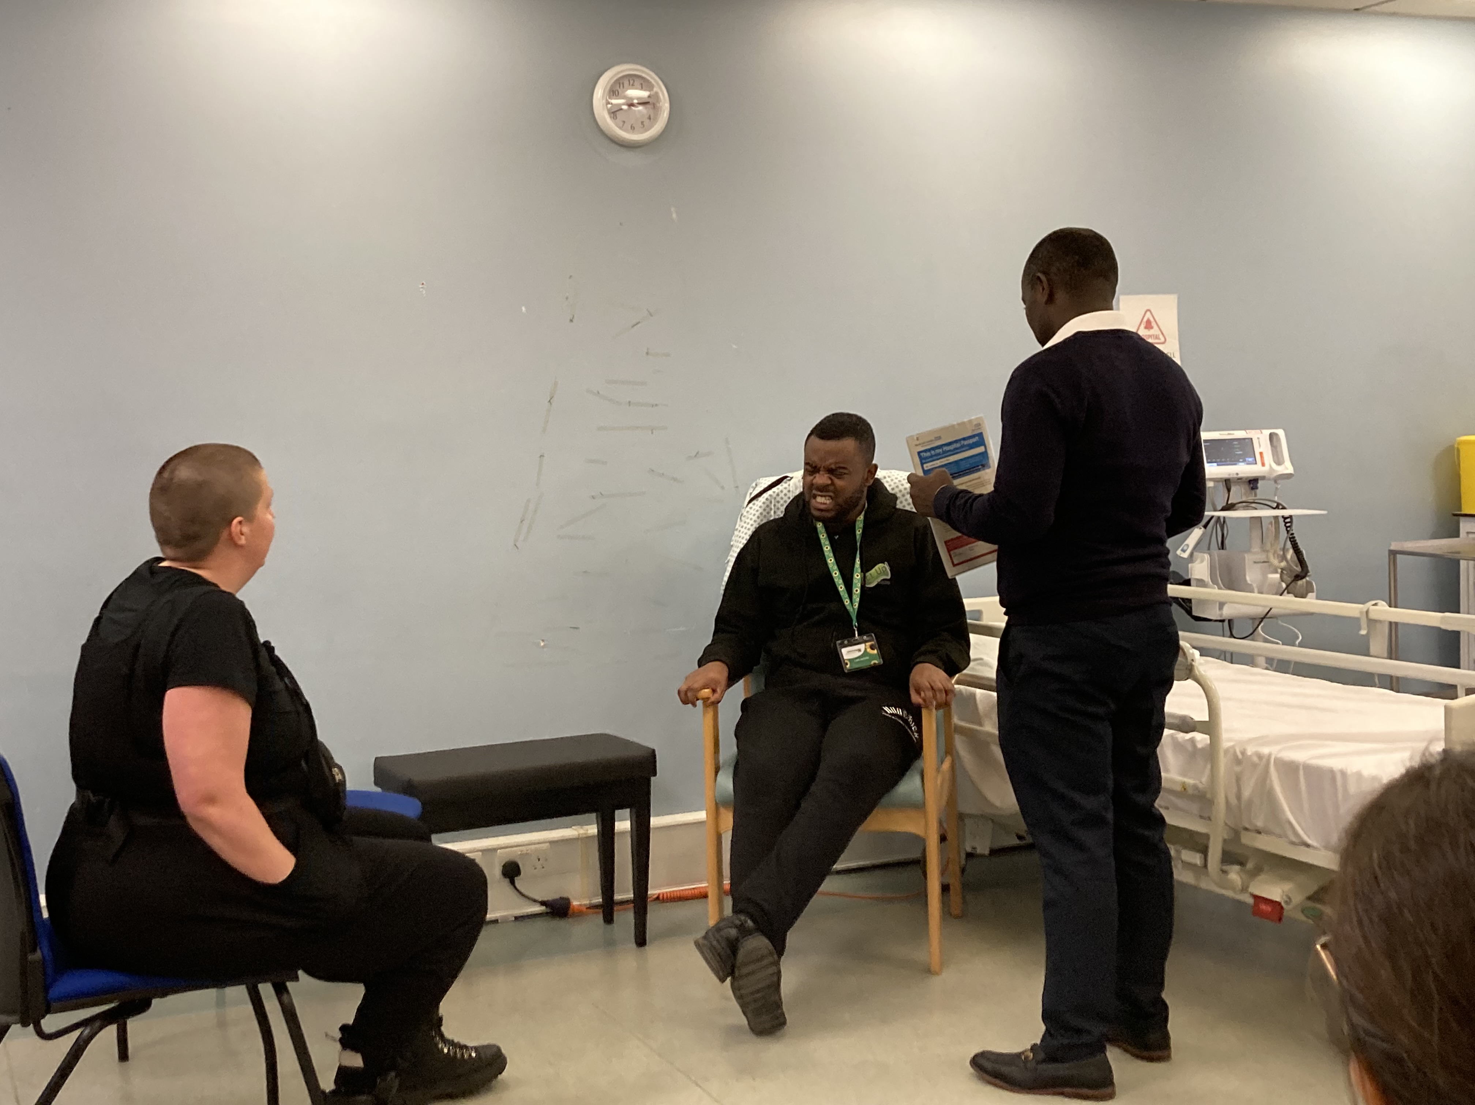
Discussion
Supported by:​​​
​
Kolb’s Experiential Learning Theory¹⁵​​​
Vygotsky’s Social Constructivism^{16,17}
Knowles’ Adult Learning Theory¹⁸
Simulation-based learning effective for improving confidence^{13,14}​
13. Cant, R.P. & Cooper, S.J. (2017) ‘Simulation-based learning in nurse education: Systematic review’, Journal of Advanced Nursing, 73(1), pp. 83–103. doi: 10.1111/j.1365-2648.2009.05240.x
14. Cook, D.A. et al. (2013) ‘Comparative effectiveness of instructional design features in simulation-based education’, Medical Teacher, 35(1). doi: 10.3109/0142159X.2012.714886.
15. Kolb, D.A. (1984) Experiential learning: Experience as the source of learning and development. Englewood Cliffs, NJ: Prentice Hall.
16. Vygotsky, L.S. (1978) Mind in Society: The Development of Higher Psychological Processes. Cambridge, MA: Harvard University Press.
17. Smith, S.E., McCann, H.P., Urbano, R.C., Dykens, E.M. and Hodapp, R.M. (2021). Training Healthcare Professionals to Work With People With Intellectual and Developmental Disabilities. Intellectual and Developmental Disabilities, 59(6), pp.446–458. doi:https://doi.org/10.1352/1934-9556-59.6.446.
18. Knowles, M.S. (1980) The modern practice of adult education: From pedagogy to andragogy. New York: Cambridge Books.
Notes:
Discuss theories more

Slide 10

Limitations
As with any educational evaluation, it is important to recognise the limitations that shape how we interpret these findings
Small sample size ​→ more frequent and lager cohorts' samples needed
Multifaceted intervention → hard to isolate components​ for exact impact
Cost and sustainability → actor involvement​,
Translation to patient outcomes → improved practice, behavior changes and shift in trends

Slide 11
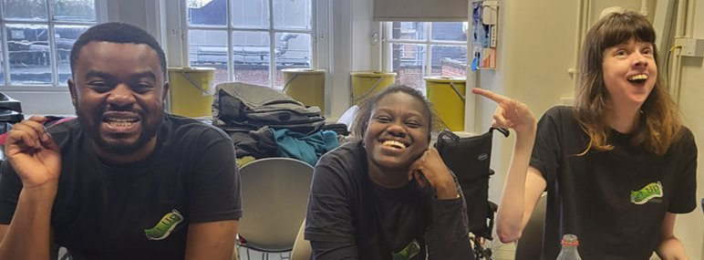
Conclusion & Next Steps
Simulation-based education is an effective approach to increasing healthcare professionals’ confidence in delivering care to patients with learning disabilities and autism
Confidence is associated with improved communication, greater adherence, and higher satisfaction with care¹⁹
Actors/participants of lived experience felt seen and heard with sense of belonging and inclusion in our hospital community ​​
Recommendations:​
Strengthening actor accessibility and collaboration to support increased simulation day delivery​
Simulations to be inclusive of current trends and data from patients' experiences and of wider NMAHP departments/settings and pertain larger cohorts
Develop long-term key performance indicators to measure sustained improvements in practice amongst staff and for patient group
19. Birkhäuer, J. et al. (2017) ‘The relationship between physician trust and patient outcomes: A systematic review’, PLOS ONE, 12(2). doi: 10.1371/journal.pone.0170988.

Slide 12

Resources:
Public Health England (2025) Learning disabilities: Applying All Our Health. Available at: https://www.gov.uk/government/publications/learning-disability-applying-all-our-health/learning-disabilities-applying-all-our-health (Accessed: 10 November 2025).
NHS England (2022). NHS England» Learning from lives and deaths – People with a learning disability and autistic people (LeDeR). [online] www.england.nhs.uk. Available at: https://www.england.nhs.uk/learning-disabilities/improving-health/learning-from-lives-and-deaths/.
King's College London, University of Central Lancashire and Kingston University London (2025) Learning from Lives and Deaths – people with a learning disability and autistic people [2023 Report], King's College London. Available at: https://www.kcl.ac.uk/news/2023-leder-report-into-avoidable-and-preventable-deaths-of-people-with-learning-disabilities#:~:text=This%20year's%20report%20placed%20a,severe%20or%20profound%20learning%20disability (Accessed: 10 November 2025).
Tabriz, E.R., Sadeghi, M., Tavana, E., Miri, H.H. and Nabavi, F.H. (2024). Approaches for boosting self-confidence of clinical nursing students: A systematic review and meta-analysis. Heliyon, [online] 10(6), p.e27347. doi:https://doi.org/10.1016/j.heliyon.2024.e27347.
Hecimovich, M.D. and Volet, S.E. (2009). Importance of Building Confidence in Patient Communication and Clinical Skills Among Chiropractic Students. Journal of Chiropractic Education, [online] 23(2), pp.151–164. doi:https://doi.org/10.7899/1042-5055-23.2.151.
Sharkiya, S. (2023). Quality communication can improve patient-centred health outcomes among older patients: A rapid review. BMC Health Services Research, [online] 23(1), pp.1–14. doi:https://doi.org/10.1186/s12913-023-09869-8.
Abu Sharour, L., Bani Salameh, A., Suleiman, K., Subih, M., EL-hneiti, M., AL-Husaami, M., Al Dameery, K. & Al Omari, O. (2021) ‘Nurses’ Self-Efficacy, Confidence and Interaction With Patients With COVID-19: A Cross-Sectional Study’, Disaster Medicine and Public Health Preparedness, 16(4), pp. 1–5. doi:10.1017/dmp.2021.1.
Betz, C.L., Zalon, M.L., Caramanica, L. and Arslanian‐Engoren, C. (2020). Nurse competencies for transitions of care: Implications for education and practice. Nursing Forum, 56(2), pp.358–364. doi:https://doi.org/10.1111/nuf.12544.
Kim, M.K., Arsenault, C., Atuyambe, L.M., Macwan’gi, M. & Kruk, M.E. (2020) ‘Determinants of healthcare providers’ confidence in their clinical skills to deliver quality obstetric and newborn care in Uganda and Zambia’, BMC Health Services Research, 20(1). doi:10.1186/s12913-020-05410-3.
Jaye, P., Thomas, L. and Reedy, G. (2015). ‘The Diamond’: a structure for simulation debrief. The Clinical Teacher, [online] 12(3), pp.171–175. doi:https://doi.org/10.1111/tct.12300.

Slide 13
Resources:
Flanagan, J. M., Beck, C. T., and Polit, D. F. (2024) Polit & Beck’s Nursing Research: Generating and Assessing Evidence for Nursing Practice[12th ed.]. Philadelphia: Lippincott Williams & Wilkins.
Chicco, D., Sichenze, A. and Jurman, G. (2025). A simple guide to the use of Student’s t-test, Mann-Whitney U test, Chi-squared test, and Kruskal-Wallis test in biostatistics. BioData Mining, 18(1). doi:https://doi.org/10.1186/s13040-025-00465-6.
Cant, R.P. & Cooper, S.J. (2017) ‘Simulation-based learning in nurse education: Systematic review’, Journal of Advanced Nursing, 73(1), pp. 83–103. doi: 10.1111/j.1365-2648.2009.05240.x
Cook, D.A. et al. (2013) ‘Comparative effectiveness of instructional design features in simulation-based education’, Medical Teacher, 35(1). doi: 10.3109/0142159X.2012.714886.
Kolb, D.A. (1984) Experiential learning: Experience as the source of learning and development. Englewood Cliffs, NJ: Prentice Hall.
Vygotsky, L.S. (1978) Mind in Society: The Development of Higher Psychological Processes. Cambridge, MA: Harvard University Press.
Smith, S.E., McCann, H.P., Urbano, R.C., Dykens, E.M. and Hodapp, R.M. (2021). Training Healthcare Professionals to Work With People With Intellectual and Developmental Disabilities. Intellectual and Developmental Disabilities, 59(6), pp.446–458. doi:https://doi.org/10.1352/1934-9556-59.6.446.
Knowles, M.S. (1980) The modern practice of adult education: From pedagogy to andragogy. New York: Cambridge Books.
Birkhäuer, J. et al. (2017) ‘The relationship between physician trust and patient outcomes: A systematic review’, PLOS ONE, 12(2). doi: 10.1371/journal.pone.0170988.

Slide 14

Contact details:​
Alvin Ryan Sayat: asayat@nhs.net
​
Ben Taylor: ben.taylor11@nhs.net​
Barts Health Education Academy
Postgraduate and Preceptorship team
Royal London Hospital
Turner Street
London
E1 1FR

Slide 15
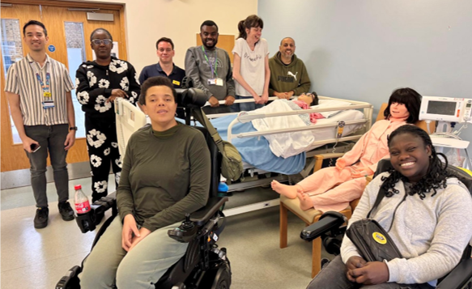
Thank You / Q&A's
Acknowledgements:
This project is a true reflection of co-production; we would like to recognise the dedication and partnership of the following individuals; Hannah, Sterre, Awa, Glory, Jade, Pritesh and Merlow the dog from Act Up!
Abbie McFarlane, Postgraduate Education Lead at Barts Health

