Slide 1

CAIPE Quality Standards
for the design, management and delivery of pre-registration interprofessional education
Prof. Elizabeth Anderson PhD SRN MW HV (CAIPE President)
Dr. Sharon Buckley PhD PGCE PG Dip. NTF (CAIPE Standards Group)
Prof. Dawne Gurbutt (CAIPE Co-opted Board Member)
Prof. John Hammond EdD (CAIPE Trustee)

Slide 2

CAIPE – a trusted voice in health and social care
Founded in 1987, a scholarly charity dedicated to advancing interprofessional education & collaborative practice - established the Journal of Interprofessional Care
Active international engagement - research, partnerships & knowledge exchange with IP.Global, WHO
Our Mission is to generate, synthesise, & translate the evidence base for best practice in IPE
Our Trustees
  Academics, clinicians and regulators - drawn from across the four home nations
  Serve voluntarily, contributing time and expertise to drive CAIPE’s mission
Reinvesting in the future - CAIPE reinvests all its funding into four strategic priorities:
  Research
  Quality Standards Development
  Faculty Development
  Translation of Evidence into Practice

Slide 3
Interprofessional Education (IPE)
Definition
  “Interprofessional Education occurs when learners from two or more professions learn with, from, and about each other to improve collaboration and the quality of care” Barr, 2002.
IPE v Multi-Professional Education
  IPE: Focuses on interactive learning and collaborative practice and places patients, service users, families, and carers at the heart of care
  Multi-Professional Education: Parallel learning without intentional interaction or integration
IPE as a Strategic Solution
  Promotes collaborative readiness and team-based care
  Reduces fragmentation, improves safety and promotes a supportive culture
  Aligns with system-wide goals for quality improvement and risk reduction

Slide 4

Workshop Aims
To raise awareness of CAIPE and the quality standards
To consider how these pre-registration standards can inform and enhance practice-based education
To obtain feedback on the appropriateness and utility of these standards for your context
Notes:
FORMAT
Introduction to CAIPE and the standards (15 min)
Group exercise (30 min)
Feedback (10 min)
Close (5 min)

Slide 5
Why collaborative care matters
Evidence shows that collaborative practice improves:
  patient recovery and satisfaction
  patient safety and continuity of care
  reduction in medical errors and hospital readmissions
  enables teams to co-create personalised, holistic care plans
A timely imperative
  £3.6bn: Clinical negligence costs in 2024–25
  £1.4bn: Maternity claims alone
  £60bn: Total accumulated liabilities as of 31 March 2025
  NHS litigation is largely driven by avoidable harm due to substandard clinical care
System-wide insight - NHS-commissioned independent reviews of healthcare
  consistently highlight poor teamwork and communication as root causes of harm
  “those who work together should train together.”
  IPE is a key lever to improve team-based delivery and reduce systemic risk

Slide 6
CAIPE Quality Standards
Quality Standards for the design, delivery and management of pre-registration interprofessional education
House of Lords 3rd November - a gift to health & social care communities
first interprofessional education standards published nationally or internationally, setting a benchmark for quality and consistency
based on the best available evidence and shaped through wide consultation with our regulators, statutory bodies and stakeholders across the UK
six domains covering the design, delivery and management of IPE
robust and adaptable framework for education institutions to embed IPE that fosters collaboration, mutual respect, and effective professional relationships
educational processes, not student outcomes—flexibility across diverse contexts
Notes:
Statutory – NHS England, Scotland, Ireland
Regulatory – GMC, NMC etc

Slide 7
Where do the Quality Standards operate?
Regulatory
Standards
Outcomes
CAIPE
IPE Quality Standards
Supporting guidance
Education providers
Delivery of IPE
Application of CAIPE standards

Slide 8
Who are the beneficiaries?
Education providers such as Higher Education institutions and NHS Trusts can use the standards to develop IPE locally
Regulators can use the standards to review IPE at the system or institutional level
Standards can facilitate all educators to develop the quality of their IPE
Health and social care providers and those they care for benefit through better teamworking and higher quality care

Slide 9
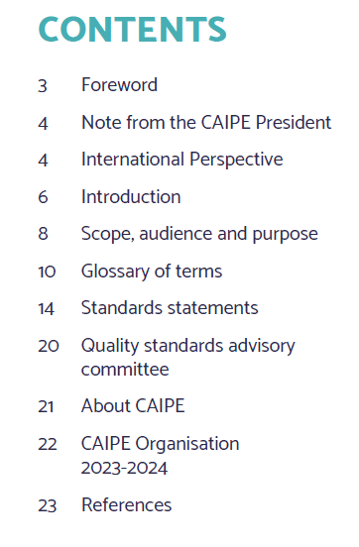
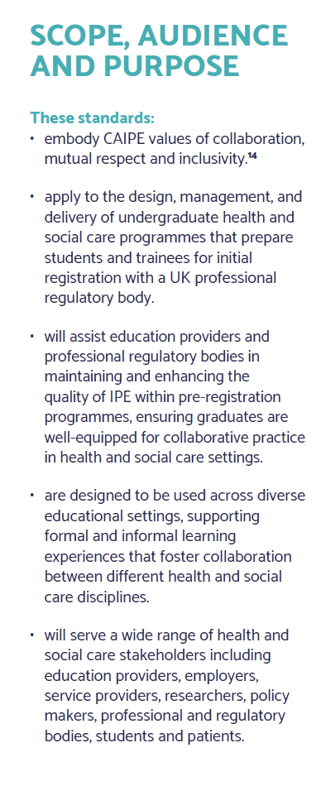
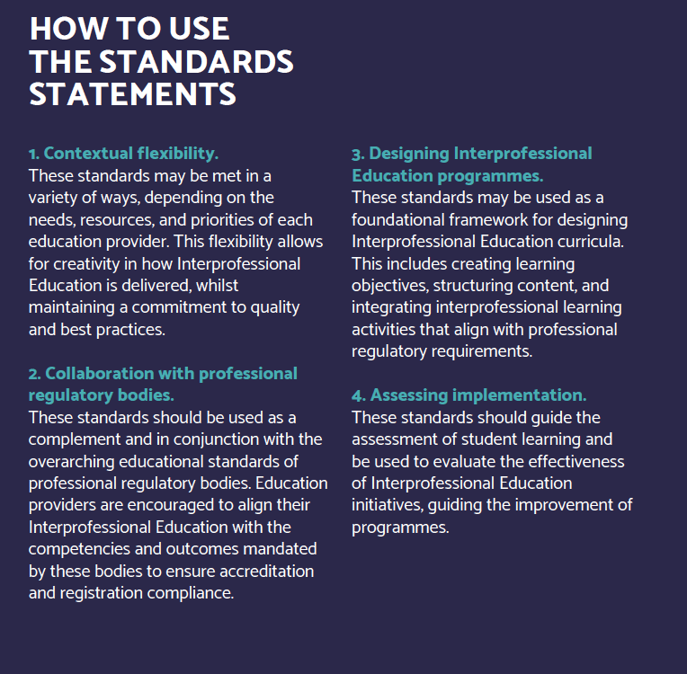
CAIPE Quality Standards
Educational processes NOT learner outcomes
Aspirational but realistic
The standards can shape the teaching context from the classroom setting to simulation, technology enhanced learning and into practice
Standards for post-registration contexts in preparation
Notes:
The introduction includes

Slide 10

Inside the CAIPE Quality Standards
Access the Quality Standards here
Governance
Leadership and Management
Interprofessional Education Framework
Practice-based IPE
Faculty Development
Scholarship and Research
Notes:
Moving onto the standards -

Slide 11
Standard domain for practice-based IPE (page 18)
Access the Quality Standards here
Practice-based interprofessional education
Formal and informal interprofessional education placements that occur in health and social care practice and other external environments
  4.1 Practice-based interprofessional education is integrated into partnership arrangements with providers
  4.2 Educators collaborate to promote interprofessional education in the local context
  4.3 Educators raise the profile of interprofessional collaborative practice with students and with health and social care teams
  4.4 Educators role model interprofessional collaborative practice
Notes:
Moving onto the standards -

Slide 12
Self-assessment for practice-based IPE: discussion
Practice-based interprofessional education
Formal and informal interprofessional education placements that occur in health and social care practice and other external environments
  4.1 Practice-based interprofessional education is integrated into partnership arrangements with providers
  4.2 Educators collaborate to promote interprofessional education in the local context
  4.3 Educators raise the profile of interprofessional collaborative practice with students and with health and social care teams
  4.4 Educators role model interprofessional collaborative practice
Rating | Descriptor | Definition
1: Not in Place | Foundational stage | The standard is not established. Structures or processes are absent or applied only in a limited or informal way
2: Emerging | Early development | Early steps have been taken, but implementation is inconsistent or limited. Further development is required
3: Mostly in Place | Established but developing | Most aspects are established and working. Some refinements or greater consistency may be needed
4: Fully in Place | Embedded and sustained | The standard is well developed, consistently applied and supported by evidence. It is embedded across programmes and reviewed regularly
Notes:
Moving onto the standards -

Slide 13
Self-assessment for practice-based IPE: feedback
Practice-based interprofessional education
Formal and informal interprofessional education placements that occur in health and social care practice and other external environments
  4.1 Practice-based interprofessional education is integrated into partnership arrangements with providers
  4.2 Educators collaborate to promote interprofessional education in the local context
  4.3 Educators raise the profile of interprofessional collaborative practice with students and with health and social care teams
  4.4 Educators role model interprofessional collaborative practice
Rating | Descriptor | Definition
1: Not in Place | Foundational stage | The standard is not established. Structures or processes are absent or applied only in a limited or informal way
2: Emerging | Early development | Early steps have been taken, but implementation is inconsistent or limited. Further development is required
3: Mostly in Place | Established but developing | Most aspects are established and working. Some refinements or greater consistency may be needed
4: Fully in Place | Embedded and sustained | The standard is well developed, consistently applied and supported by evidence. It is embedded across programmes and reviewed regularly
Notes:
Moving onto the standards -

Slide 14



CAIPE – getting involved
Access the Benefits of membership here

Slide 15
Summary
First standards nationally and internationally
Best evidence from >40 years of research - providing assurance for roll out
Provides institution and system-wide benchmarking and monitoring
Supported by delivery of CAIPE workshops, case studies, podcasts & self-assessment tool
Timely, in view of ongoing concerns for the determinants of patient safety
Just the start of a journey … post-registration standards in preparation
Notes:
Based on >40 years
Determinants: Poor team working Communication and culture
Just the start of a journey continue working with our stakeholders – roll out, postgraduate, practitioners, evaluation and refinement

Slide 16
CAIPE Quality Standards
for the design, management and delivery of pre-registration interprofessional education
Thank you

