Slide 1


Evaluation of a community-based CLiP (Collaborative Learning in Practice) placement for Physiotherapy students.
Christie Robinson – University of Plymouth

Slide 2
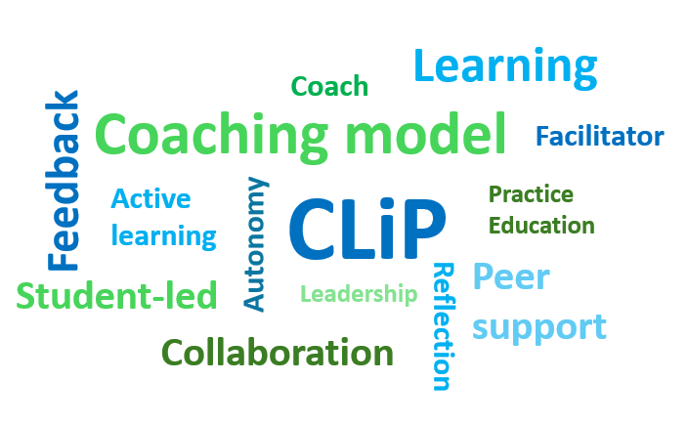


Slide 3


- Capacity
Experience
Value / Impact

Slide 4


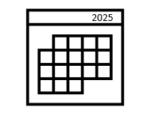


















3 First year students
(BSc / Pre-Reg MSc)
5-week placement
April – May 2025
2 Third year students (BSc)
Based within Care Home Liaison team and Community Neuro Rehab team
1 full-time CLiP
Physiotherapy Facilitator / Coach
CLiP
Older adults with a range of conditions – presenting with mobility or balance issues.
Support from Clinical, Placement Care home teams
Financial support for the pilot from HEE / NHSE

Slide 5


Evaluation
Evaluation drew on four data sources:
- Service delivery metrics
- Service user feedback
- Student placement assessment data
- Stakeholder discussions
Ethical approval - University of Plymouth FREIC (Ref: 6268) and Livewell’s Service Evaluation team

Slide 6










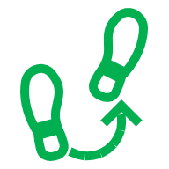
Service Impact
More than 50 hours direct patient contact
in addition to usual service delivery
2-week reduction in wait list time
56 individual patient contacts
18 group-based contacts
Direct patient contacts
28 general exercise interventions
22 balance interventions
13 mobility assessments
8 neuro assessments
3 general exercise advice or guidance
21 new assessments
53 follow-up appointments
39 Care Home Liaison Team
- 35 Community Neuro rehab Team

Slide 7


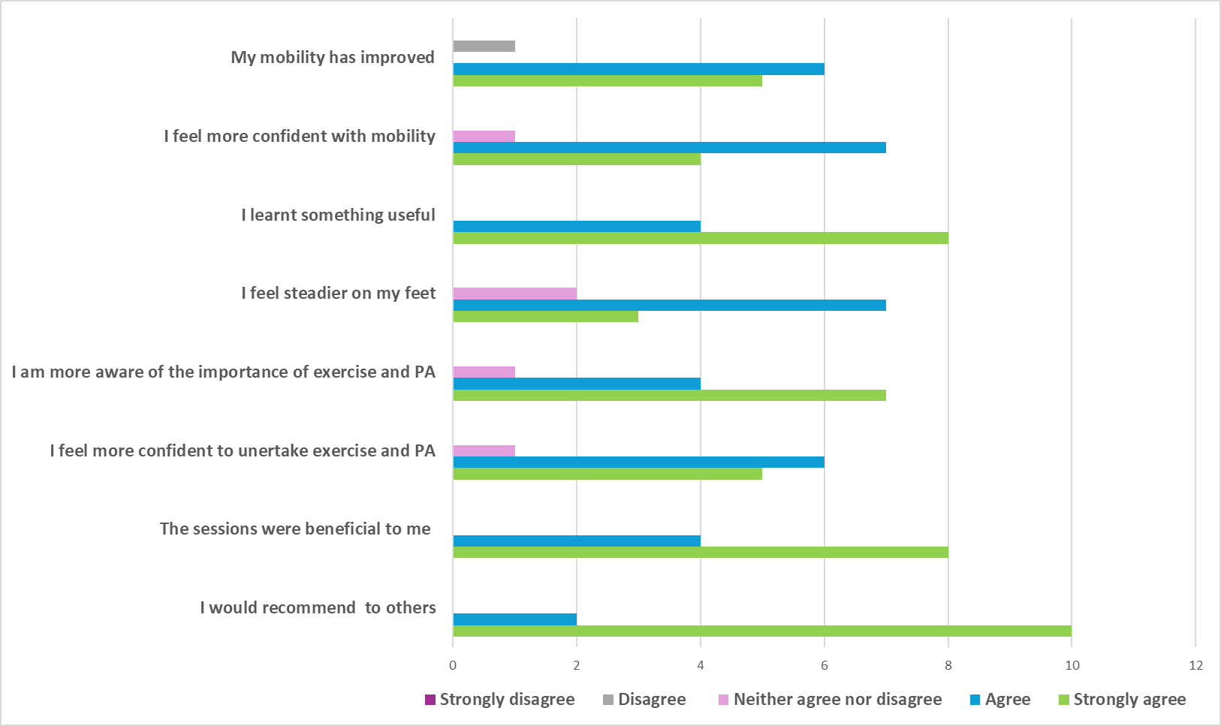




Service User Experience

Slide 8

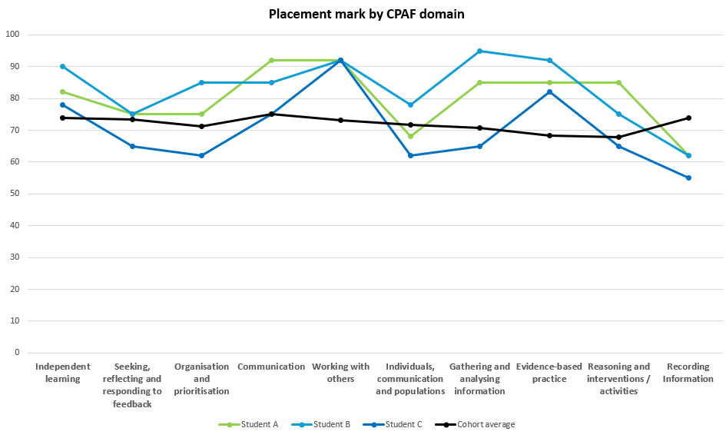
Student achievement
77.7%
71.9%

Slide 9

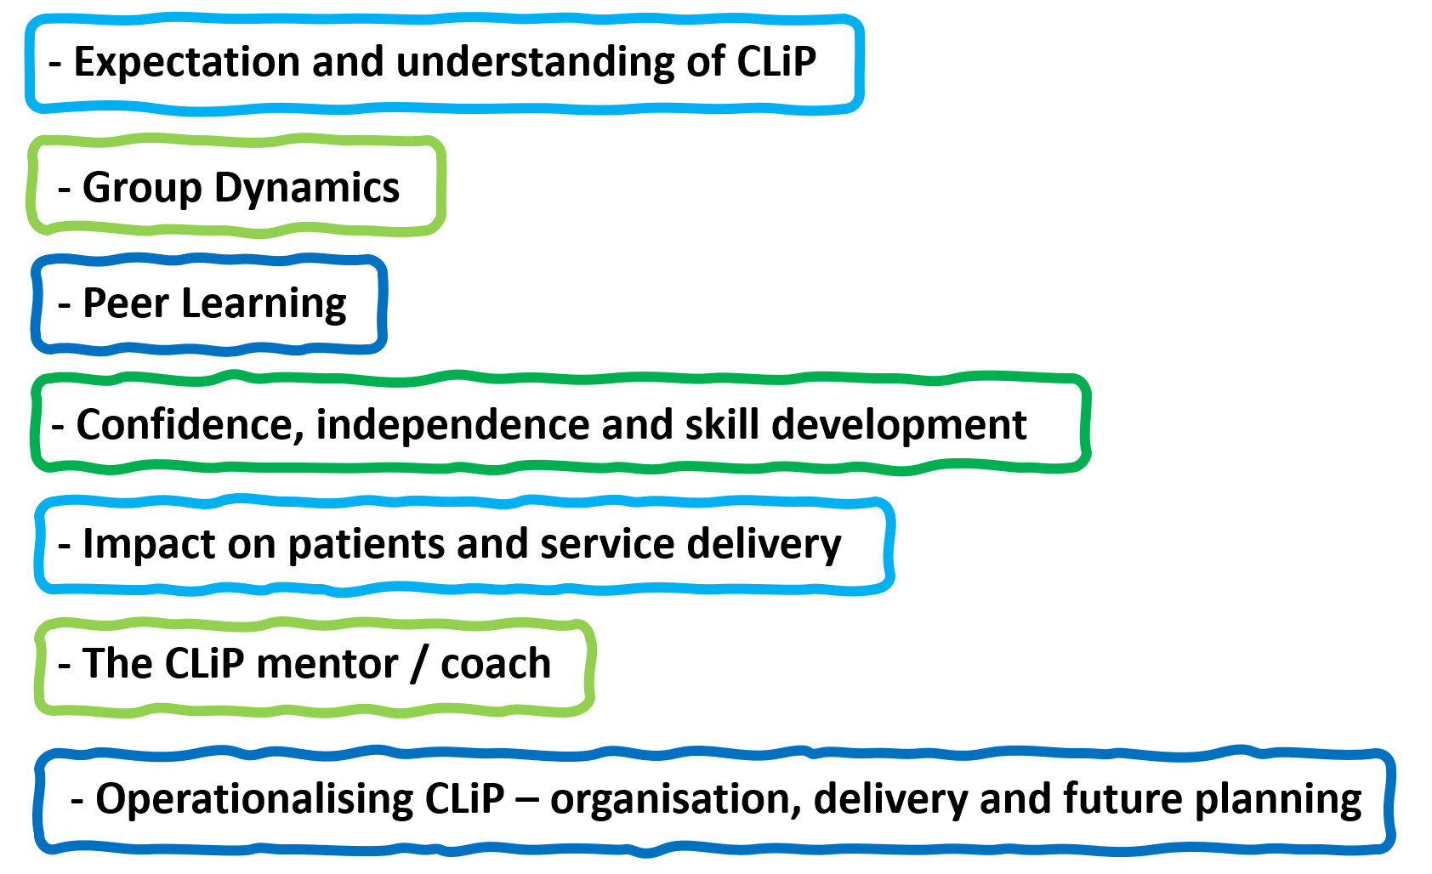
Stakeholder experience

Slide 10
“with CLiP, they did it as a group and so they had that support from each other. To maybe be a little bit bolder about it, or maybe take a little bit more of it on, or maybe think a little bit more outside the box”
“even if I had some expectation, it was much better than I expected”
“we were close, it would help when we worked together. That we had that support for each other, or like, you know, that safe space we had created , it really helped in our work.”
“I do think if it was a different team, it might have been a different story. I think we got lucky”
“Overall, we had the time to spend with these patients”
“We didn't have as much one-on-one time with our educator as any other student would have, because. They are full-time, one-on-one with their educator.”
“I think what CLIP is supposed to be is, like, all levels of knowledge, and we're just, you know, sharing and helping each other.”
“I'll put it up there with one of my most fun placements.”
“They were given time as a group, which, again, I wouldn't have done
you know, with a one-to-one with one student. So that’s something that CLiP allowed .”
“I observed others, learned from them, and then I myself, of course, tried and learned”
“with CLIP it meant that they could really work together on patient visits and patient and get confident without an educator- to be the ones going and doing the program or running the bit of the exercise class.”
“there's only been positive conversations, you know, it's gone right up to kind of directorate level, and they've been really excited by the idea and the impact it's had on the service ”

Slide 11
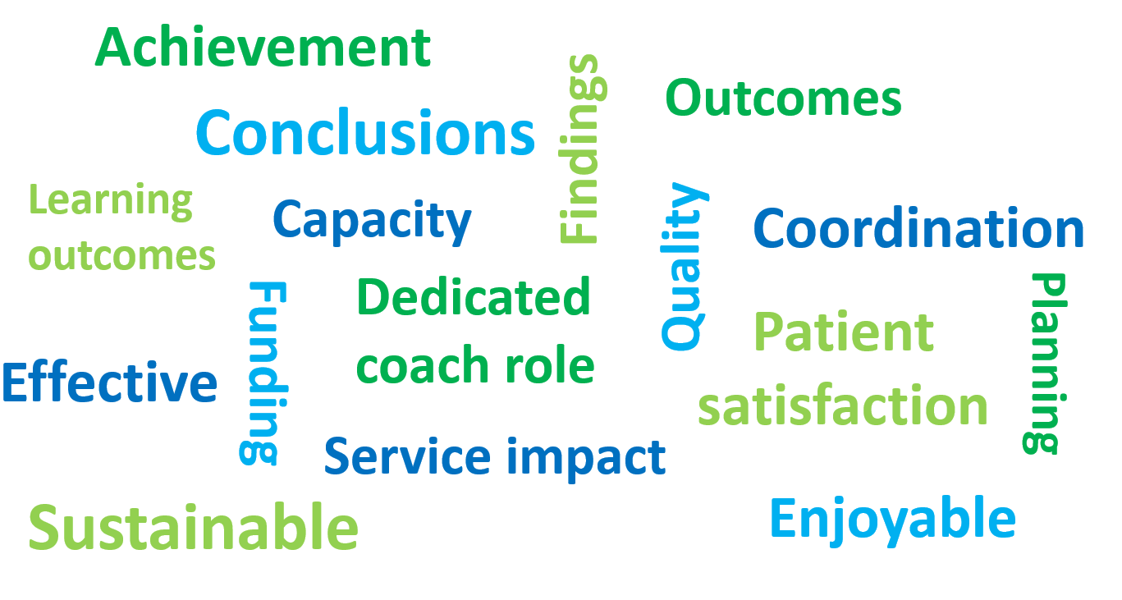

Slide 12

- Expectation and understanding of CLiP
- Group Dynamics
- Peer Learning
- Confidence, independence and skill development
- Impact on patients and service delivery
- The CLiP mentor / coach
Operationalising CLiP – organisation, delivery and future planning
- Operationalising CLiP – organisation, delivery and future planning
Notes:
Invitations to participate in online stakeholder discussions were sent to twelve identified stakeholders including all students (n-5 ), the CLiP mentor / coach (1), service lead / placement co-ordinator (1) and identified clinicians and staff working within the services (5) where the CLiP was based .
Individual discussions were conducted online between check and insert dates.
methods :)
Feedback discussions were undertaken with 7 key stakeholders (4 students, 1 CLiP mentor / coach, 1 clinician and 1 service lead / placement co-ordinator). Written feedback was also provided by one clinician as an alternative to an online discussion.

Slide 13
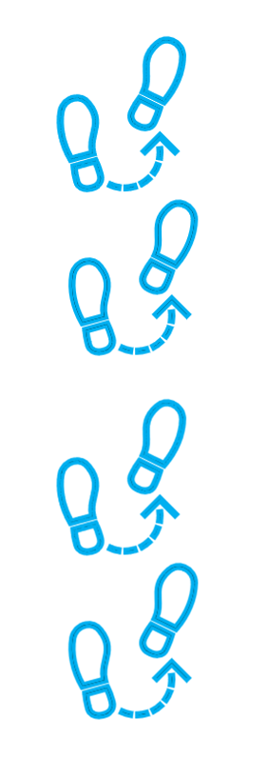
Next steps

Slide 14
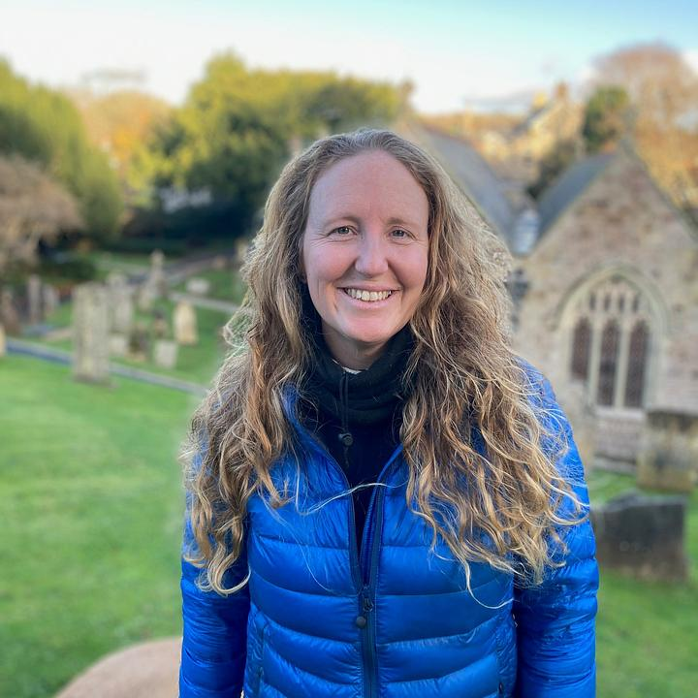
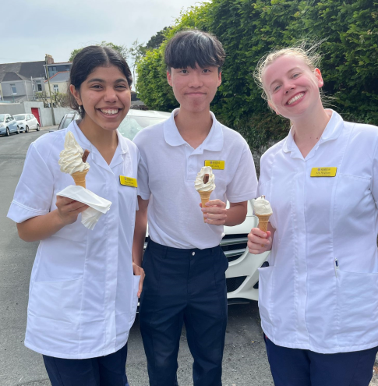

Special thanks
Jess Hughes – Physiotherapy Service Lead and Placement coordinator
Livewell CHLT & CNRT
Amy Souster Physiotherapy Lecturer
University of Plymouth
Funding for the CLiP Project

