Slide 1
Clinical Educator National Development Programme
Service Evaluation
Gabriella Cork
Clinical Education Associate, NHS Elect
Lecturer in Physiotherapy, University of Liverpool
Notes:
Cover Slide V3 Slide Master: Text only cover page for presentations that are difficult to illustrate.
Reduce type size as necessary for long presentation titles (copy does not auto fit).
Background colours can be changed on the Slide Master pages (View > Master > Slide Master).

Slide 2


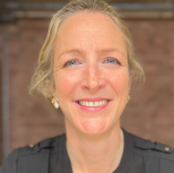
Co-authors
Lydia Lofton
Associate Director, NHS Elect
Julie Combes
Director, NHS Elect
Dr Libby Thomas
Clinical Education Associate, NHS Elect
Reader in Clinical Medicine, QMUL
Notes:
Presenter Introduction Slide Master – three speakers
Click the small icon in the centre of the photo box to add a photo, the photo will automatically fill the box.
If necessary use the standard Picture Format Tools (eg. Crop, Fit, Fill) in the normal way.
Note you can adjust the depth of the photo if necessary.

Slide 3
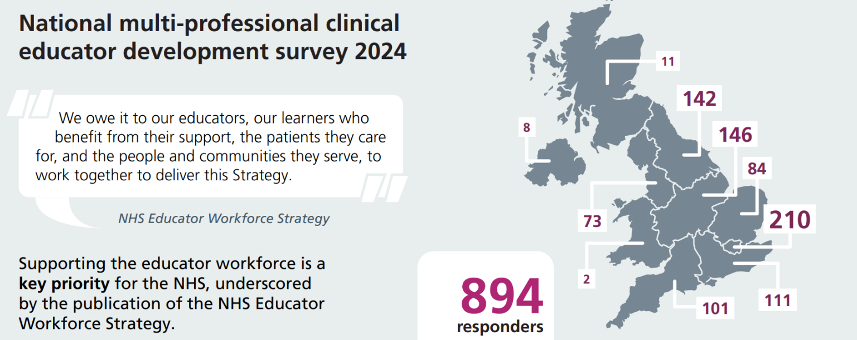










Background
6-month programme
Multi-professional clinical educators
8* x 3-hour online, synchronous sessions
Led by clinical education specialists
Self-directed learning pre- & post- session
Digital interface (Padlet) for additional resources
Practical application & peer learning
Content includes educational design and delivery, inclusive learning environments, leadership, and communication
Educator Workforce Strategy, NHS England, 2023 NHS England » Educator Workforce Strategy
Notes:
The Clinical Educator National Development Programme (CENDP) was developed by NHS Elect in response to findings from a national needs analysis survey for clinical educators. Supporting the educator workforce is a priority for the NHS, underscored by the Educator Workforce Strategy, but opportunities for training and development of educators remain limited.
4 sessions for those on an abridged programme with less experience as educators.

Slide 4
Aim & Design
To evaluate perceived benefits, strengths, weaknesses, effectiveness and impact of participation in the Clinical Educator National Development Programme.
Service evaluation using mixed methods approach.
Registered with Imperial College Healthcare NHS Trust audit committee.
CEND programme
October 2024 – April 2025
Online Survey
Immediately post-completion
Online interview
2-3 months after programme completion
Deductive, thematic review approach
Framed using Kirkpatrick levels of training evaluation (Kirkpatrick, 1994)
Kirkpatrick, DL. (1994). Evaluating training programs: the four levels. San Francisco: Emeryville, CA: Berrett-Koehler; Publishers Group West
Notes:
2 cohorts – one Oct - March, one in Nov- April.

Slide 5



Results
31 survey responses
Response rate 67% (31/46)
4 interviewees
Operating Department Practitioner
Physiotherapist
Dietitian
Doctor
Notes:
Top 3 when asked to rank importance of content: interpersonal communication skills, designing inclusive learning environments and leadership.

Slide 6

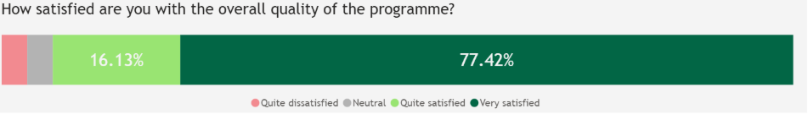
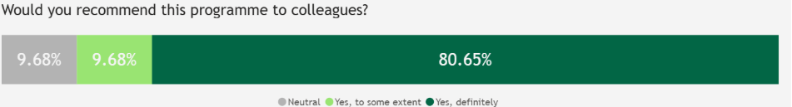
Kirkpatrick level 1 - reaction
94% quite or very satisfied & 90% would recommend to colleague
Online format valued; flexibility noted but some screen fatigue
Enjoyed collaborative, reflective & pragmatic approach
Praised facilitation, safety & engagement
Content depth may not be appropriate for all
"provides a good grounding and a supportive learning environment to help settle people moving into nurse education roles for the first time."
"Faculty built a psychologically safe learning community."
"invaluable to meet and work with such a wide range of people from diverse professional backgrounds and education roles. "
Notes:
Screen fatigue had already been identified and addressed during programme.

Slide 7
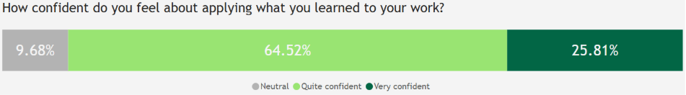
Kirkpatrick level 2 - learning
Key models: ADDIE, Universal Design for Learning, GROW, Systems Thinking
Digital tools learned: Padlet, Slido, Mural, Canva
Focus on inclusivity, digital literacy
Importance of leadership, project management and communication skills content
"the influencing, the systems learning, the systems partnership, certainly the communication styles were definitely really helpful"
"it has given me more confidence to use digital technology"
"I am ensuring [clinical education] content is considered via use of a model such as ADDIE."
Notes:
Some respondents felt they were too inexperienced to benefit, others that had previously undertaken Level 7 study felt it was too basic (but other appreciated the time to reflect).

Slide 8
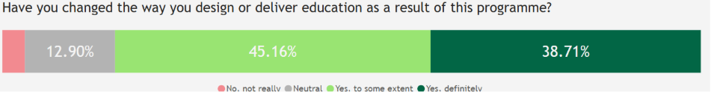
Kirkpatrick level 3 - behaviour
Improved confidence and reflective practice
Structured educational design applied to own practice
Inclusion strategies implemented
Some digital limitations noted (NHS IT constraints)
Began to identify as change agent in organisation
More likely to identify other professions as stakeholders
"The programme has changed some of the ways that I think. And has given me so much to reflect on professionally and personally." "I am no longer closed off to technology and do not fear trying"
"I have had some interesting and thought-provoking discussions with my learners around discrimination and barriers to learning."
"taking the accessibility considerations of individuals and reasonable adjustments into every meeting that I am now part of"

Slide 9
Kirkpatrick level 4 - results
Changes to educational design and delivery in organisations
Initiated training needs analysis
Promoted multidisciplinary education
Some limitations due to low organisational reach
"We want nurses on the wards and in out patients to be able to deliver it [spirometry] to a certain standard... so I've had a meeting with the different stakeholders...involving the different practice educators....doing a learning needs gap analysis".
"There's not much cross specialty education in medicine – nurses don't train with doctors or vice versa. But...delivering sessions which are multidisciplinary, it's so much richer."
"It makes me a bit frustrated that ...we've got a whole education.
department that if I'm honest, AHPs are a bit outside... the whole thing makes me think are we
[the organisation] working like this? And I'm not sure we are."

Slide 10
Conclusion
Programme aligns with NHS England Educator Workforce Strategy, specifically delivery of “Priority 7: Embedding evolving and innovative models of education”
Demonstrates effectiveness at all Kirkpatrick levels
Programme was valued and recommended by participants for its relevance and pragmatism
Provides a unique offering that many participants felt was missing from prior development experiences as a clinical educator

Slide 11

Next Steps
Improve clarity about potential participants for whom programme is best suited
Promote team enrolment for broader impact
Develop follow-on and wraparound offer
Launch network for programme alumni
Research project exploring impact in more depth
In Progress
Ethical approval granted
Data collection commenced

Slide 12
Notes:
Any questions Slide Master

Slide 13





 | National NHS organisation
 | 90 members
 | Training, consultancy and coaching
 | Over 120 free webinars, online courses, networks and resources
 | Check out our website www.nhselect.nhs.uk
Notes:
About NHS Elect: Use this slide towards the beginning of your deck. Content to be reviewed.

Slide 14
Gabriella.cork@elect.nhs.uk
Notes:
Thank you Slide Master
Add your email address and contact details here

