Slide 1
Innovating Interprofessional Education: A student Led Approach to Collaborative Practice
Hannah Seagraves
Becky Fillery
Elaine Macaninch

Slide 2

Interprofessional Education (IPE)
Why IPE?
How?
Interprofessional education (IPE) is essential for developing a collaborative, practice-ready health workforce
Suspected gap and opportunity in Allied Health Professional Services within UHSussex
Recent CAIPE IPE standards released
Student Leadership Placements
Project supported by AHP Education Team
Being student led meant key stakeholders were involved throughout

Slide 3

IPE Project Part 1
Two Physiotherapy students:
IPE literature review
Identified stakeholders
Interviewed staff whose role related to IPE
Survey conducted
Thematic analysis
Recommendations
Notes:
With team for 6 weeks

Slide 4
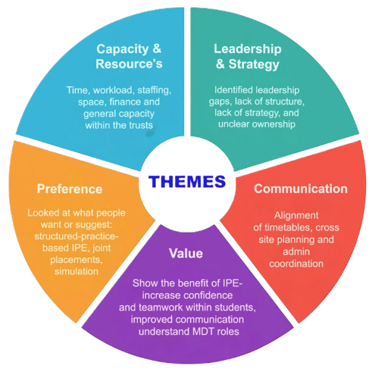

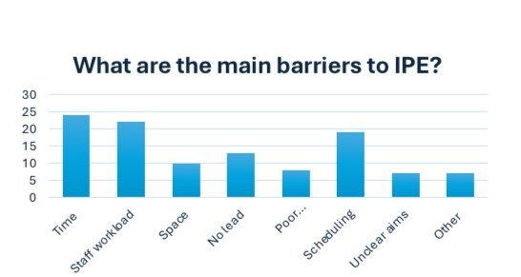
Themes
Out of 400 invited participants, 30 responded (7.5% response rate)
UHSussex Nursing & AHP PEF’s, Sussex PEFs, AHPs, lecturers of surrounding HEIs
Short response time- less that 2 weeks
Notes:
71% from University hospital Sussex: most data is coming from the trust we are in meaning we can get a deeper understanding on what is currently going on and what is and is not working.​
16% of the data is coming from surrounding trusts so we can see what IPE is taking place for a students and staff in other trusts and weather any of this can work fort his trust. ​
10% of the data is coming from universities such as Brighton and Southampton so we can see what the universities are putting in place for the students and wether we need to get more input from the uni’s so IPE is presented to students more.

Slide 5
'Needs to be designed collaboratively from the beginning.'
'Dedicated internal leadership on IPE, setting up IPE, increased communication'
'Case-based MDT sessions improve problem solving and teamwork'
'IPE depends on whether student groups overlap'
'People don’t really understand what IPE is or what the aims are'
'We need training on how to set up and deliver IPE.'
'Different professions have specific needs or learning needs that are different to other professions.'
'Poor communication; Scheduling; No lead'

Slide 6

Recommendations
Survey students and AHPs​ for further scoping
IPE Awareness campaigns
IPE Implementation​
Dates when student placements cross over
Hybrid module​- alternating between online and face to face
Simulations of MDT, case study discussions
Games- escape rooms
Set learning objectives and evaluation so it can be measured

Slide 7
IPE Project Part 2

Slide 8
IPE SIM- 3 OT students
How?
Aim
Literature review focused on SIM
Interviewed SIM lead within UHSussex
Reviewed SIM opportunities for students and AHP staff within UHSussex
Survey to students, local HEI lecturers, educators
Results analysis
Recommendations
Focus on simulation training (SIM)
To explore the awareness, current use, perceived benefits, and barriers of IPE delivered through SIM training for pre-reg AHP students across UHSussex.
Project also considered AHP specific SIM opportunities for staff
Notes:
Understand current use​
Explore benefits and barriers​
Compare perspectives​
Inform recommendations​
Why We Used Surveys: ​
​
Evidence-informed, needs-led approach​
Multiple perspectives​
Identify key gaps​
Baseline for design​

Slide 9
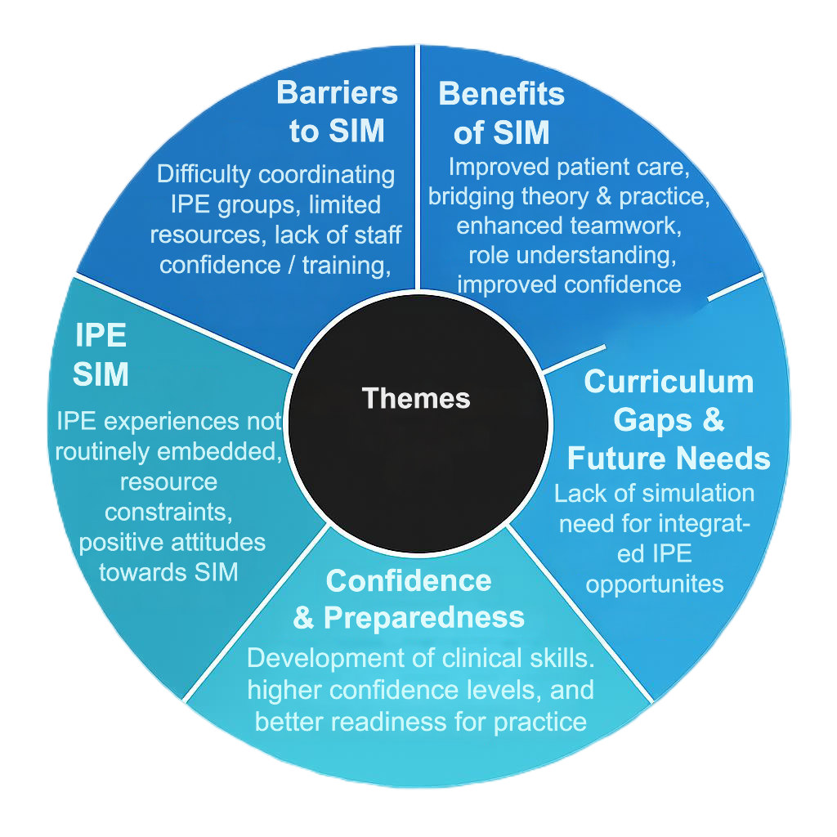
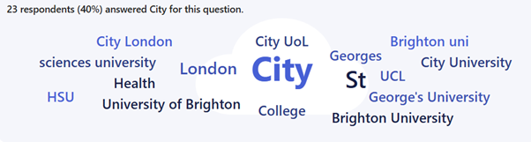
Student survey – 58 responses across 7 Universities.
Tutors – 10 responses across 5 Universities
Clinicians – 15 responses from UHSussex AHP clinicians
Themes
Notes:
Recognised mire SIM in academia is required by barriers impact on provision.
71% from University hospital Sussex: most data is coming from the trust we are in meaning we can get a deeper understanding on what is currently going on and what is and is not working.​
16% of the data is coming from surrounding trusts so we can see what IPE is taking place for a students and staff in other trusts and weather any of this can work fort his trust. ​
10% of the data is coming from universities such as Brighton and Southampton so we can see what the universities are putting in place for the students and wether we need to get more input from the uni’s so IPE is presented to students more.

Slide 10
"Practice real-life situations in a controlled, less anxiety-inducing environment"
"Preparation for professional career"
"Safe practice space"
"Opportunity to see how others work"
"Exposure to new clinical environment before going to placement can be scary"
"Applying taught skills to real life clinical scenarios"
"Developing an awareness of how patients may respond to interventions and getting feedback"
"It's the ideal place to make mistakes and reflect on how you can do better"
"Gaining experience of dealing with different situations"

Slide 11
Examples of SIM Sessions
Session 2 – Best Interests
Focus:
Mental Capacity Act principles
Best interests decision-making
Balancing risk, autonomy, and safety
Professional disagreement
Scenario ideas:
Patient lacks capacity re: nutrition, discharge, or rehab
Family present with strong views
Conflicting professional recommendations
Key skills:
Ethical reasoning
Justifying recommendations
Respectful challenge
Purpose
How do MDTs make hard decisions?
Session 1 – Introductory MDT Meeting
Focus:
Roles & Responsibilities
Speaking up in MDTs
Shared goal setting
Key Skills:
Interprofessional Communication
Role awareness and respect
Collaborative decision-making
Professional confidence and participation
Teamwork and group dynamics
Person centered focus
Purpose:
What is an MDT and how do I contribute?
Notes:
Some based on educator feedback, could also be used for educators as well as students.
Others based on experience and discussions

Slide 12
SIM Session Planning
2 Hour session
10 minute welcome and pre‑brief
15 minute introduction to MDT working and roles
30 minute simulation: MDT meeting (first half)
10 minute break
20 minute facilitated debrief
10 minute key learning points and evaluation
5 minute feedback from attendees
20 Minute simulation (second half)
ASPiH, 2021
HCPC, 2023
HEE, 2021
Issenberg et al., 2005
Rudolph et al., 2006
Notes:
The structure of this two-hour simulation session is informed by national standards and regulatory guidance for interprofessional education.
A 10-minute pre-brief ensures orientation and psychological safety, consistent with ASPiH Standards for Simulation-Based Practice, which emphasise planning, learner preparation, and clear objectives to optimise engagement and learning outcomes.
The next bit will be a 15-minute introduction to MDT roles which aligns with HCPC expectations that learners develop interprofessional collaboration skills and understand the responsibilities of other professions.
W would split the simulation into two segments with a 10-minute break in between. This allows learners to process experiences and maintain attention.
A 20-minute facilitated debrief consolidates learning through reflection, supporting clinical reasoning, teamwork, and professional judgment.
We then have 10 minutes at the end for concluding with key learning points and evaluation.
Lastly we have 5 minutes for attendee feedback which ensures consolidation of knowledge and supports continuous quality improvement, aligning with HCPC Standards of Proficiency for Occupational Therapists and NHS/Health Education England guidance on simulation-based learning.
Overall, this layout follows a structured, evidence-informed approach to interprofessional simulation that maximises learning, reflection, and professional development.

Slide 13
Recommendations
Short-Term Plan
Pilot of IPE SIM focusing on learning needs of AHPs
Collaborative multiprofessional design input
Structured Evaluation
Use findings from pilot activity to refine session design and inform broader implementation.
Long-Term Plan
Embed interprofessional simulation as a core, required component of the AHP placement module.
To consider where practice based IPE fits within the student journey
Explore cross organisation IPE opportunities.
Notes:
Explore IPE for cross organisations- at uni and on placement

Slide 14
Conclusion
Service development can be led and progressed via student placements
Building capacity - Students are the perfect driver
Logistical challenges
Lack of IPE leadership within AHP services
Limited IPE opportunities however stakeholder interest
Evidence base to progress project further within UHSussex
PEF learning and development
Translate existing models into AHP
Collaborating with organisations and HEIs to explore IPE
Notes:
No PEF capacity for project work on this scale
Logistical challenges- lack of leadership, scheduling, topics
Building capacity- students do the work

Slide 15
Any questions or thoughts?
Contact us: UHSussex.ahpstudents@nhs.net

