Slide 1
Advanced Practice Supervision
Developing supervisor capability through an eLearning programme
Presented by:
Heather Nisbet, Head of AHP Education, NHSE WTE SE Region
Karen Swift, Advancing Practice Supervision & Assessment Lead, NHSE WTE SE Region
Notes:
Standard title slide

Slide 2
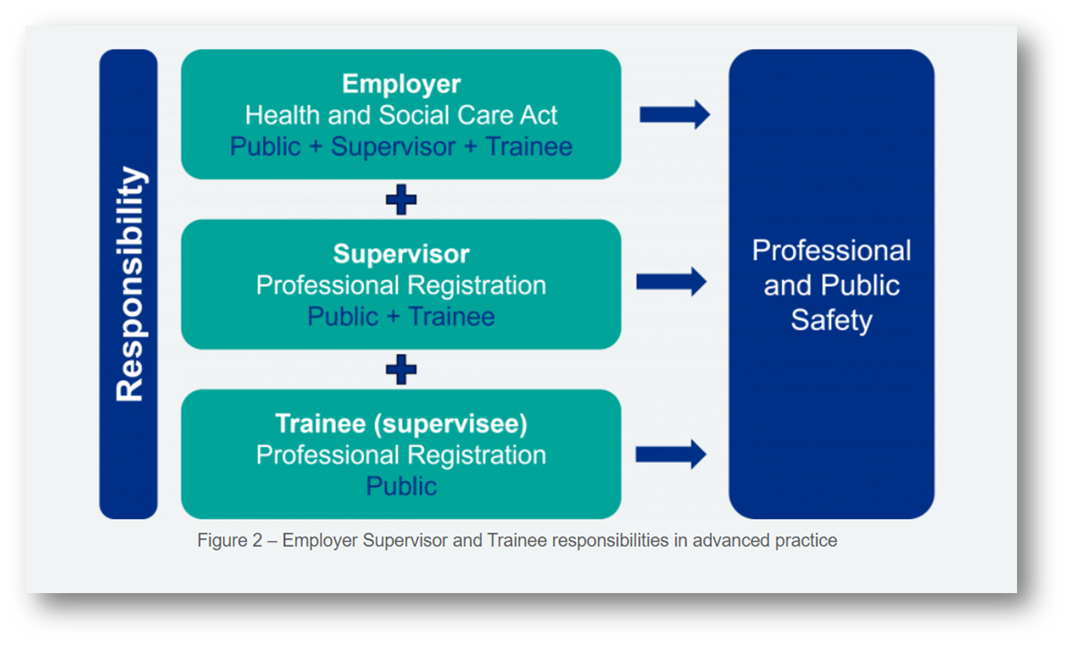
Responsibilities in advanced practice supervision
Employers should be able to evidence:
investment in supervisor development across all levels of practice;
continuing professional development of those with supervisory responsibility, for example, through review and inclusion of supervisor learning and development needs in appraisal objectives.
Supervision is key for the maintenance of professional and public safety

Slide 3

Minimum Standards for Supervision
Supervisors should:
have completed some formal supervisor development.
Examples of formal training include:
Clinical educator programmes;
PgCert in clinical education;
practice educator programmes;
local supervisor training courses.

Slide 4

Selecting a supervisor learning and development opportunity
What training has already been undertaken?
Does the training follow a multi-professional approach?
Is the training quality assured:
  aligns with the Workplace supervision for advanced practice 2025 guidance
  maps to the Advanced Practice Supervisor Capabilities, Guiding Principles for Supervisor Learning and Development

Slide 5
Developing an eLearning resource
2022 publication of minimum standards - highlighted lack of specific training for advanced practice supervisors
Jan 2023 – discussion with SE HEI Network partners to gain a consensus for collaboration across all HEI programmes in the region
Jan 2023 – Task and Finish group convened with representation across all HEI programmes in region
July 2023 – start of project proposal development with Technology Enhanced Learning (TEL) team
December 2024 – structure and content of programme agreed, eLearning build starts
Review and development process Jan 25 – June 2025
August 2025 –launch of ADVANCED PRACTICE SUPERVISOR TRAINING

Slide 6
SESSION TITLES
SKILLS SCAN – all must complete as learning needs analysis
MODULE 1 – Mandatory to complete both sessions
1 | Foundations of Advanced Practice Supervision
2 | Understanding the advanced practitioner’s scope of practice
MODULE 2 - Optional sessions depending on skills scan:
3 | Supporting advanced level learning and development in the workplace
4 | Creating a good workplace learning environment for advanced practice
5 | The developing advanced practitioner as an individual
6 | Feedback & facilitation for advanced practice
7 | Enabling critical reflection for advanced practice
8 | Coaching skills for advanced practice
9 | Assessment for advanced practice
10 | CPD

Slide 7


Slide 8


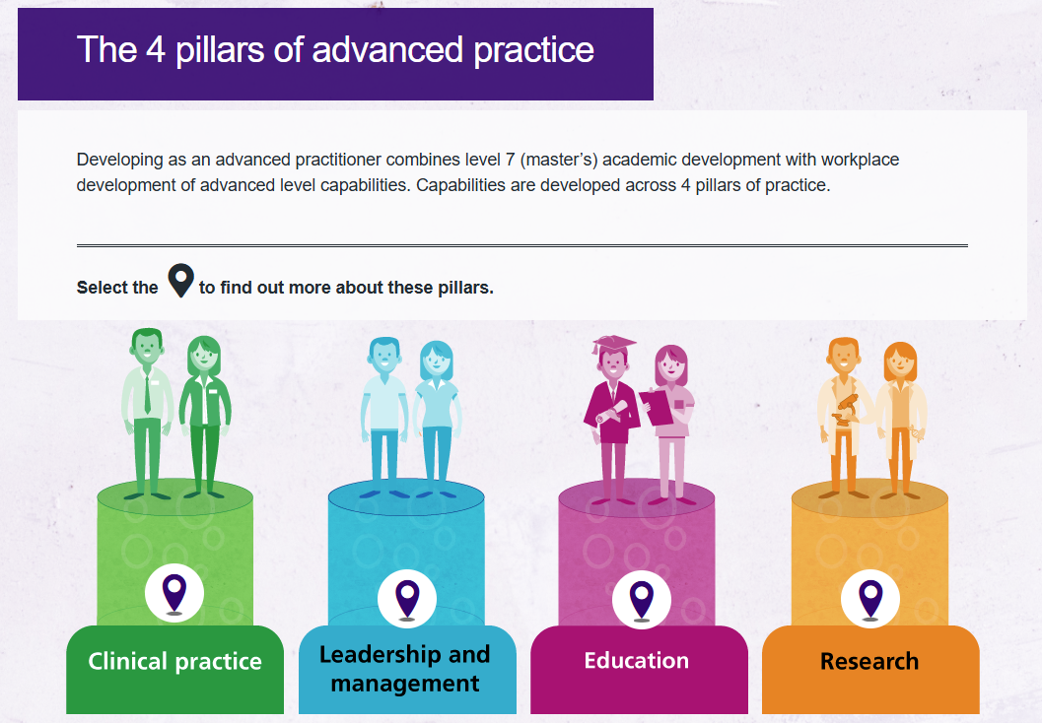

Slide 9
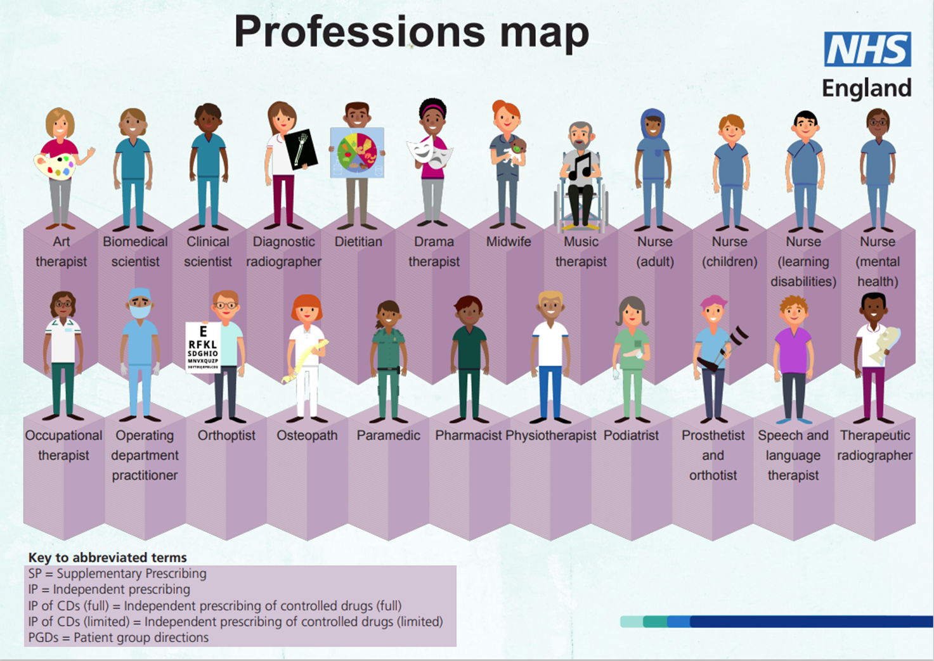

Slide 10

Evaluation
Focus group piloting eLearning
Post training evaluation built into eLearning package
eLearning metrics

Slide 11
Over 95% of respondents agreed or strongly agreed that the material was appropriately challenging, the learning objectives were relevant, and they were well engaged during the programme.
The Learning Hub, evaluation survey responses
January 2026

Slide 12
‘Knowing my supervisor has completed this reassures me they are committed to my training’
‘This is very much needed, as I soon realised supervising APs is very different to junior medical colleagues’
‘We will be recommending all our APs complete this whether they are ready to supervise or not to start building the skills needed’

Slide 13

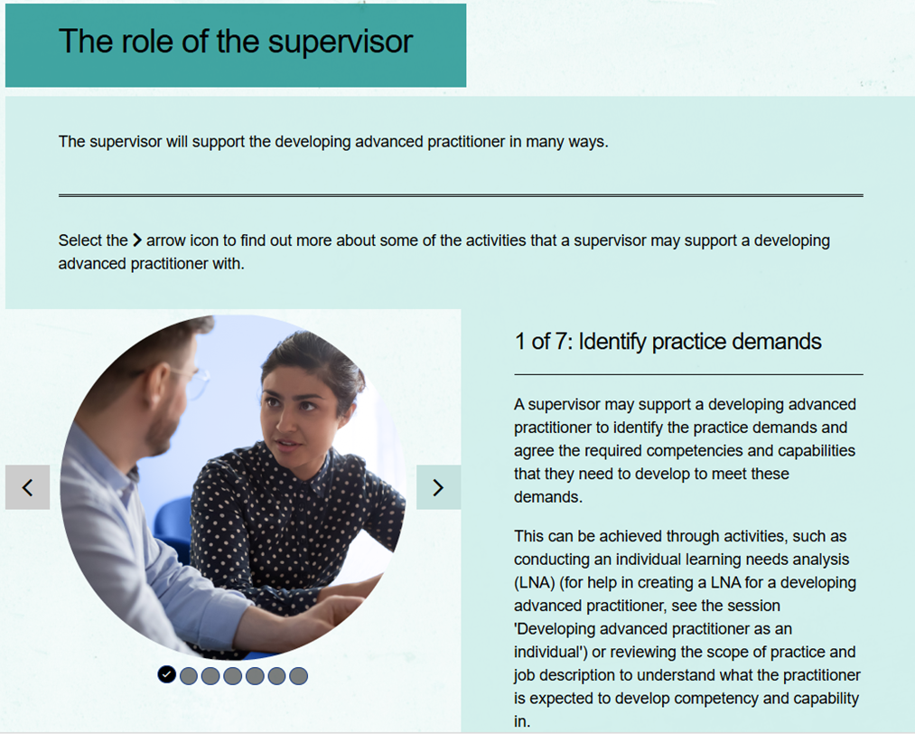
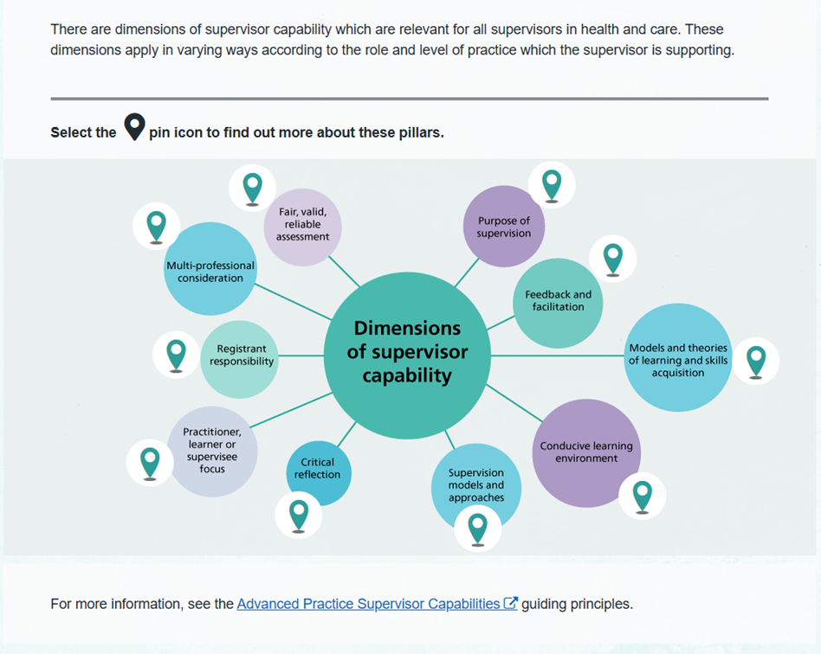
Next Steps and Future plans
Lesson plans to facilitate face to face masterclasses
Integration into AP programmes as part of education pillar
Impact and evaluation
Publications and conference proceedings
Apply for CPD accreditation with professional bodies

Slide 14
Acknowledgements
LEAD AUTHORS
Heather Nisbet, DCR(T), MSc Higher Professional Education, PgCert NMP, Head of AHP Education, NHS England SE Region
Karen Swift, Supervision and Assessment Lead, NHSE South East Region Advanced Practice Faculty
TASK AND FINISH GROUP
Professor Deborah Harding, Centre for Advancing Practice NHS England; Professor of Learning and Innovation for Practice, City St George's, University of London
Daren Briscoe RN, MSc, SFHEA, School of Education, Sport and Health Sciences, University of Brighton
Dr Francine O'Malley, University of Southampton
Dr Hilary Walsgrove, Health Sciences University, Bournemouth
Professor Els Freshwater BA(Hons), PGCert, DClinP, DIMC (RCSEd), DMIM (RCSEd), MAcadMEd, FHEA, FCPara, Scottish Ambulance Service, Buckinghamshire New University
Helen Orton, MSc Health Care Ethics; PG Diploma on Learning and Teaching in Higher Education, The Open University
Inmaculada Diaz Alonso, Canterbury Christchurch University/ Medway Practices Alliance (MPA)
Mark Stobbart, University of Surrey
Ollie Phipps, Professional Lead for Advanced Practice and Independent Prescribing at Canterbury Christ Church University.
Sophie Gay BSc (Hons), MRes, Practitioner Diploma Executive Coaching, SRP, MCSP, University of Winchester
Vicky Macarthur, Senior Lecturer Advanced Clinical Practice. University of Cumbria.
Rachel Bruce , University of Bedfordshire
CONTENT REVIEWERS
Sarah Goodhew, Faculty Lead, NHSE South East Region Advanced Practice Faculty
Amanda Riley, NHSE South East Region Advanced Practice Faculty
Clare Thomson, NHSE South East Region Advanced Practice Faculty
Donna Rawlings, University Hospital Southampton NHS Foundation Trust | NHS England W,T&E (SE Region)
Hannah Ingram, University of Brighton
Katie Hudson RN, ACP MSc, Wessex Cancer Alliance
Loryn Caulfield, Oxford University Hospitals NHS Foundation Trust
Louise Baker BSc (hons), MSc, HCPC, Hampshire and Isle of Wight Healthcare NHS Foundation Trust
Marie-Clare Wadley, NHS England South East
Matthew Fell, South East Coast Ambulance Service NHS Trust
Mrs Alison Rae, Canterbury Christ Church University
Stuart Pinson, Faculty of Advanced Practice, NHSE S/E
Vivian Zinyemba, NHSE South East Region Advanced Practice Faculty
TECHNOLOGY ENHANCED LEARNING TEAM
Rob Taylor, Senior Project Manager
Runam Prasad, Lead Learning Designer
Alex Cleary, Learning Content Designer
Judith Hurrell, Learning Content Designer
Abigail Lingford, Graphic Designer

