Slide 1

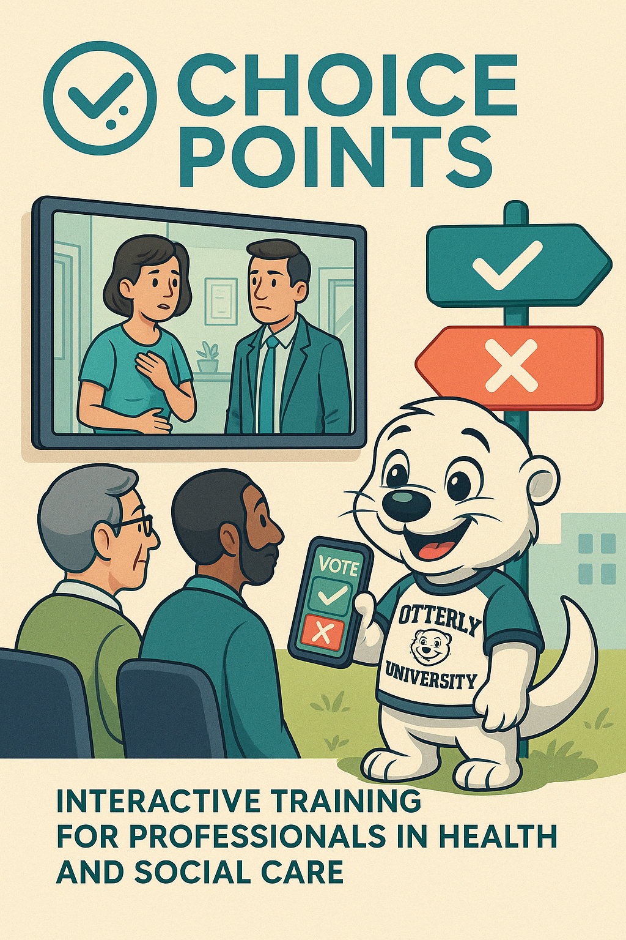




The National Association of Educator in Practice Conference
Live Decision-Making with ChoicePoints:
A Co-Designed Approach to Scenario-Based Learning
James Wilson
Senior Lecturer
University of Chichester
James.Wilson@chi.ac.uk
Disclaimer: AI-created images have been produced for this presentation
Notes:
Primary Logo Colours (Observed): Teal BlueHEX: #008080 (approximate) Name: Teal
FONT: Nunito
Complimentary Colour palette
Name Soft Neutral Background #F4F4F9 Ghost White
Highlight / Secondary #FFC857 Saffron
Soft Contrast / Calm #AED9E0 Powder Teal
Text/Dark Contrast #2E2E2E Charcoal Grey
Accent Shade #F7B2AD Rose Quartz

Slide 2
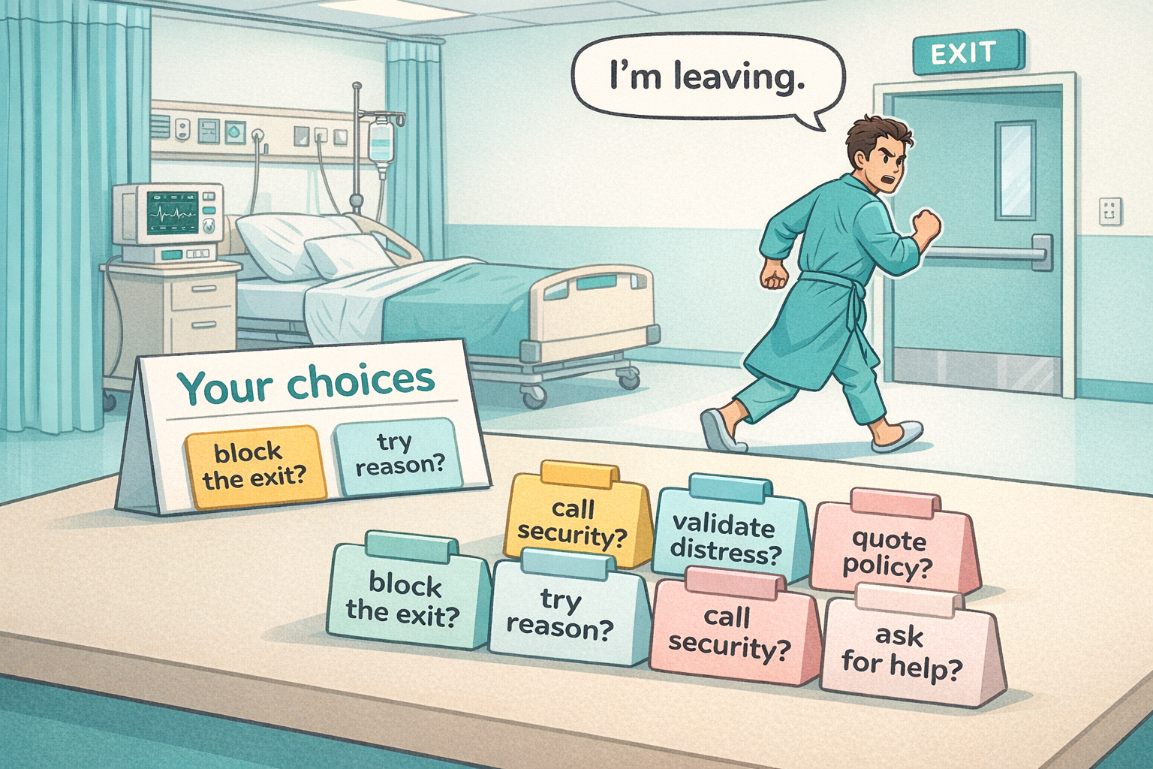
The National Association of Educator in Practice Conference
Decision-Making with ChoicePoints:
Picture the scene…
“It is 08:42. Six bedded bay. One patient attempting to leave. One relative distressed. One healthcare assistant off sick.
STOP
What are you going to do?
Decisions present themselves…
No protocol tells you exactly how to speak the next sentence.
And yet, you decide.
In seconds.
Not once.
But repeatedly.
Hundreds of micro decisions.
Every day.

Slide 3
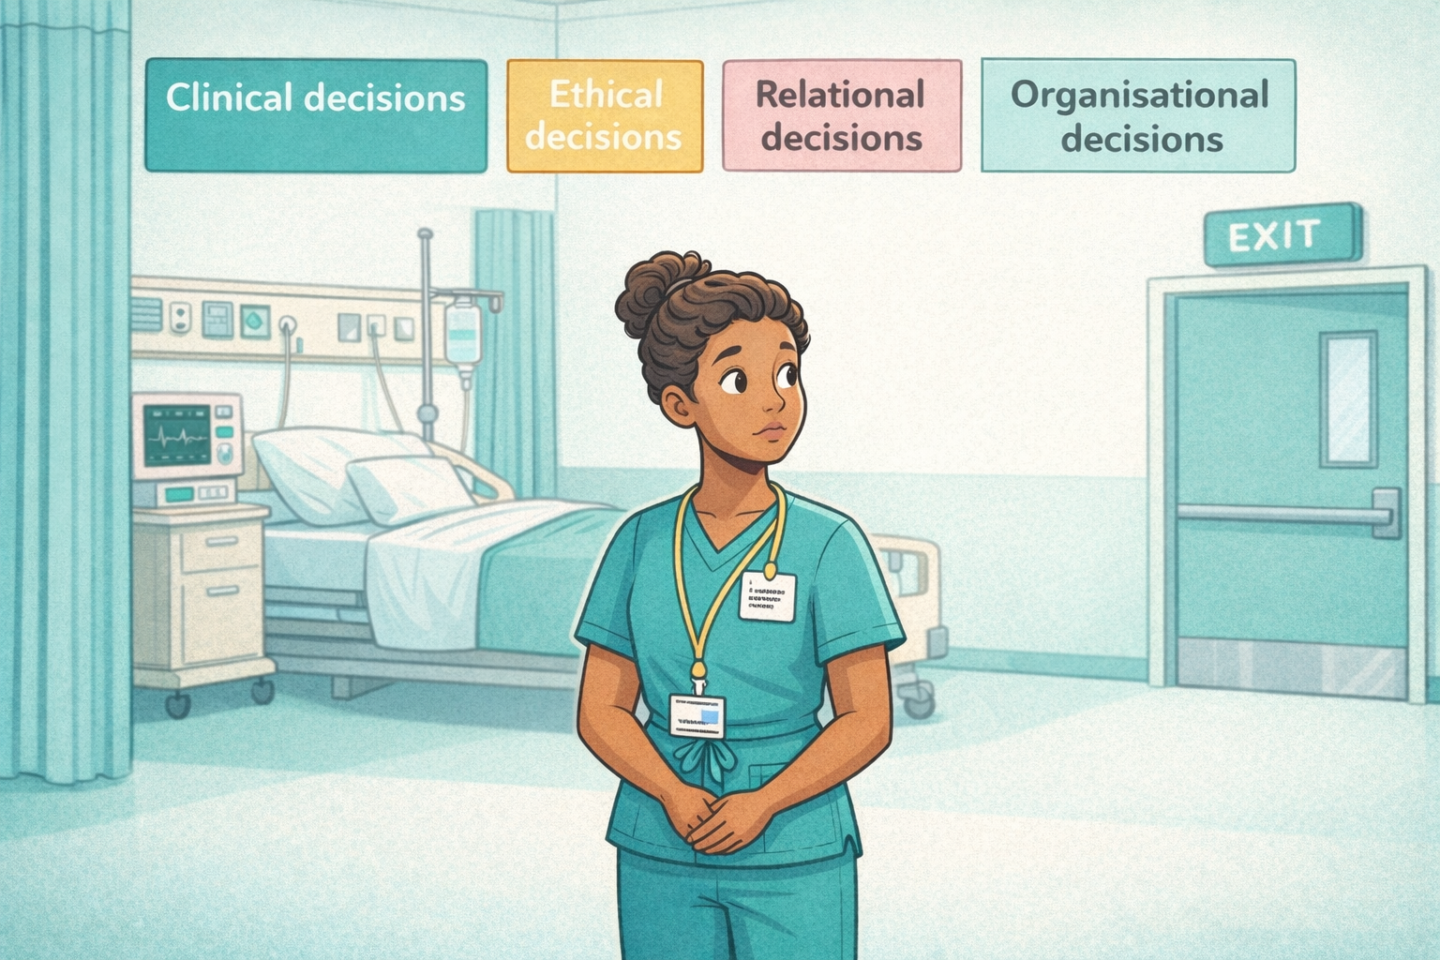
The National Association of Educator in Practice Conference
How Decisions are Made
Make the invisible visible.
We like to imagine decisions are rational, measured & Sequential.
But in practice, they are instantaneous & shaped by multiple factors.
What is happening? Is this risk?
Is this deterioration?
Do I confront?
Contain? Empathise? De escalate?
Decisions
Often simultaneously.
Often under pressure.
Autonomy or protection?
Least restrictive or safest option?
Policy. Documentation. Escalation pathways. Accountability.
Often without full information.
We navigate complexity
Once spoken, once acted, the choice sets consequence in motion.
Cause & Effect
Often irreversible.

Slide 4
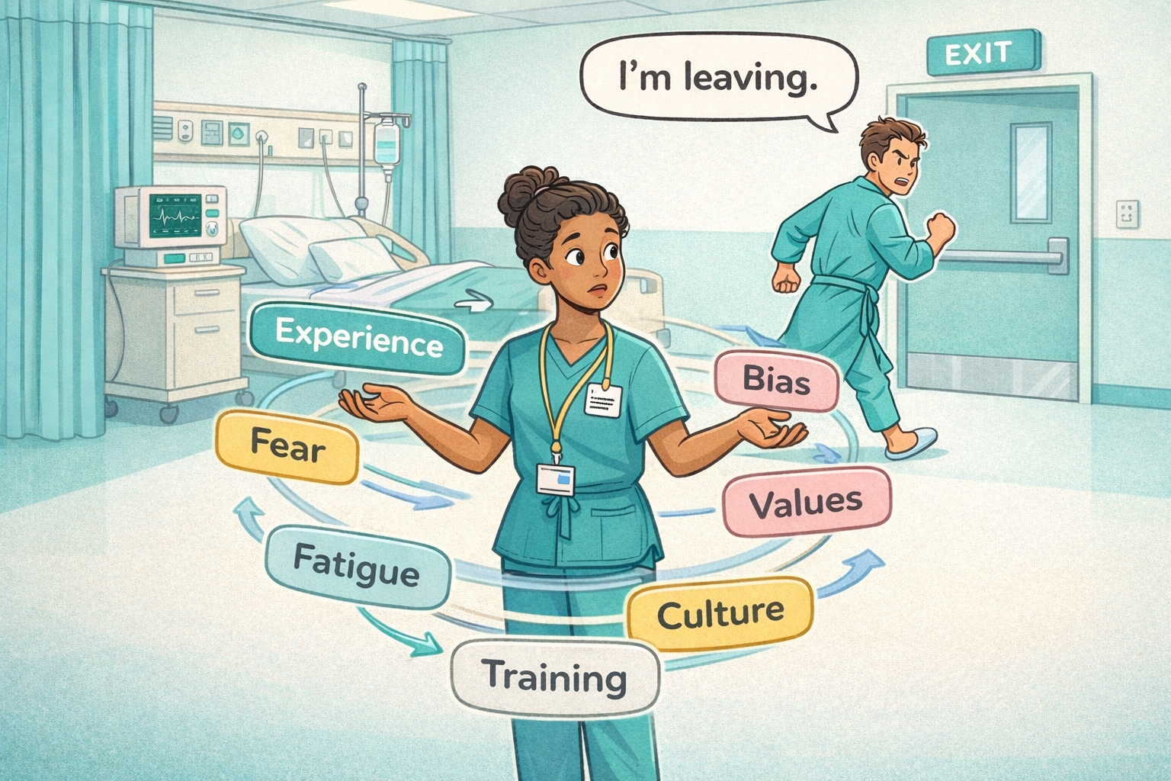
The National Association of Educator in Practice Conference
The Reality of Practice
How Decisions Are Made:
Dual process thinking
Fast/intuitive Slow/analytical
Heuristics and bias
Mental shortcuts "rules of thumb"
Bounded rationality
limitations & incomplete information
Moral reasoning under constraint
Cognitive process of determining right from wrong when choices are restricted by external pressures (laws, rules, authority) or internal limitations (empathy, duty, cognitive capacity)
Under pressure, we do not slow down.
We accelerate.
If we agree that decision making in practice is layered, pressured, and deeply human…
…How do we teach it?

Slide 5
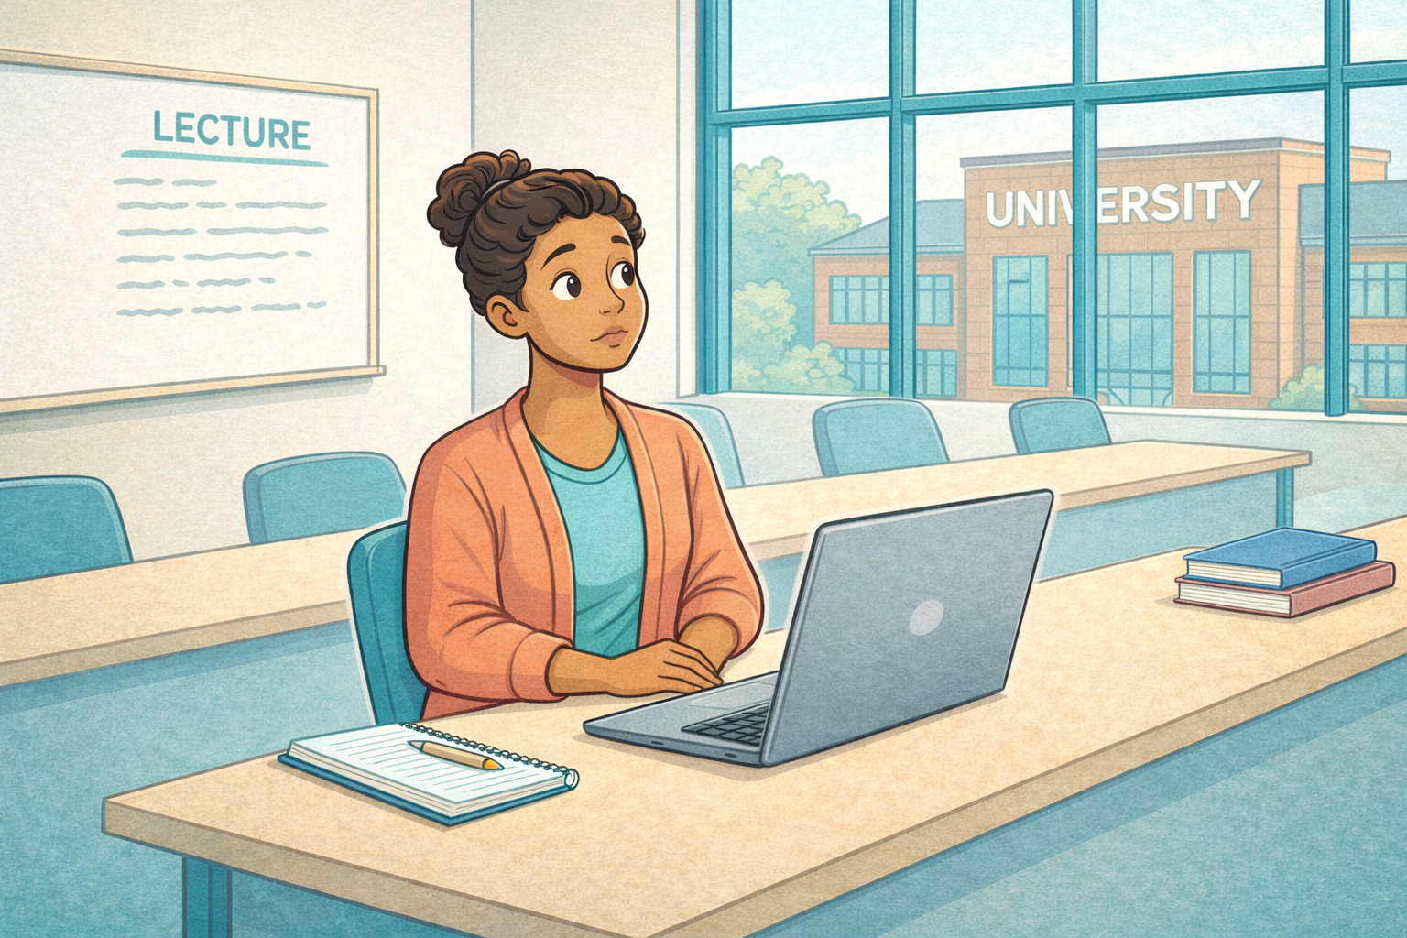
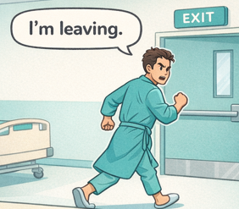
The National Association of Educator in Practice Conference
The Gap in Education
Often we teach:
Knowledge
Protocol
Policy
But not so much:
Live decision pressure
Ambiguity
Competing values
Emotional load
We rarely teach ‘the moment’

Slide 6

The National Association of Educator in Practice Conference
What is ChoicePoints?
ChoicePoints is a structured way of slowing decision making down.
It recreates the moment.
But removes the consequence.
It takes a live dilemma
And pauses it at the point of action.
Then asks: What would you do?
Each ChoicePoints Session
Live or narrated scene
Defined decision point
Collective polling
Visible consequence
Facilitated reflection
It creates the moment
Removes the consequence

Slide 7
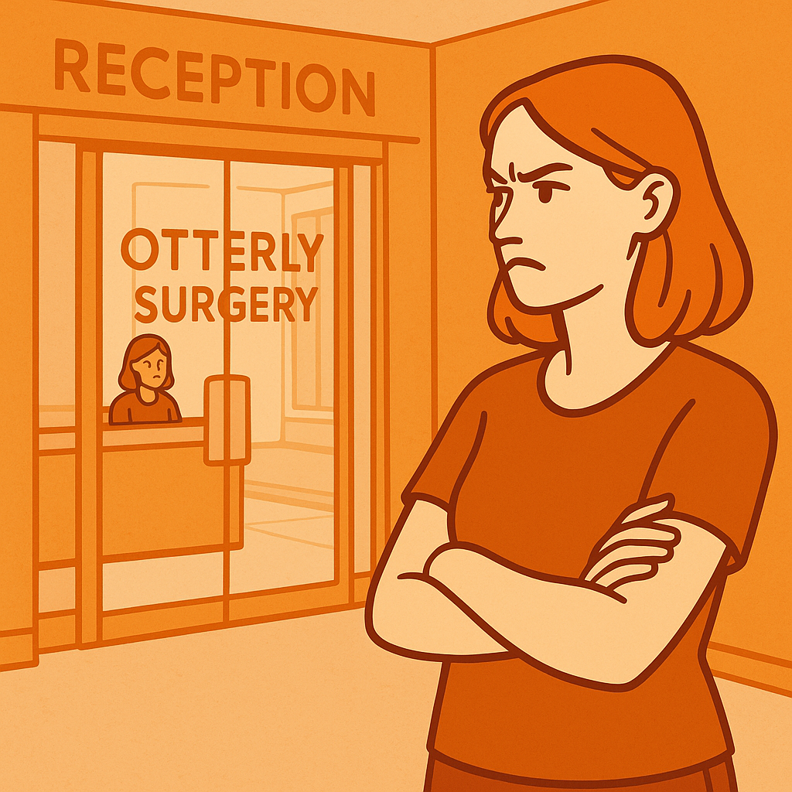


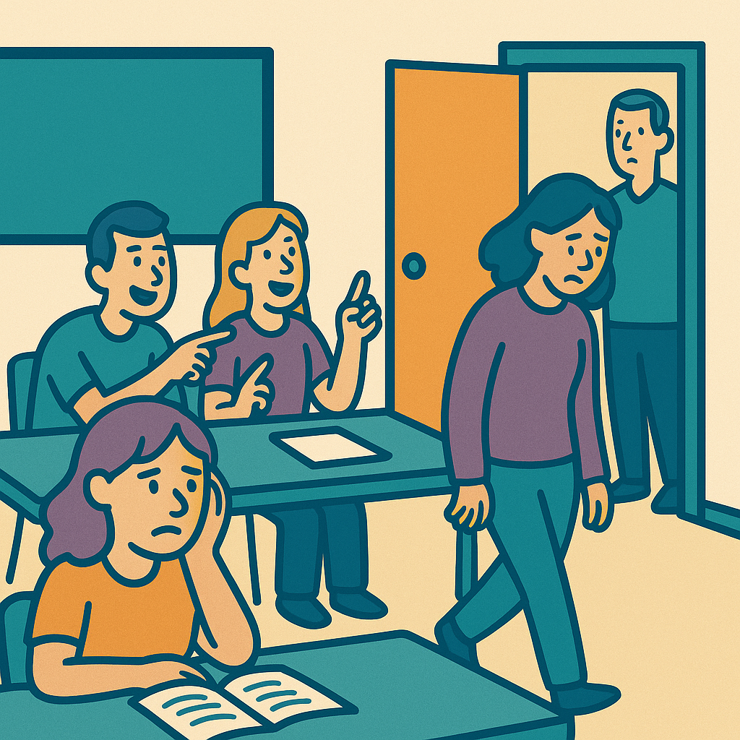
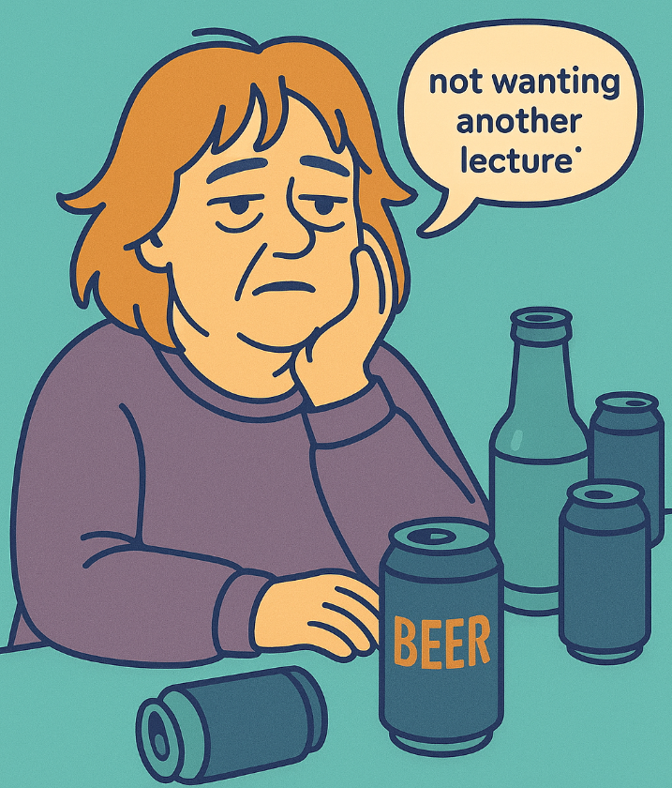
The National Association of Educator in Practice Conference
What Makes It Different?
ChoicePoints LIVE
In person.
Live actors.
Real time audience polling.
Facilitated debrief.
ChoicePoints LIVE ONLINE
Delivered via digital platform.
Live performance streamed.
Interactive polling.
Breakout reflection.
ChoicePoints STORY
Facilitator led narrative case.
Branching decision slides.
Collective voting.
Structured reflection.
ChoicePoints Gambit
Weekly narrative case.
Decision points.
Asynchronous Collective voting.
Structured reflection.

Slide 8
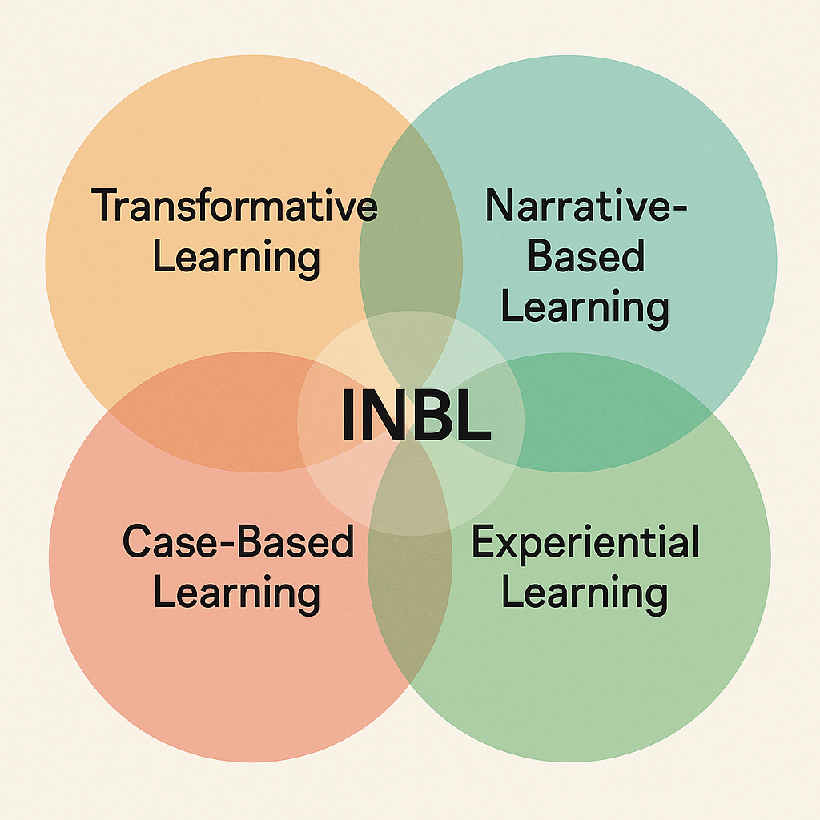
The National Association of Educator in Practice Conference
The Learning Mechanism
We create the dilemma.
Then hold it long enough for thinking to happen
When we inhabit the story, we inhabit the decision.
Dialogue over instruction.
Collective reasoning over individual performance.
The scenario becomes the experience.
The debrief completes the cycle.

Slide 9
The National Association of Educator in Practice Conference
The Learning Mechanism
ChoicePoints is best when Co-Designed:
Brings Lived Experience alive (Case Study)
Moments that felt Difficult / Messy / Uncomfortable
Co design does three things:
Increases authenticity.
It surfaces power dynamics.
The patient voice is central.
The scenario becomes relational rather than performative.
In many simulations, the answer is hidden in the script.
In ChoicePoints, the ambiguity is deliberate.
There is rarely a perfect response.
Trade offs & Consequences.

Slide 10
The National Association of Educator in Practice Conference
Evaluation Evidence
We have evaluated ChoicePoints using both quantitative and qualitative measures.
Perspective Shift
Confidence and Decision Awareness
“I did not realise how quickly I judge.”
“I saw the patient differently.”
“I noticed my own bias.”
Signals transformative reflection.
“Managing ambiguity
“Responding to distressed patients”
“Articulating reasoning”
Awareness of how they decide.
Not just what they decide.
Psychological Safety
Transfer to Practice
“Safe to disagree”
“Safe to explore uncertainty”
“Safe to be wrong”
Decision making being examined honestly.
Slower communication
More deliberate questioning
Increased curiosity before escalation
Slowing decision making down helps learners notice invisible drivers which then triggers self awareness

Slide 11
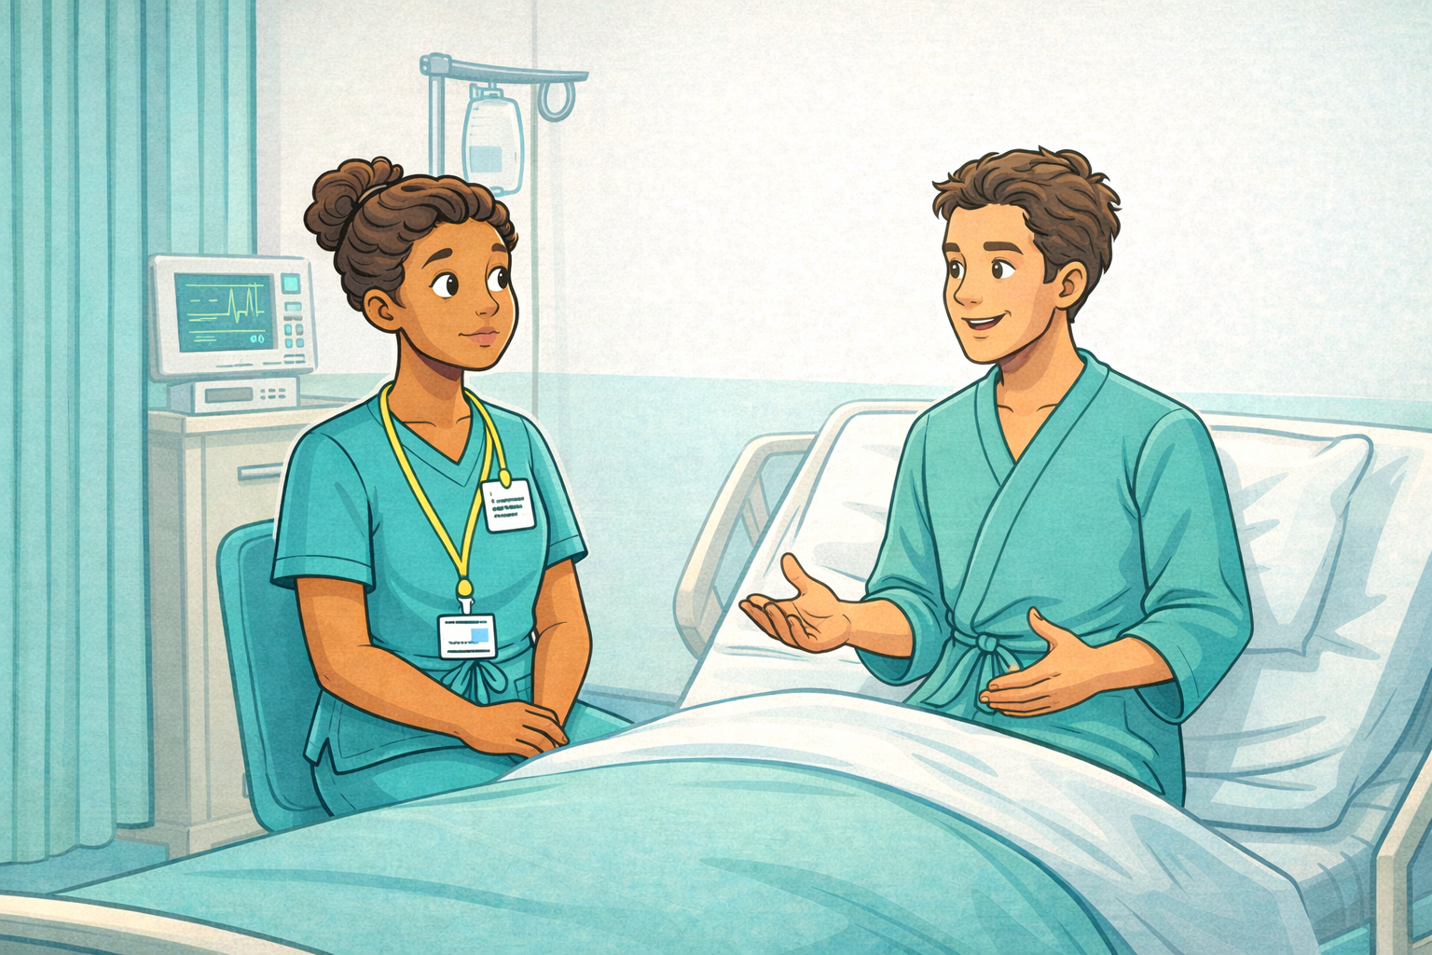
The National Association of Educator in Practice Conference
Closing Reflection
Let’s return to the bay.
When a patient says,“I’m leaving.”
The decision still needs to be made.
ChoicePoints does not remove complexity.
It does not eliminate pressure.
It does not promise perfect answers.
What it does is create a moment for rehearsal.
Rehearsal for:
Slower thinking
Clearer language
Greater awareness
More deliberate action
Before the moment becomes irreversible.
Notes:
Proposed Structure (Optimised for 10 Minutes)
Slide 1
Title Slide
Live Decision Making with ChoicePoints
A Co Designed Approach to Scenario Based Learning
Minimal text. Calm palette. Powder Teal background, Saffron accent for title.
Slide 2
Opening Story – 90 seconds
Start with a specific moment.
Not abstract.
For example:
“It is 08:42. Six bedded bay. One patient attempting to leave. One relative distressed. One healthcare assistant off sick. One student frozen.”
Then pause.
Then ask:
How many decisions have already been made?
Who is deciding?
On what basis?
This grounds the audience immediately.
Slide 3
The Reality of Practice
Make the invisible visible.
Healthcare professionals make:
Clinical decisions
Ethical decisions
Relational decisions
Organisational decisions
Often simultaneously.
Often under pressure.
Often without full information.
Then introduce the question:
How are these decisions actually made?
Slide 4
How Decisions Are Made
Briefly anchor in theory without overloading:
Dual process thinking, intuitive and analytical
Heuristics and bias
Bounded rationality
Moral reasoning under constraint
One slide. No deep dive.
The purpose here is not to teach decision theory.
It is to show the problem.
Then transition:
If we know this is how professionals decide, how are we teaching them?
Slide 5
The Gap in Education
Often we teach:
Knowledge
Protocol
Policy
But not:
Live decision pressure
Ambiguity
Competing values
Emotional load
That is your pivot.
Slide 6
What is ChoicePoints?
Clear. Structured. Visual.
Three modalities:
ChoicePoints Live
ChoicePoints Live Online
ChoicePoints Story
Each built around:
Branching dilemma
Collective polling
Visible consequence
Facilitated reflection
Keep this slide clean.
Slide 7
What Makes It Different?
Here you introduce co design.
Emphasise:
Developed with service users and carers
Dilemmas drawn from lived experience
Not hypothetical perfection
Real ambiguity
This is important for NAEP.
You are not just simulating.
You are co constructing narrative.
Slide 8
The Learning Mechanism
Now you bring in theory again, briefly:
ChoicePoints deliberately creates:
Disorienting dilemmas, transformative learning
Experience, Kolb cycle
Dialogue, Freire
Narrative meaning making
One sentence each.
Do not lecture on them.
Slide 9
Evaluation Evidence
Be disciplined here.
What have you measured?
For example:
Confidence shift
Perspective change
Self reported behavioural intention
Qualitative thematic outcomes
If you have percentages, use them.
If not, use themes.
Avoid claims you cannot evidence.
This slide is credibility.
Slide 10
Closing Reflection
Return to the opening scenario.
Ask:
If we expect practitioners to make complex decisions in live environments,
should education remain static?
Then close with something simple:
ChoicePoints is not about getting the right answer.
It is about making visible how we decide.
Primary Logo Colours (Observed): Teal BlueHEX: #008080 (approximate) Name: Teal
FONT: Nunito
Complimentary Colour palette
Name Soft Neutral Background #F4F4F9 Ghost White
Highlight / Secondary #FFC857 Saffron
Soft Contrast / Calm #AED9E0 Powder Teal
Text/Dark Contrast #2E2E2E Charcoal Grey
Accent Shade #F7B2AD Rose Quartz

Slide 12
The National Association of Educator in Practice Conference
Closing Reflection
So in summary:
Practice is layered and ambiguous.
Decision making is fast and human.
Education must create space to slow it down.
Practitioners need to make complex decisions in live environments
So…education should reflect these conditions
In ChoicPoints:
The decision is made publicly.
The reasoning is unpacked collectively.
The ambiguity is explored safely.

Slide 13
The National Association of Educator in Practice Conference
Thank you
Live Decision-Making with ChoicePoints:
A Co-Designed Approach to Scenario-Based Learning
James Wilson
Senior Lecturer
University of Chichester
James.Wilson@chi.ac.uk

