Slide 1




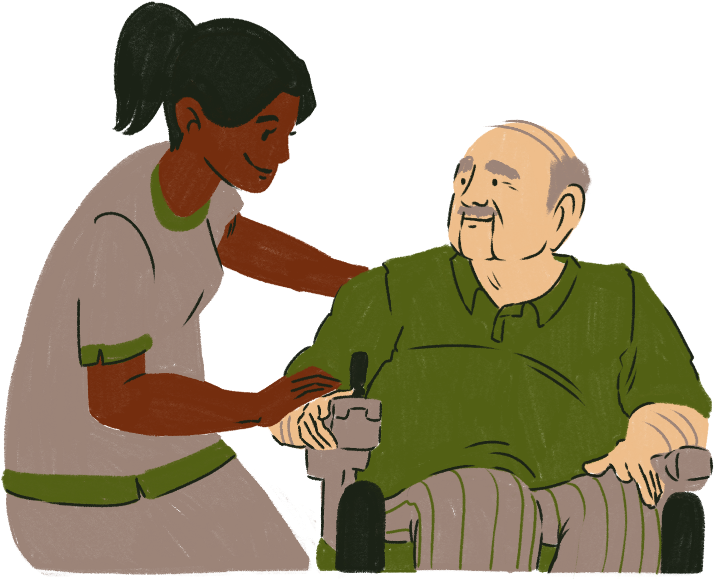
INNOVATIVE PRACTICE-BASED LEARNING FOR DIETETICS IN THE SOCIAL CARE ENVIRONMENT
MARCH 2026
Jess Cristofoli-King (BSc, PGCE, FHEA, RD)
NAEP Conference

Slide 2


Session outline
  Background
  Planning
  Aims & objectives
  Practicalities
  Evaluation
  Challenges
  Key reflections
  The future
March 2026
NAEP conference

Slide 3
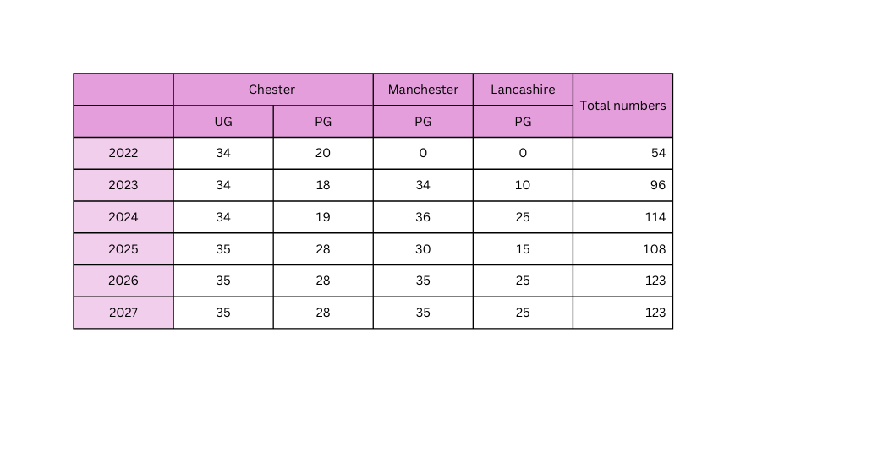
Background:
Workforce demand and landscape of Dietetic placements in NW England
  Planned 32% increase by 2031 - NHS long term plan (2023)
Notes:
In line with the NHS workforce plan (2023), numbers of dietetic learners continue to grow, with the dietetic workforce expected to increase by 32% by 2031.
HCPC registration requires 1000 practice-based learning hours for dietetic learners, - need to seek new learning environments, without adding further supervisory pressures to the already overstretched NHS dietetic workforce.

Slide 4

Changes in Practice
More focus on preventative measures and community, domiciliary and primary care rather than in the acute NHS setting
British Dietetic Association (BDA) strongly encourage diversification of practice-based learning environments that align with the 4 pillars of dietetic practice.
PRACTICE
RESEARCH
LEADERSHIP
FACILITATED
LEARNING
Notes:
Shift to preventative care in the community setting. The prevalence of malnutrition is common in older people within care home facilities and dietetic input in these settings is essential, however exposure to these environments for dietetic learners is limited.
BDA recognise changing landscape and strongly encourage a diverse range of learning experiences that align with the 4 pillars of practice

Slide 5
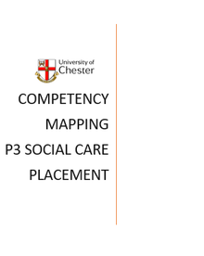

Planning:
MARCH 2026
4 UoC students have completed 10/12 week placements in a care home setting
Each placement took careful planning to ensure it aligned with BDA curriculum framework & HCPC standards for education and training
NAEP conference
Notes:
4 learners - Two learners were placed in a large care village on a full-time 12-week placement, & 2 other separate care home placements for individual students using an indirect supervision model. The learners were required to take responsibility for their own learning and to take the lead in predicting and managing their workload.

Slide 6

Placement aims & objectives
MARCH 2026
  To help prepare future dietitians to work across health and social care settings
  To experience & reflect upon the differences between clinical and social models of care
  To raise awareness of nutrition in supporting health & wellbeing in the social setting
NAEP Conference,

Slide 7
Learner aims & objectives
  Build a caseload of residents to assess, review and monitor over the course of placement
  To develop communication skills by interacting with residents, their families and care home staff
  To demonstrate healthcare professionalism, e.g. takes responsibility for own learning, maintains professional boundaries, treats service users and colleagues with compassion, empathy, courtesy and respect
  To conduct and present an audit, e.g. on nutritional risk screening standards, on hydration of staff and residents, on texture-modified diets
March 2026
NAEP CONFERENCE

Slide 8

Learner aims & objectives
March 2026
  To work with the catering team to analyze, evaluate and develop the food and fluid provision to meet the needs of the residents
  To work with the wellbeing team to develop an activity/resource for the residents
  To develop nutrition training aids/resources for care homes, e.g. posters, leaflets and five-minute training sessions

Slide 9

Long arm supervision and assessment
March 2026
  Provided by UoC dietitians
  Regular check-ins
  Site visits
  Relies heavily on work products and reflection as evidence
NAEP CONFERENCE
Notes:
Learners provided evidence to their Long – Arm Practice Assessor (LAPA) whom they met with for daily supervision sessions via MS Teams. The LAPA was a registered dietitian from the University of Chester. These sessions provided the learner with support, an opportunity to raise any concerns and discuss any resident care plans for implementation. Learners were encouraged to reflect regularly on their practice and develop action plans for improvement.

Slide 10
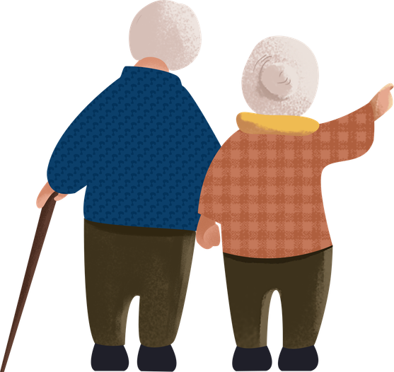
Student projects:
MARCH 2026
New referral pathway for overweight residents with or at risk of CVD
Heart healthy menu options for patients who meet specific criteria
Menu analysis and comparison to National Standards and Guidance for Care Homes in the UK
Staff training packages:
(Including monitoring anthropometrics, recognising refeeding syndrome, managing intake in residents with dysphagia and managing T2DM through diet)
NAEP Conference
Notes:
Whilst within the care facility the learners built their own caseload of residents and gained experience of managing long term conditions in a community setting. They were also able to promote healthy living, advising around the nutritional adequacy of provided meals and snacks, identifying a need for further education around residents with cardiovascular health risks and creating training packages for staff

Slide 11
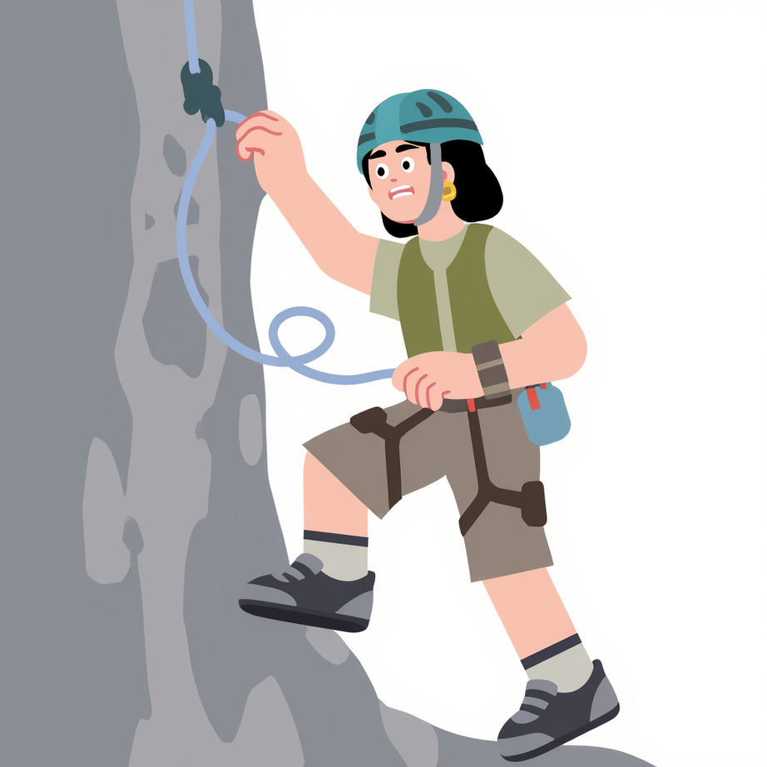
Challenges:
  Learners found it difficult to speak up in an unfamiliar and often busy environment
  Learners experienced challenges trying to manage own time & workload without direct supervision
March 2026
NAEP Conference
Notes:
Learners initially felt apprehensive around utilising an indirect supervision model and reported challenges around speaking up in an unfamiliar and often very busy environment. They also initially found it hard to consider how to manage their time and workload without direct supervision from a dietitian.

Slide 12





95% positive feedback from students
"Being independent on placement, with no dietitian to shadow, although strange at first, actually benefitted me greatly. I was able to develop confidence faster and feel more ready to practice as a dietitian. Communication skills developed much faster as a result."​
"The placement was extremely interesting and opened up opportunities that I was previously not fully aware of."
The whole experience was great, and I hope that other students can experience similar in the future. An uplifting placement, where I've learnt a lot.
Notes:
As the PBL experience progressed however, the learners reported increased confidence, leadership, project management and time management skills as a result.

Slide 13



100% positive feedback from providers
“The resources she developed are brilliant, we’ll be able to use these as part of our training for new staff. This placement has really shown the value of having a dietitian on site”
March 2026
“The students have been amazing and have taught us so much. I wish they could stay!”
NAEP CONFERENCE
Notes:
Staff reported an increased awareness of the value of having a dietitian within the care facility and the benefits it can bring to both staff, residents and their families.

Slide 14

Learner benefits:
  Project management skills
  Leadership skills
  Increased confidence
  Time management skills
  Communication skills
  Broader experience of health and social care
March 2026
NAEP Conference

Slide 15

Key reflections & learning:
  Providing structure is key
  Prepare your students
  Consider which students will thrive in that environment
  Be clear with aims and objectives
  Be prepared to be flexible
  Staff need to be available to provide support

Slide 16

The future....
  Social care environments can provide safe & effective learning environments for dietetic students
  These and similar placements can help raise awareness for increased dietetic services within this field
  Growth of other PIVO placements in line with dietetic 4 pillars of practice

Slide 17

Thank you!
Please feel free to ask any questions
Further information available at:
https://www.bda.uk.com/practice-and-education.html
BDA webinar:
https://youtu.be/-FYIrzRhbwA?si=v_H5_OkMqn_hSvo6&t=1269
PBL Case study:
https://www.bda.uk.com/static/95fcee5c-1bb9-474c-a12cc03955c6e69b/PBL-Educator-Chester-case-study-2.pdf

