Slide 1


Exploring and assessing the effectiveness of the use of digital technologies and AI to support education and learning in workplaces through an Educator Apprenticeship route
With David Maytham and Karen Burbidge

Slide 2
The Challenge: A Shifting Landscape
Educator roles are expanding beyond acute settings.
AI is accelerating change.
Yet 95% of educators report no formal AI training (Council of Deans, 2025).
Universities are normalising AI use. Practice education must respond.

Slide 3
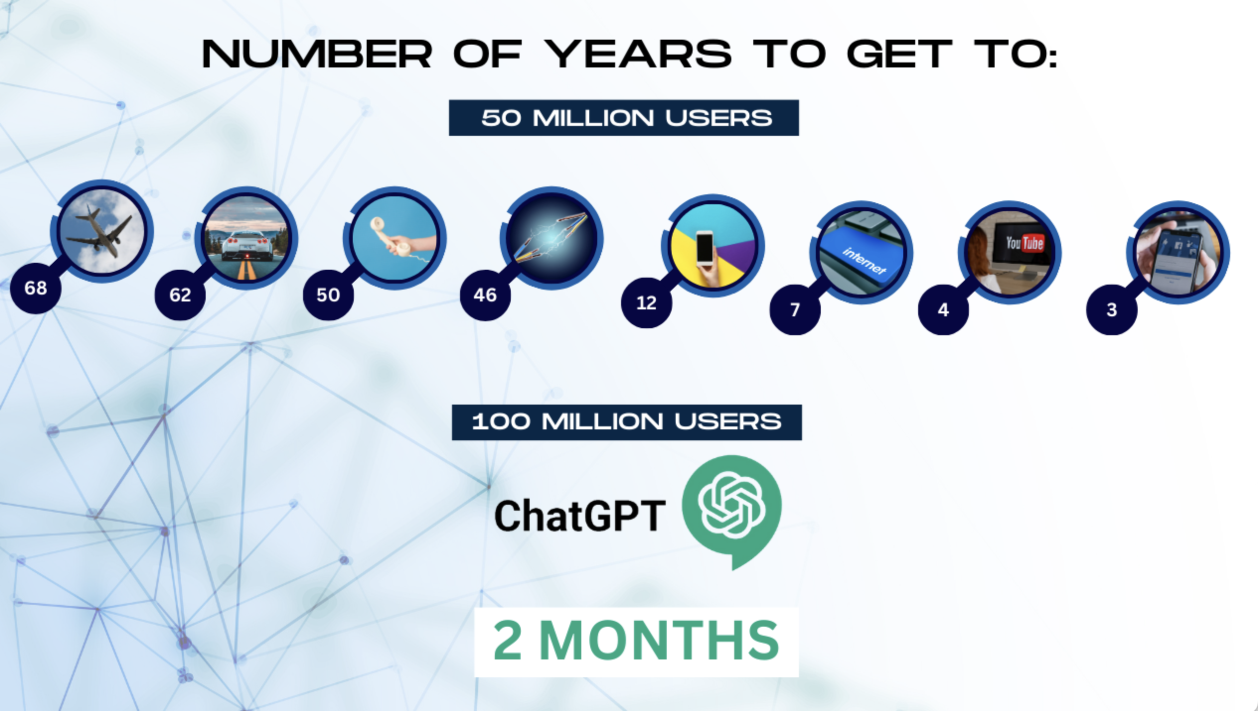
Growth in AI Adoption…

Slide 4
Usage Gap?
40%
80%

Slide 5
Background: Educator Apprenticeship Level 5
Accessible national route for health and social care educators.
Rapid uptake: Piloted with BNSSG. 70 apprentices engaged.
Opportunity to embed digitally enriched educator development.

Slide 6
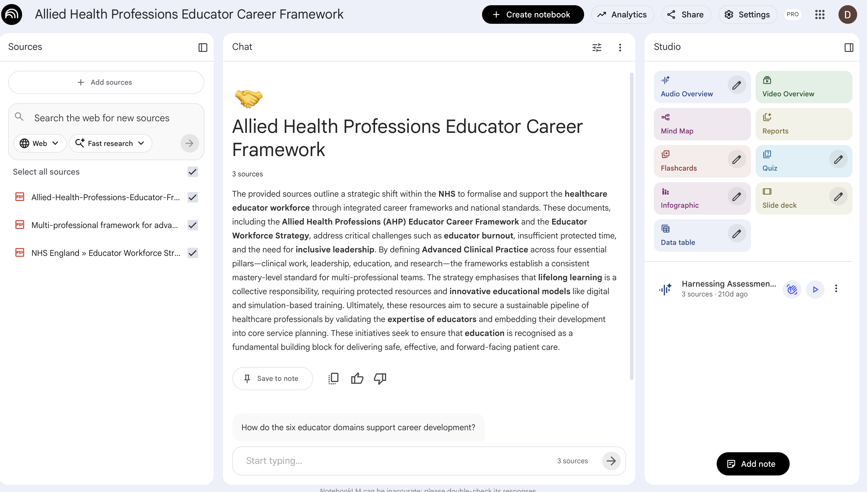
Top Tools: LM Notebooks

Slide 7
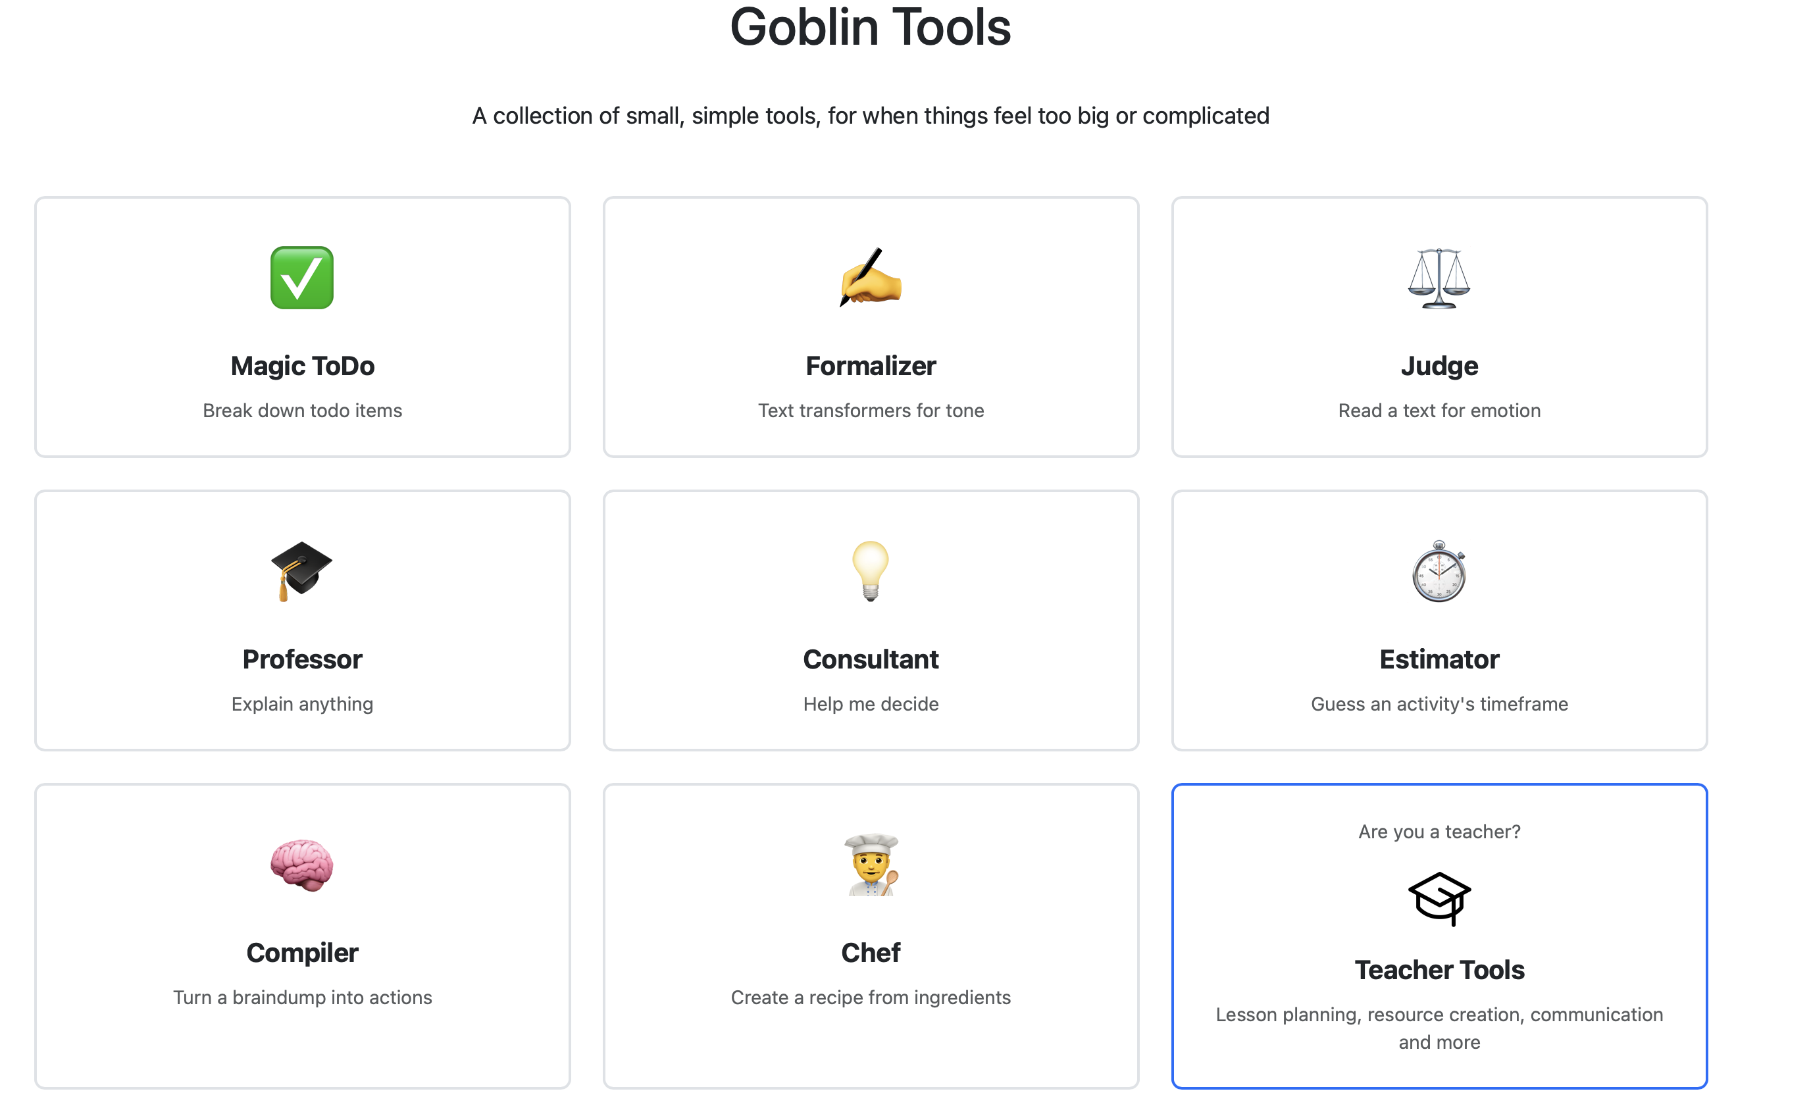
Goblin Tools
Notes:
SET up by xxxx
Reference to that
Free

Slide 8
Prompt Engineering…
[Role]
[Audience]
[Output]
[Style]
[Chain-of-Thought Instructions]
“____”
[Instruction]

Slide 9

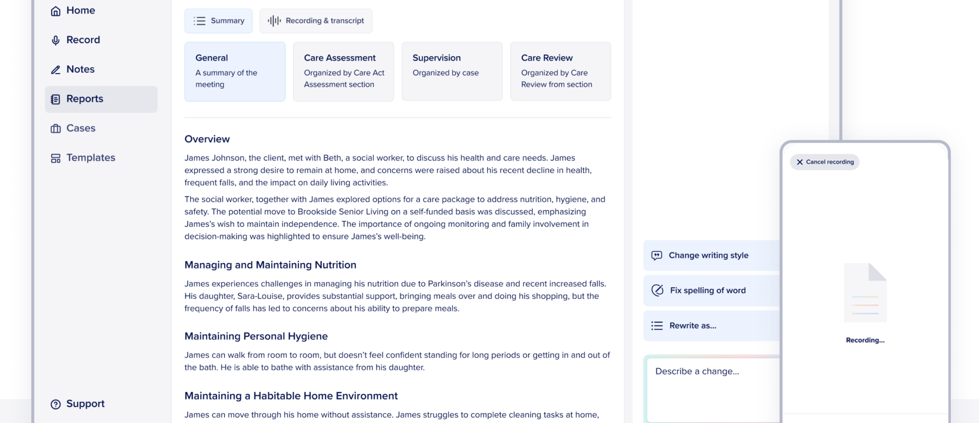
Magic Notes
Notes:
When a learner is taking clinical notes
How do you take notes yourself
Notes used in court – accuracy
Teach core skills – clinical debate writing

Slide 10
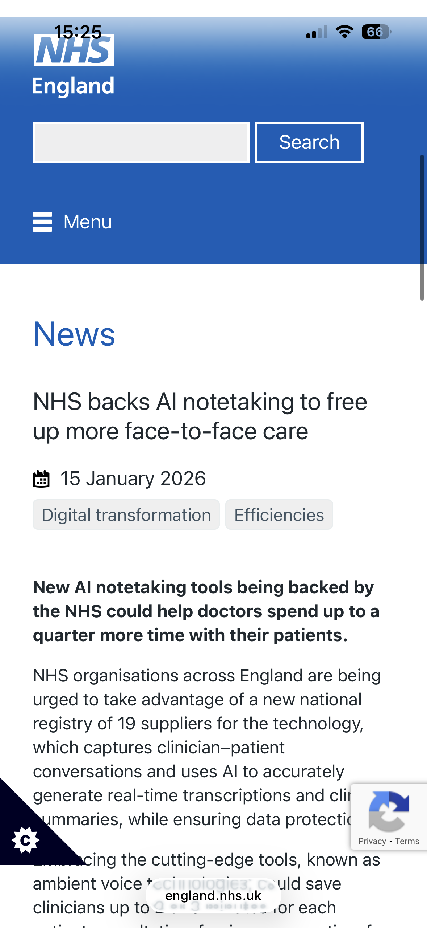
AI Notetaking…
Virtual Classroom
Coaching
Notes

Slide 11
AI Literacy
Bias
Plagiarism
Safeguarding
Clinical reasoning/ critical thinking
Closed AI

Slide 12
FACTS Framework
F
Focus Prompts: ensure prompts are clear, concise, and purposeful
A
Analyse Outputs: check for hallucinations, errors in facts and bias
C
Check for Bias: identify any bias in the output
T
Tailor Suitability: ensure the content is suitable for the context and requirements
S
Strengthen Prompts: refine instructions for better results in future iterations
DFE Training materials – June 2025
Notes:
The FACTS framework offers a structured approach to prompting in education by emphasising clarity, accuracy, and contextual relevance. It effectively addresses key concerns such as bias and factual integrity while encouraging iterative improvement. However, its success depends on consistent application and user awareness of AI limitations and potential biases.

Slide 13
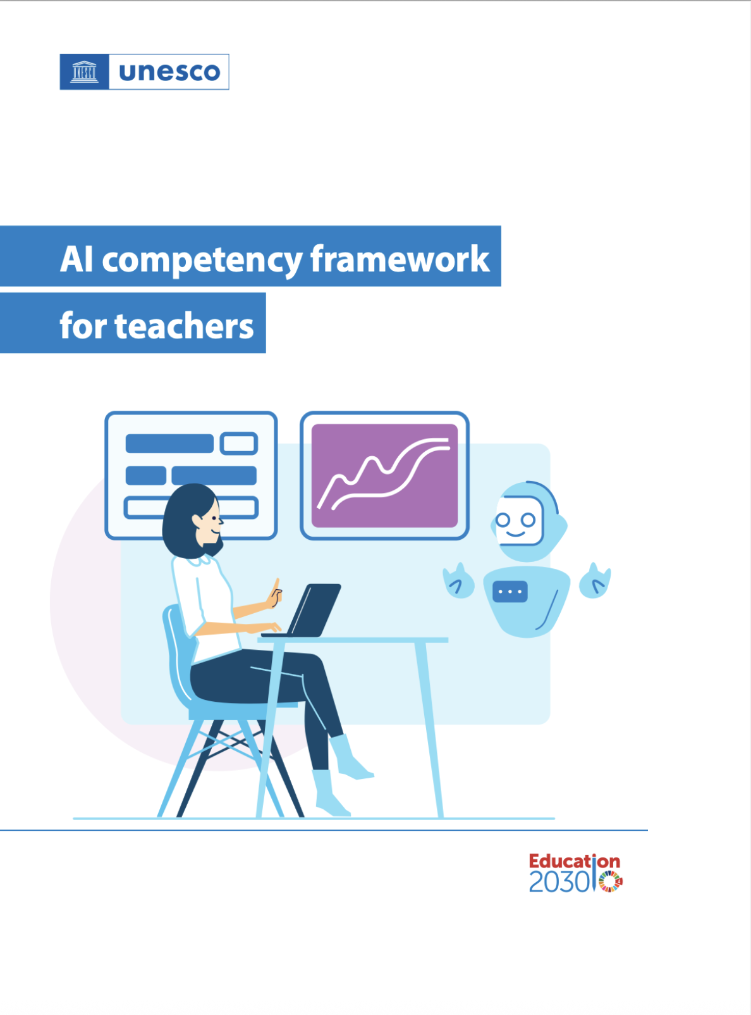
UNESCO AI Roles → Pedagogical Possibilities
From the UNESCO perspective, AI can function as:
Possibility engine
Socratic opponent (critical friend)
Collaboration coach
Personal tutor
Dynamic assessor
“We positioned AI not as a replacement for educators, but as a pedagogical amplifier.”
Notes:
My AI

Slide 14
Rogers’ Adoption Curve → Educator Engagement
Not all educators adopt AI at the same pace, and that affects programme design.
“We recognised early on that AI adoption is not a skills issue alone. It is a behavioural issue. Rogers’ Adoption Curve reminds us that within any educator cohort, we have innovators, early adopters, the early majority, late majority and laggards.”
Some apprentices were already experimenting with AI.
Others were hesitant, concerned and fearful.
The apprenticeship allows structured, psychologically safe experimentation.
This reduced resistance and supported movement from scepticism to informed adoption.

Slide 15
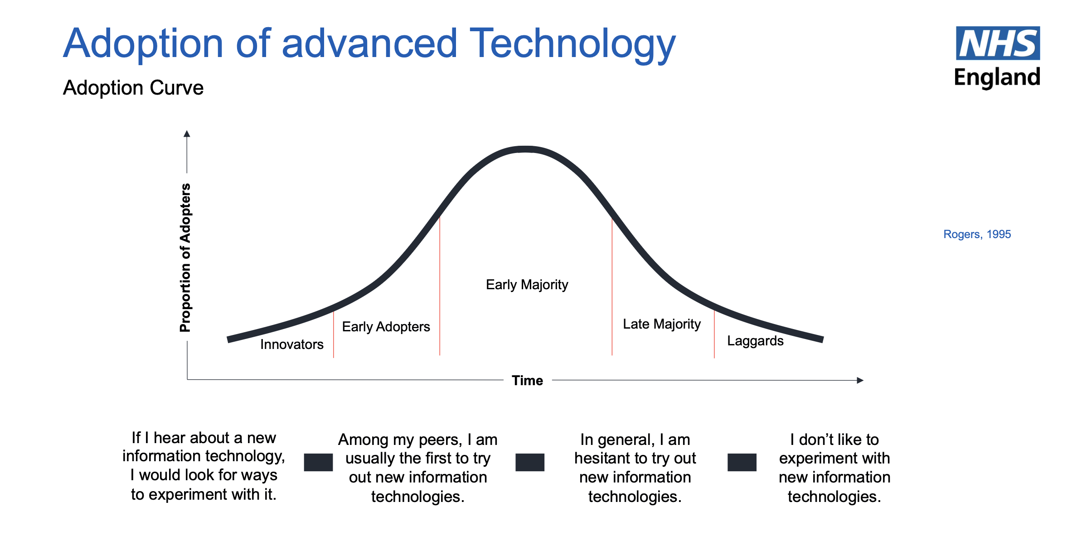

Slide 16
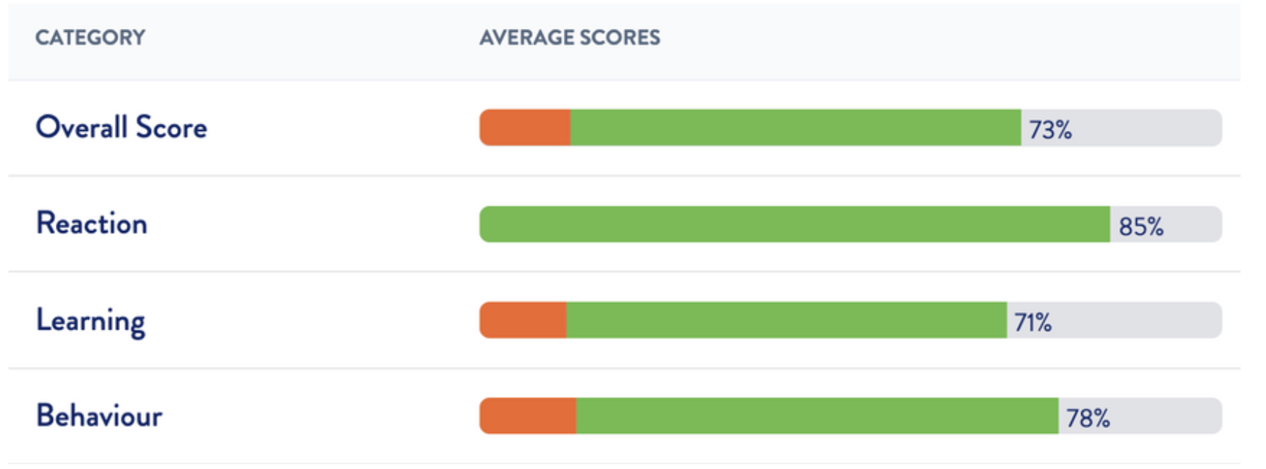
Kirkpatrick Evaluation → Impact Across Levels
“Rather than measuring enthusiasm alone, we are evaluating impact across behavioural and workplace levels, ensuring this is capability development, not simply exposure.”
We are evaluating beyond satisfaction.
Level 1 – Reaction: Did apprentices value the AI content?
Level 2 – Learning: Did their digital capability increase?
Level 3 – Behaviour: Did they actually use AI ethically in practice?
Level 4 – Results: Early indications of improved educator confidence and learner experience.

Slide 17
Feedback from pilot cohort
“Very eye opening and skill building on how to look at the practice educator role in a different lens. Always feel excited after session to take the information and tools presented to do with students.”
“Really interesting. Good to learn about equity and how it impacts a wide variety of people. Helpful to learn of the future of AI.”

Slide 18
A final thought…
“We should not be training educators to outsource thinking. We should train them to collaborate with AI, responsibly automating low-level tasks while retaining professional judgement.”
David Maytham, 2025
“Human oversight remains central. AI is assistive, not autonomous.”

Slide 19


Find out more
About the pilot project:
Karen Burbidge Email: karen.burbidge1@nhs.net Tel: 07581 492265
About the Educator Apprenticeship: Varsity Training Email: enquiries@varsitytraining.co.uk Tel: 01934 235236 Web: www.educatorapprenticeship.co.uk

