Slide 1
The art of personalised employment for neurodivergent AHP’s
And how compassionate adjustments can improve quality and safety
Presented by: Laura Smith, Kendal Rose & Simon Dooknah
Notes:
Standard title slide

Slide 2

Funding Acknowledgements

Slide 3
“Compassion can enable inclusive cultures that enable people to thrive and ultimately, we know that creating cultures where people can thrive, patients get better care.”
Interview participant
Notes:
Established in the social model of disability, neuro-inclusion

Slide 4
Why does supporting Neurodivergent staff matter?
Mental Health
Suicide
Burnout
Retention
Attrition from profession
Quality of care

Slide 5
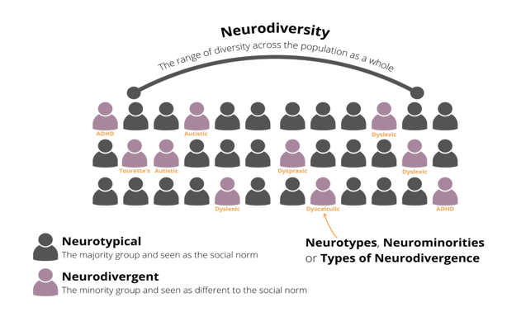

Neurodivergence
Notes:
Spikey profiles
Established in the social model of disability, neuro-inclusion

Slide 6
Neuro inclusion
Reframes disability not as a deficit within individuals, but rather a disparity between the person and their environment
(Goering, 2015; Honeybourne, 2019; Wise, 2023)
Notes:
Established in the social model of disability, neuro-inclusion

Slide 7
Study Aim
To explore the ways in which neurodivergent Allied Health Professionals adopt personal strategies that allow them to thrive in professional settings.
Ethical approval was obtained for a minimal-risk study by the Kings College, Research Ethics Committee (reference: MRSU-24/25-49783; 06/06/2025)
Notes:
Through exploring lived experiences, the research hopes to reveal coping mechanisms and inclusive practises that are effective and meaningful

Slide 8
Methodology

Slide 9
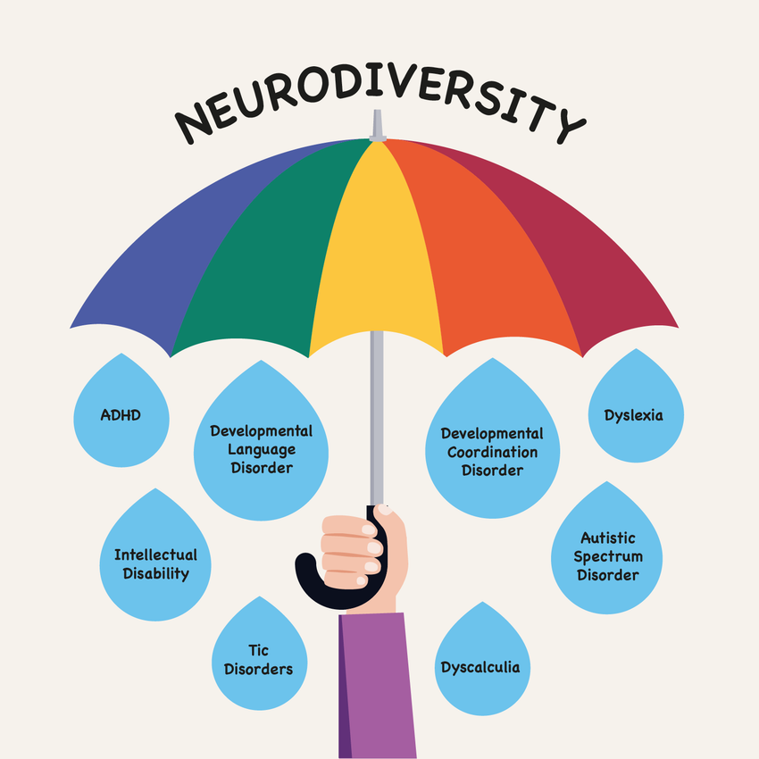
Inclusion criteria
Registered AHP’s and AHP Support workers working in the UK
Minimum of 1 year experience working in healthcare environments
Diagnosis of neurodivergent condition or self identify as neurodivergent

Slide 10
Recruitment
35 participants expressed in interest
5 did not meet inclusion criteria
15 interviews conducted and saturation reached
Recruitment was conducted over 30 days via Linkedin

Slide 11
Semi- structured 1:1 MS Teams Interviews
Tell us more about your current role career?
Would you feel comfortable sharing a bit about when you first became aware of your neurodivergent trait?
Have you received a formal diagnosis, or do you self-identify based on your experiences?
Many people talk about using strategies or tools that help them thrive at work-
What strategies, tools, or routines have you developed that help you succeed in your workplace?
Technology
Flexible working
Lists and structured assessment
Working areas and spaces
Uniform and shoes
Have you noticed any positive ways that your neurodivergence shows up in your role as an AHP in the workplace.
team dynamics, problem-solving, or creativity? In what way…
Are there aspects of your work where you feel your neurodivergent traits give you a unique advantage or insight?
Can you describe a time when you felt you were thriving at work? What contributed to that experience?
Have you ever asked for any adjustments or accommodations that have significantly improved your ability to thrive?
Have you ever come across any challenges when trying to implement these strategies.
How does embracing your neurodivergent identity shape the way you approach your profession?
Do you ever feel like you need to “mask” or hide aspects of your neurodivergence in the workplace.
Have you witnessed or been a part of any initiatives or practises that made your workplace more inclusive and empowering?
If you could design a workspace, what would it look like to support a neurodivergent professional?

Slide 12
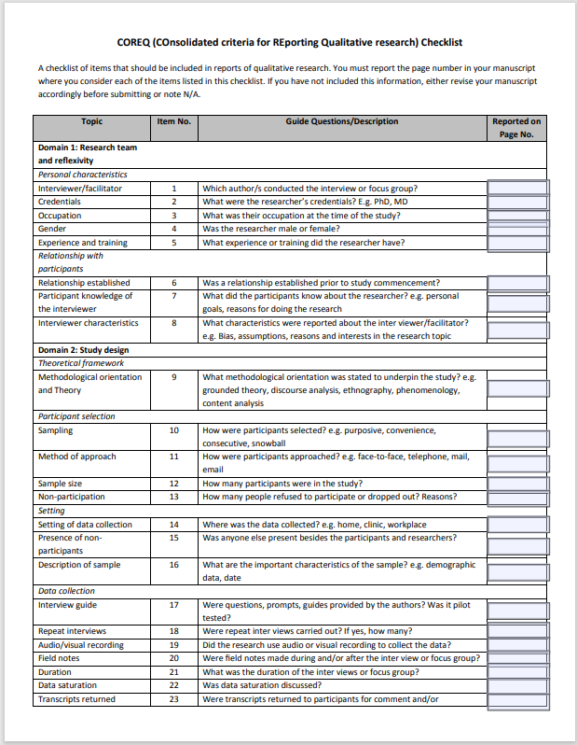
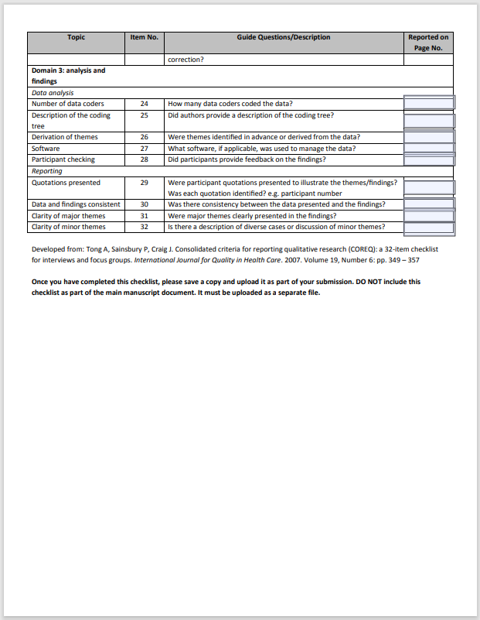
Braun & Clarke Reflexive Thematic Analysis
Familiarisation
Generating initial codes
Searching for themes
Reviewing themes
Defining Themes
Writing Up
COREQ Checklist

Slide 13
Participant profile

Slide 14


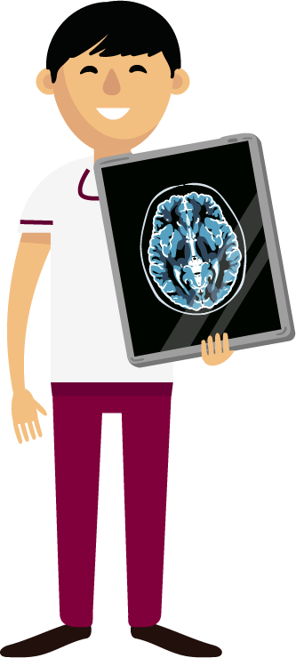

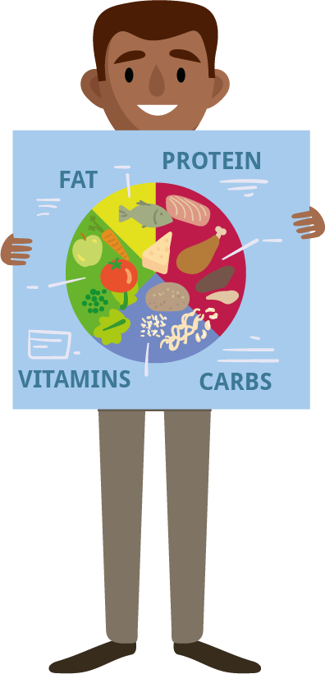
Interview Participants
10
14
Clinical roles
Female
3
15
Non-clinical roles
1
2
Male
Split clinical & non-clinical

Slide 15
Percentage Prevalence of Neurodivergent Traits Among Participants by Profession

Slide 16
Data Analysis

Slide 18
What did our participants tell us?

Slide 19
Surely its simple….
Attitudes
Technology
Environment
Structural
Personality
Notes:
A menu of workforce solutions.. Managers can simple ask chat GPT what their AuDHD staff member will need and implement these …

Slide 20
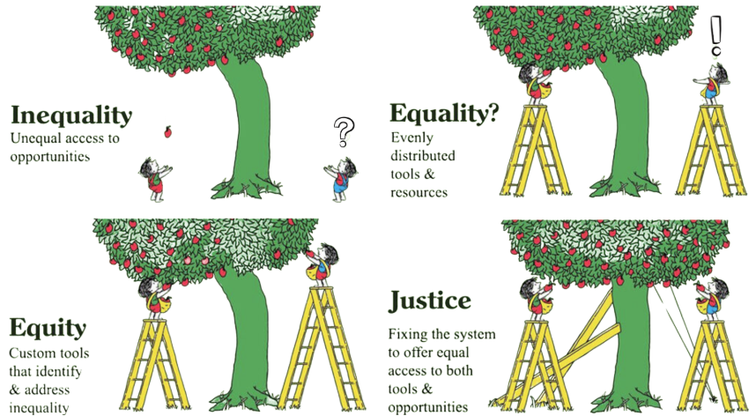

Slide 21
What did our participants tell us?
They need organisations to:
Utilise Access to Work
Encourage Open and mindful teams: e-learning & SLEP
Inclusive leadership: role modelling
Ongoing feedback & appraisal
Neurodivergent staff networks & forums: promote and facilitate time to participate.
Clear access to adjustment pathways
Flexible working structures, remote, adjusted, hybrid.

Slide 22
What did our participants tell us?
“It's about that awareness that you can't fix people. You just need to support them. And when you provide a supportive environment, that's where people grow.”
They need others to:
“They knew about my diagnosis and seemed very supportive about that. Again, which then just kind of took a little bit more pressure off me”
Peers that understand without judgement
They have time to .
“I have orange overlays that I use and I've also got orange tinted lenses that I put over, but I get embarrassed to wear them sometimes, so I just struggle along.”
Notes:
This highlights the significance of moving beyond superficial generic adjustments and instead incorporating modifications based off the individual’s circumstances and recognising them as an essential organisational responsibility with substantial advantages.
Participants expressed contrasting preferences, one favoured a regimented timetable that was managed by others while another desired complete control over her time and diary

Slide 23
What did our participants tell us?
“I've just got a lot of internalised ableism, but I'm aware of it and I'm trying to challenge it.”
“Being able to control that sensory stimulus, managing my time where I can allow myself to pause and have breaks. I feel like that's when I have thrived.”
They need to:
Develop self reflection skills
Navigate strategic disclosure
Establish energy management strategies
Understanding legal rights
Develop strategies to improve productivity / task completion
Enhance their self efficacy
I don't disclose too much at work. Not even with my new manager's, not even what I had. She just said how do you like to work? I don't need to know what your diagnosis is, I just want to know how you like to work?....Really helped me
“I need a 5-minute break. So, I've just run down the stairs and run back up again as my break because if I don't do that, I won't be able to sit and engage with you because my brain will be bouncing around the room.

Slide 24
What can you do?

Slide 25
The hope is …
Universal Design
Accelerated screening and assessment
Specialist Occ Health support for ADHD coaching
Wider staff education and reduced stigma

Slide 26
Limitations

Slide 27
Limitations
Only 5 of 15 AHP specialties were represented.
Sampling bias likely due to researcher networks.
Mostly female participants; gender imbalance
Self-selection may have led to response bias.
Research team was neurodivergent-only, limiting neurotypical perspectives.

Slide 28
Conclusions

Slide 29
Conclusions
Neurodivergent strengths (creativity, resilience) often overlooked.
Lack of inclusive environments leads to burnout and disengagement.
Supportive leadership and tailored adaptations help neurodivergent staff thrive.
Inclusion should be embedded in organisational culture, not treated as optional.
Future research should broaden representation and reduce bias.
Supporting neurodivergent AHPs strengthens workforce performance and retention
Neurodivergent experiences are highly varied and complex

Slide 30
End slide

