Slide 1

Embedding sustainability within physiotherapy curricula using a real-world scenario to develop innovative learning resources.
Lorna Johnson & Jo Conway
Faculty of Life Sciences & Medicine

Slide 2
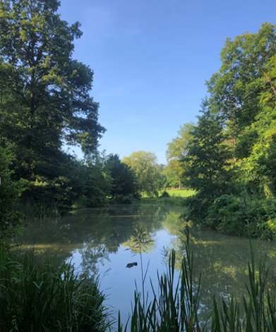
Outline of session
Background
Objectives
Project outline
Progress
Planned evaluation
Reflections
Next Steps
Sustainable Healthcare
'Health system that improves, maintains or restores health, while minimising negative impacts on the environment and leveraging opportunities to restore and improve it, to the benefit of the health and wellbeing of current and future generations' (WHO, 2017)

Slide 3
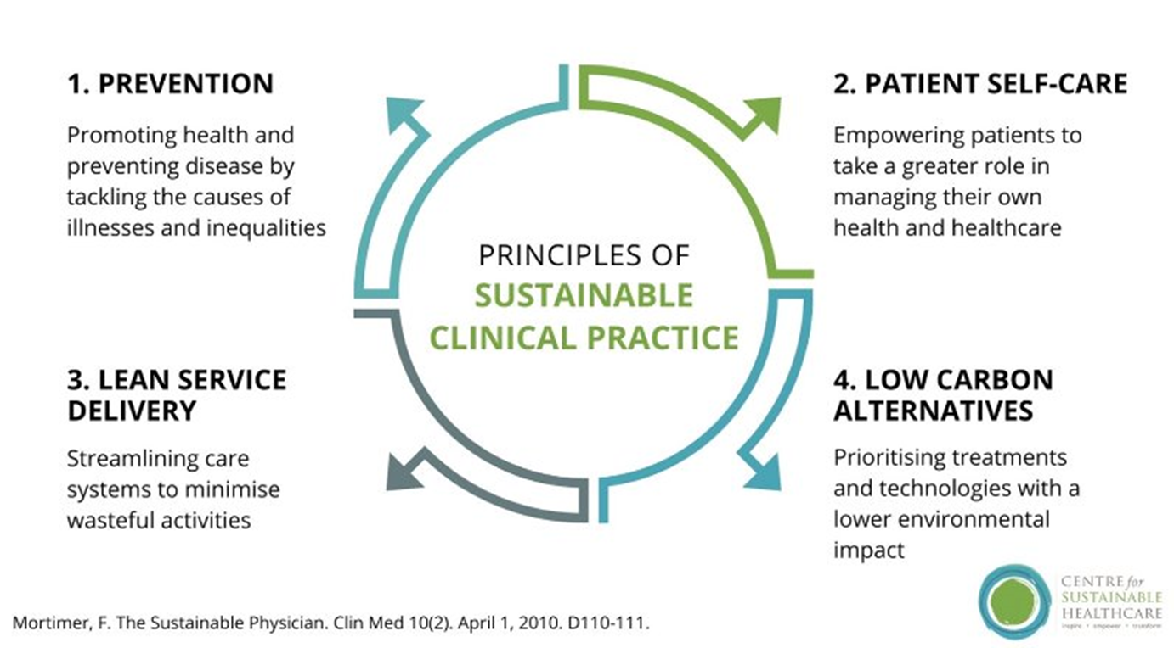
Background
Two pre-registration physiotherapy curricula at King’s launched in 2021 (BSc and MSc pre-reg).
Curricula are integrated and use a spiralled approach to curriculum delivery.
Aim to train physiotherapists who will be future leaders in delivering healthcare and health research.
Allied health professionals (AHPs) are the third largest workforce in the NHS and thus well placed to lead delivery of sustainable healthcare (The Council of Deans, 2023)

Slide 4
Project Objectives
To identify a real-world scenario focused on a sustainability theme that will form the basis of the learning resource to be developed for use in the classroom
To increase staff and student knowledge and understanding about sustainability in healthcare by engaging with relevant literature and training and support provided by the Sustainability in Quality Improvement (SUSQI) Academy
To co-produce teaching resources and situate within both programmes using a spiralled approach (lecture and seminar)

Slide 5
Project outline
Recruitment of student partners
Teaching resources piloted
Delivery to BSc year 1 students (Lecture & Seminar)
Evaluation
Student partner visits- sustainability in-action at CLCH
Staff and student partners completed training sessions with SusQI and engage with range of resources
Placements with a leadership/sustainability focus at CLCH
Teaching resources (lecture and seminar) co-produced using backward design
Training for student partners (pedagogy and teaching delivery)

Slide 6

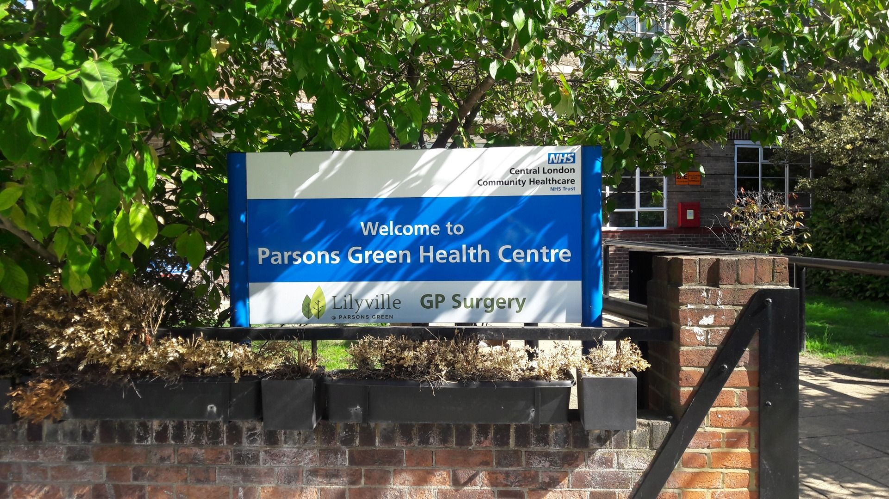
Site visits- sustainability in action
Finchley Memorial Hospital Falls Clinic & Parson’s Green Health Centre
Saw how language barriers in referral letters can delay care and waste time
Realised that unclear admin can lead to unnecessary travel and strain on staff
‘It made me think about how improving communication systems also supports sustainability’
Noticed how training staff and choosing suppliers with green policies makes a real difference

Slide 7
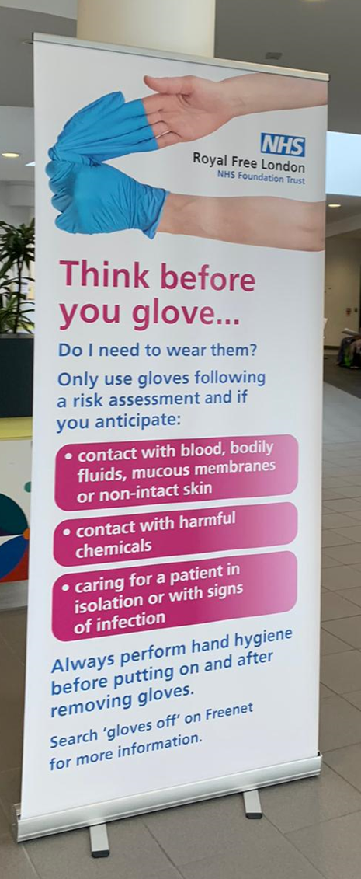

Progress - Placements
Four students completed placements with a leadership/sustainability focus at CLCH in August 2024
6-week hybrid placement
Outputs
Elevator pitches for two quality improvement projects
Project 1: Transport
Project 2: Gloves off

Slide 8
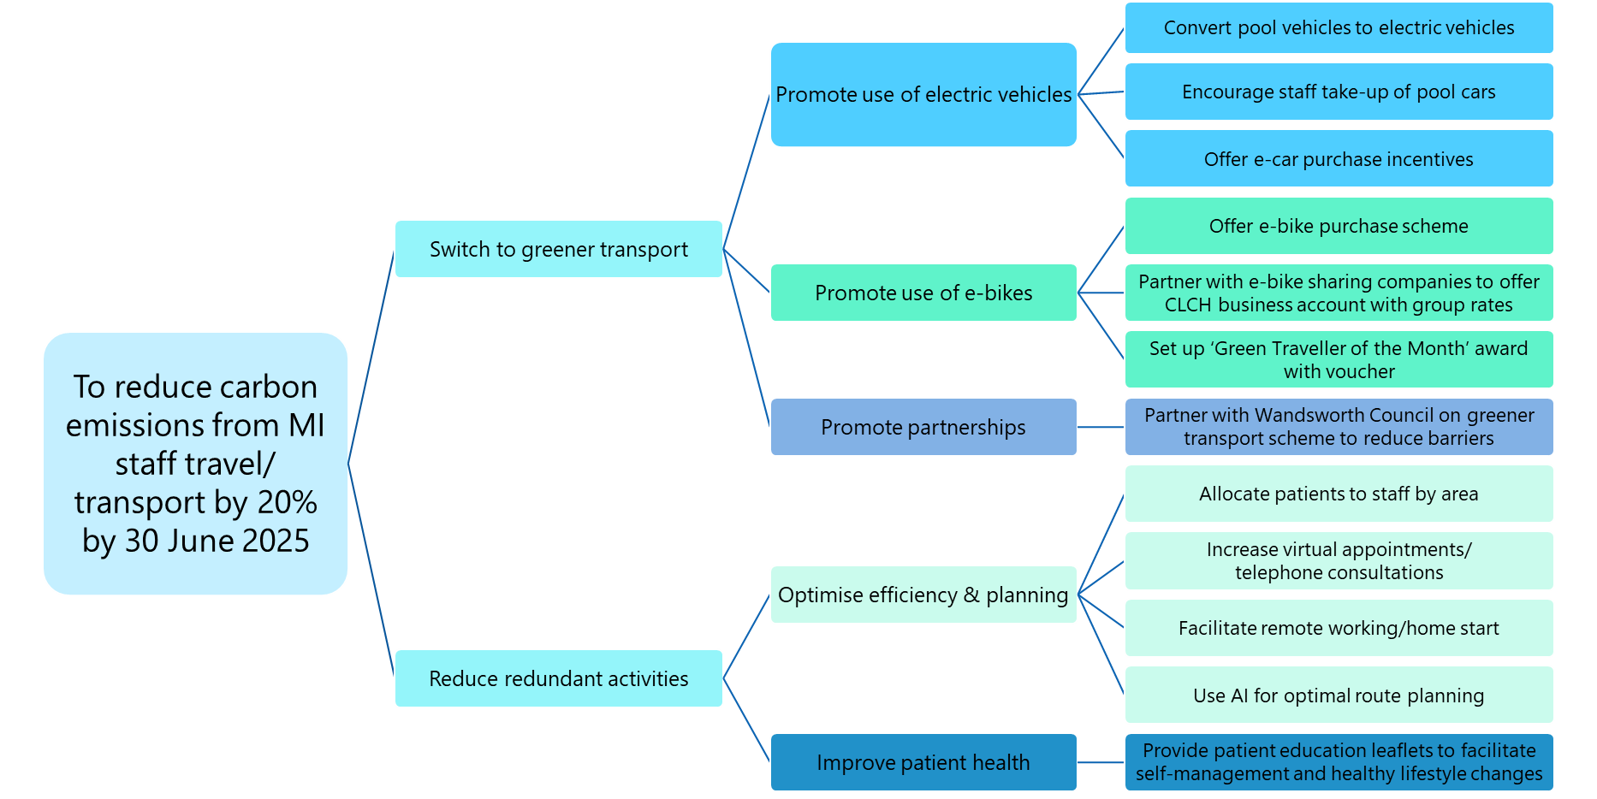
Project 1 - transport
Did you know that NHS-related travel & transport totals 9.5 billion miles per annum? ¹ That’s equal to going around the globe 380,000 times!!
Within CLCH Maximising Independence (MI) team, each staff member makes an estimated 4 trips a day on average, spending 40 minutes per trip. That’s a lot of travels and CO₂
Our project aims to reduce MI staff travel & transport carbon emissions by 20% by 30 June 2025.

Slide 9
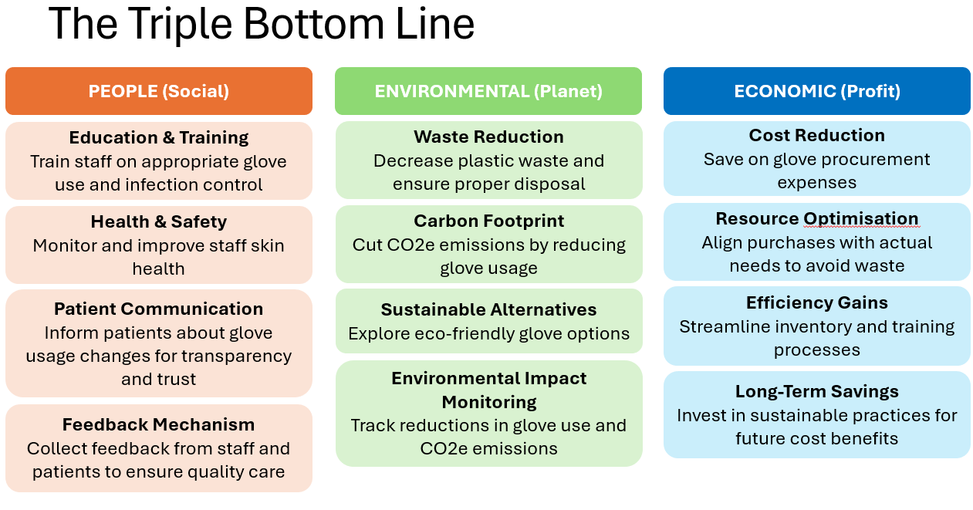
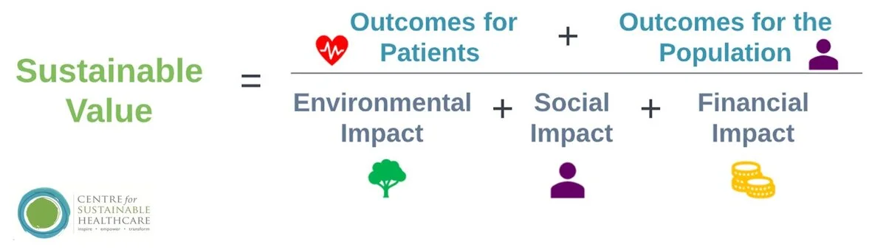
Projects– Gloves off
Notes:
The Sustainability in Quality Improvement framework (SusQI) is an approach to improving healthcare in a holistic way. In SusQI, the “sustainable value” of a service is determined by measuring the health outcomes against its environmental, social and economic costs and impacts (these are sometimes referred to as “the triple bottom line”).
The 'Gloves are off' campaign, which aims to improve patient safety by ensuring that patients and their families are seen by staff with clean hands.

Slide 10
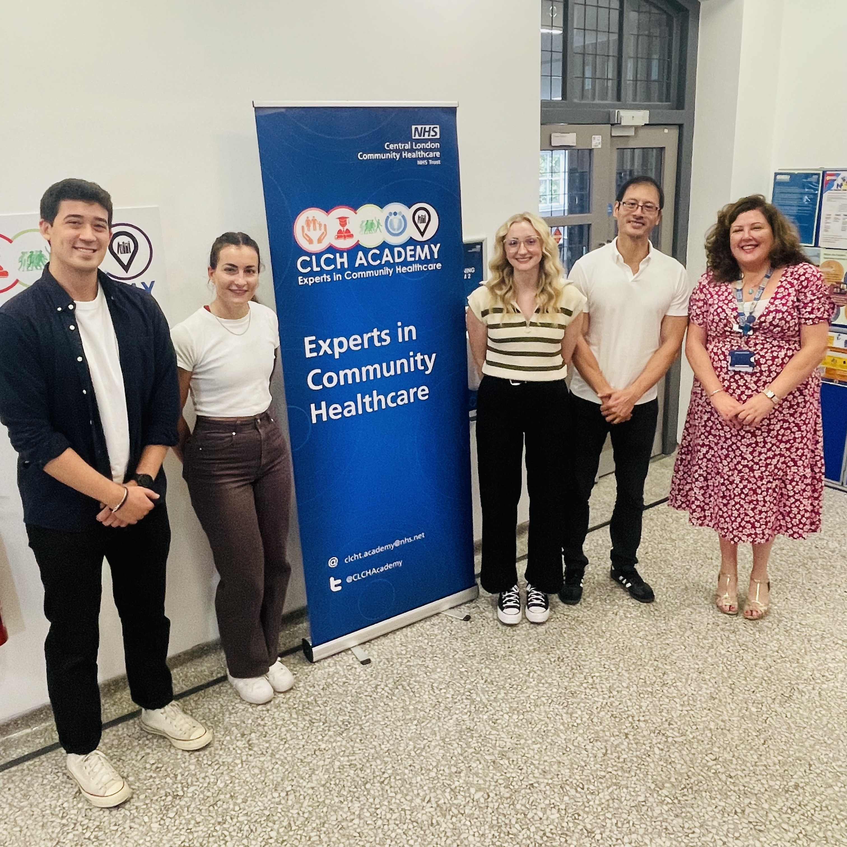
Progress - Placements
This experience has informed my subsequent clinical placements, making me more aware of the sustainability impact of my clinical actions - for example, prescribing digital home exercise programmes instead of paper printouts, and considering how MDT handovers could be streamlined for greater efficiency.
Sustainability in healthcare was a new concept to me, therefore, engaging in the leadership placement focusing on sustainability was an opportunity to broaden my perspective. I now view sustainability as a key pillar of modern progressive healthcare. The placement encouraged me to think critically about whether our healthcare systems are benefiting current but also future generations
It also directly strengthened my academic work: in a recent QI assignment, I was able to confidently develop an initiative and apply relevant frameworks, tools, and best practices - much of which drew on the practical and conceptual learning gained during the placement.

Slide 11
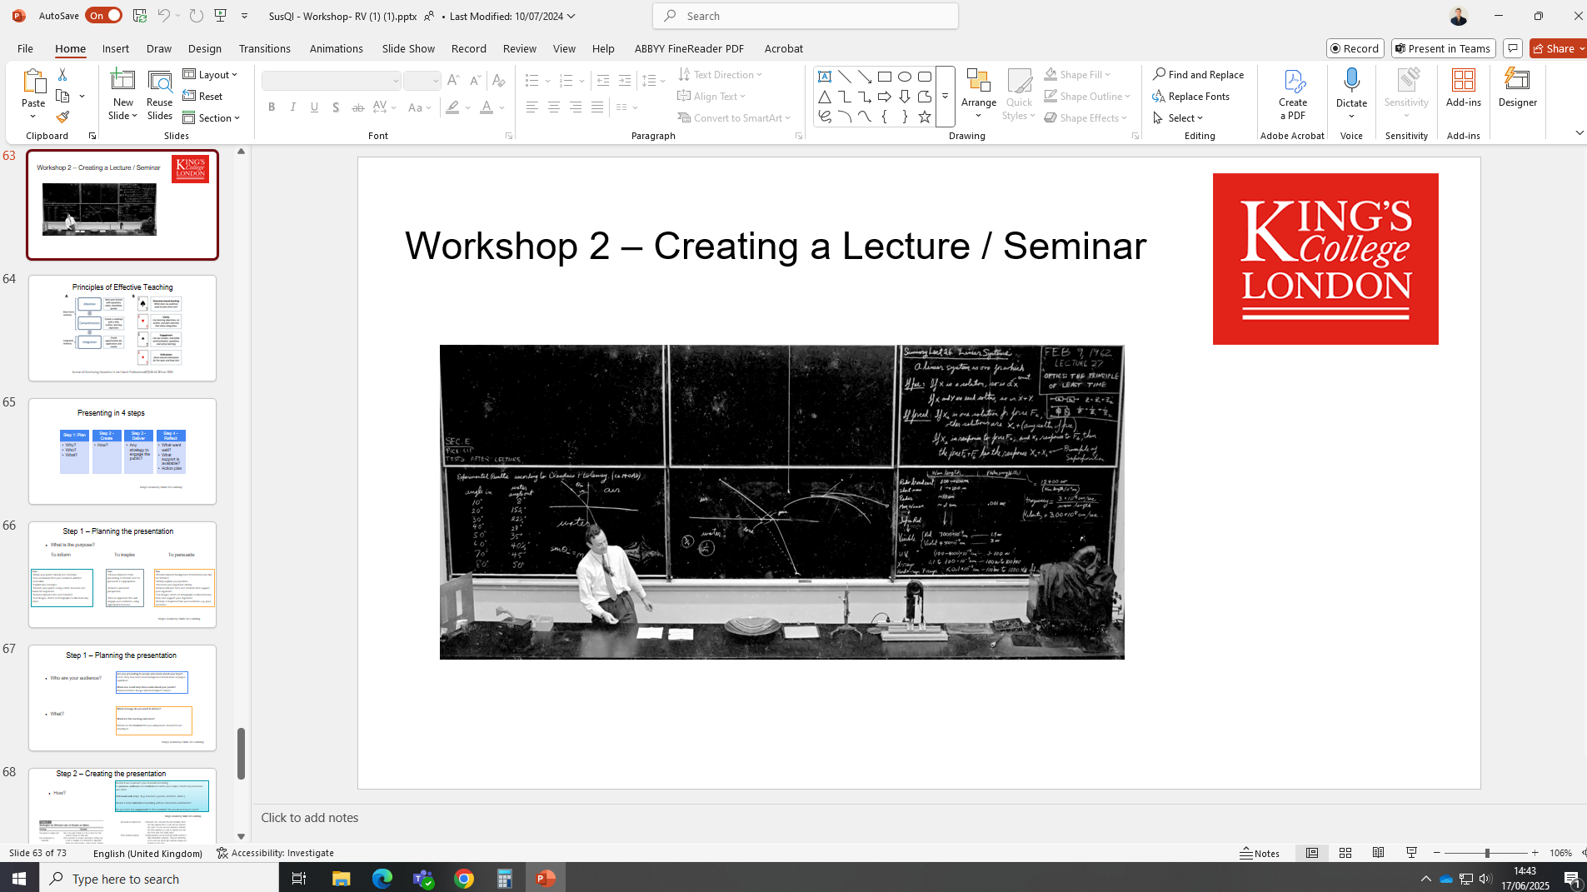
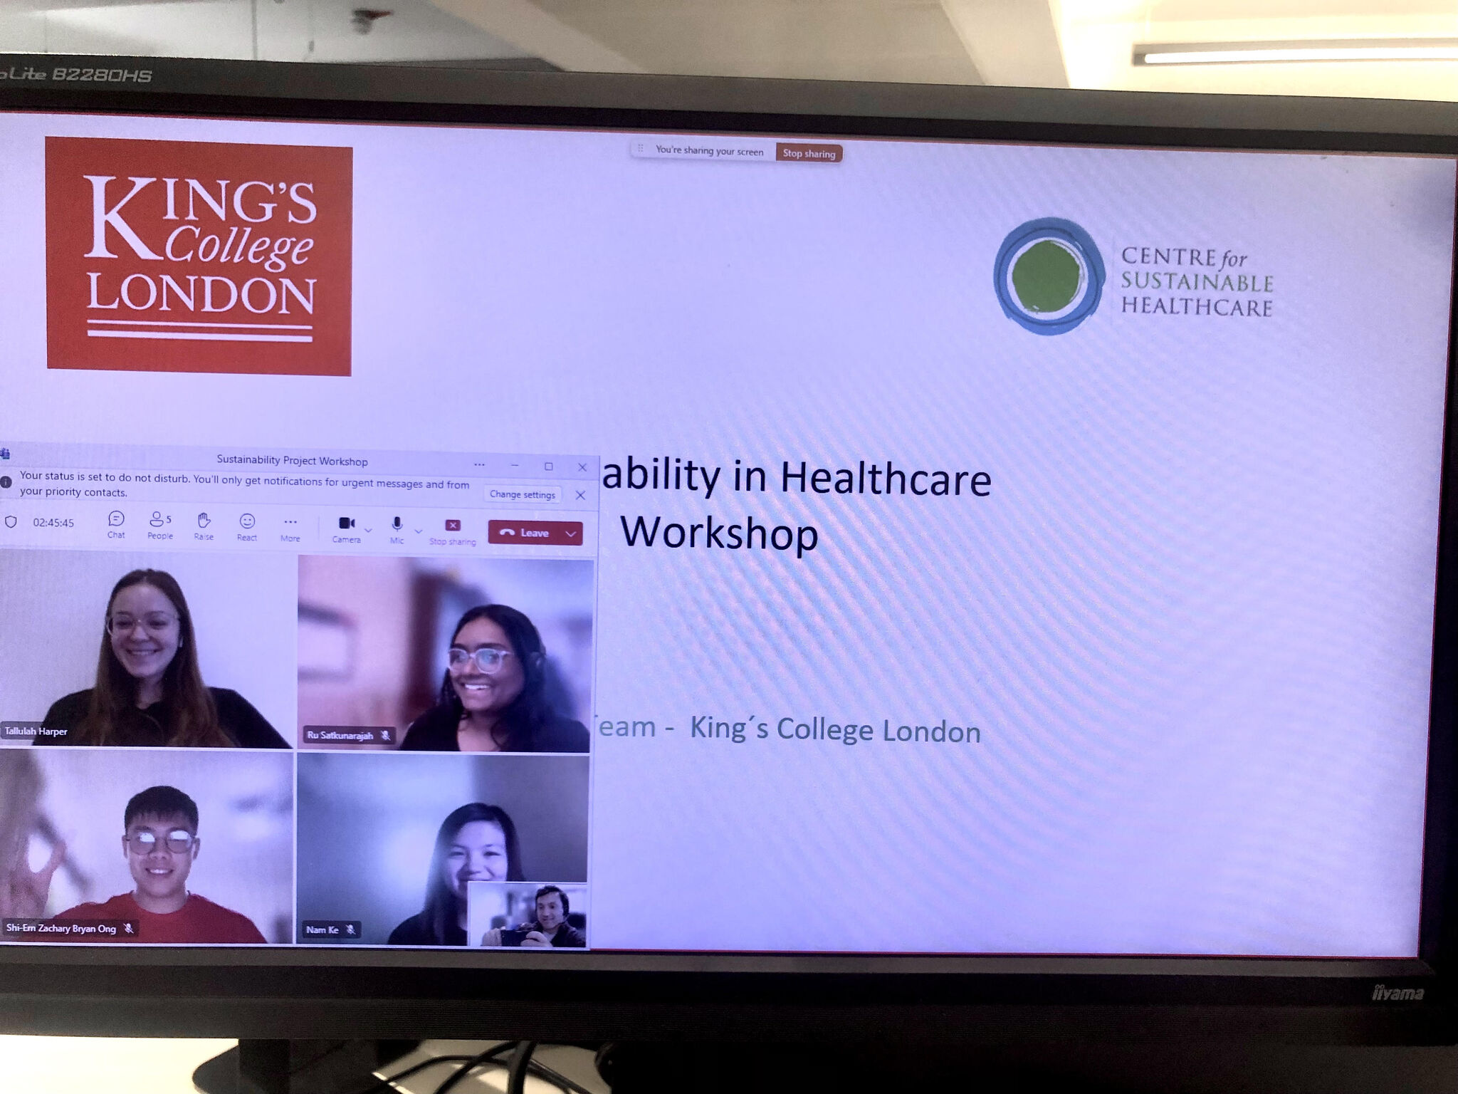
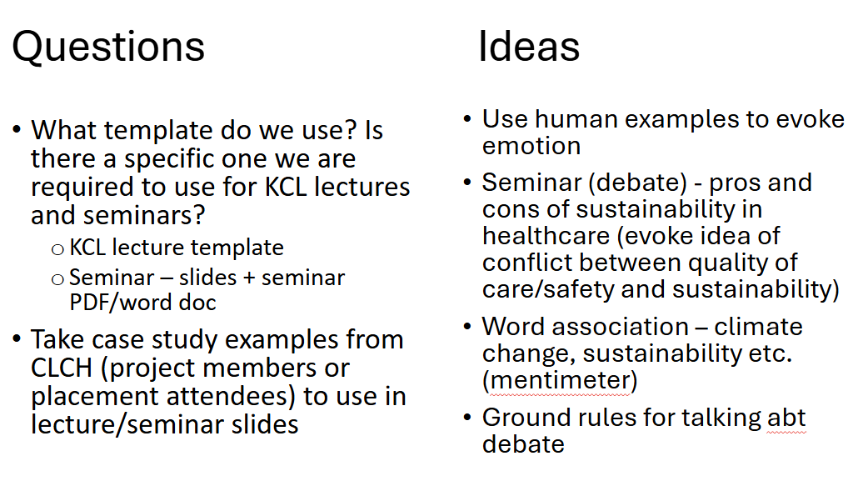
Content co-production
Scoping resources
Meetings to share resources, ideas
Backward design
Learning Outcomes
Content
Delivery

Slide 12
Progress – content creation
Learning Outcome Number | Lecture Learning Outcomes
1 | Define the concept of environmental sustainability in healthcare and describe the health impacts of climate change.
2 | Describe the different types of environmental impact resulting from healthcare provision, including physiotherapy examples (i.e. inhalers, walking aids, self-referral, MDT meetings).
3 | Identify previous sustainability initiatives and ways to improve the environmental sustainability of health systems – in individual practice and health service management.
4 | Identify ways to improve environmental sustainability as physiotherapists/student physiotherapists.
Learning Outcome Number | Seminar Learning Outcomes
1 | 1. Discuss the healthcare and environmental impacts of sustainable clinical practice in a specific physiotherapy example
2 | 2. Discuss ways to improve the environmental sustainability of health system in individual practice (as physiotherapist/students) and health service management.
3 | 3. Engage in respectful, diverse, and inclusive conversations, acknowledging the significance of compassionate care and eco-anxiety

Slide 13
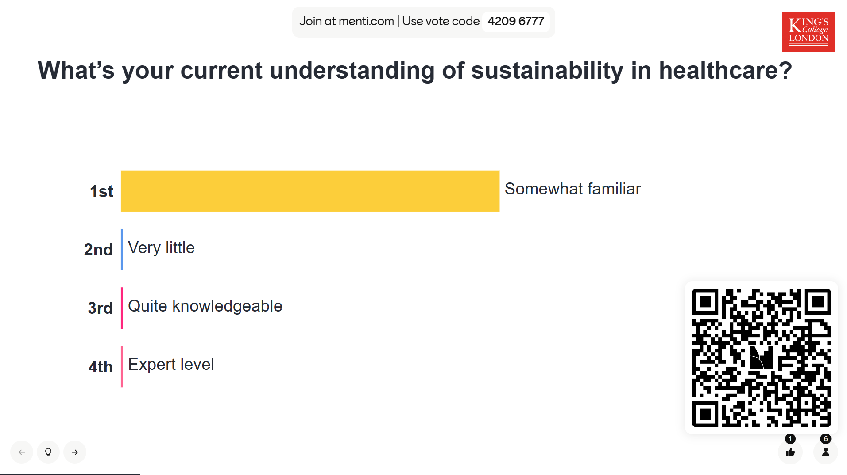
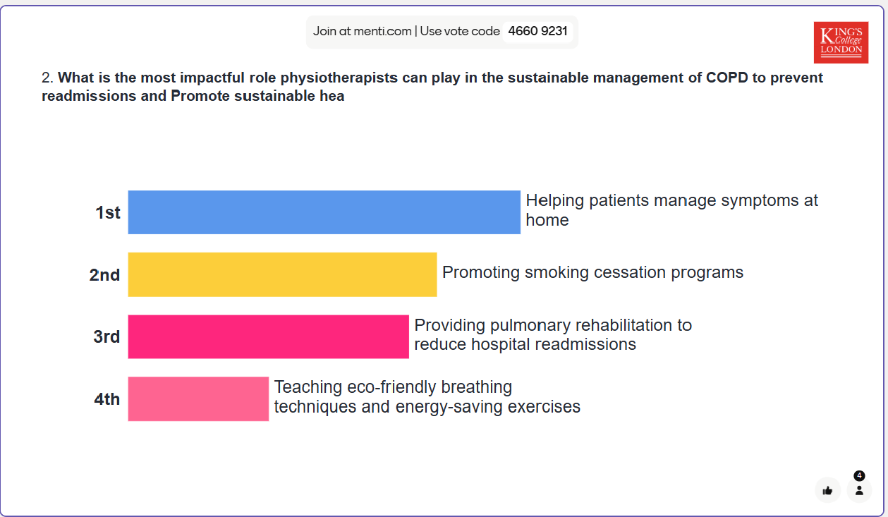
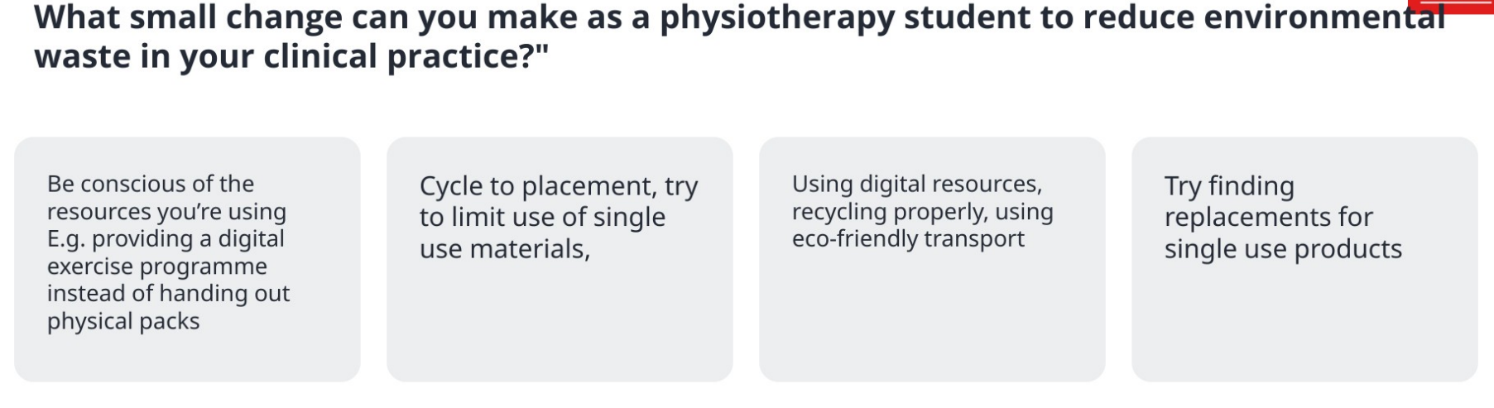
Implementation – lecture & seminar

Slide 14
Evaluation
Survey and focus groups to examine students’ understanding of sustainability and their preparedness to engage with sustainability and to influence change during placements and in practice
Evaluation before and after placements in summer and autumn 2026
Themes to explore
Knowledge of Sustainable Healthcare in Physiotherapy Practice
Confidence
I am likely to ask questions about sustainable healthcare and physiotherapy practice during my placement
      I am likely to take action to reduce the environmental impact of physiotherapy practice during my placement
Attitude and applied value
    It’s important to me to take action to reduce carbon emission in my practice placements
Placement Experience

Slide 15
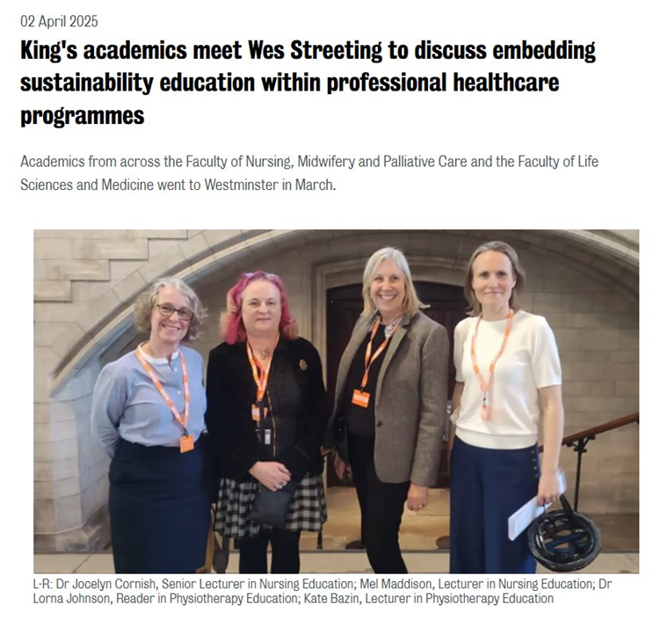
Impact
Staff
Increased knowledge and understanding
Networking opportunities
Enhanced curricula – contemporary & authentic
Additional Placement capacity
Student Partners
Developed skills in collaboration and co-creation of teaching content
Hospital visits offered insight into real-world sustainability practices in healthcare
Understood the behind-the-scenes work involved in sustainable service delivery
Encouraged more critical thinking around sustainability in both physiotherapy education and clinical practice
Carrying Sustainability into Placement: Upper Limb Rehab at RNOH
“This project made me more mindful of small choices , like when to give out exercise bands, or how towels are used in hydrotherapy and how they impact sustainability in clinical settings.”

Slide 16

Next steps
Complete evaluation
Sustainable placements summer 2026
Develop additional resources for seminars and workshops
Embed in later stage of curricula to include quality improvement projects

Slide 17
Thank you
Acknowledgements
King’s – Dr Stewart Morrison & Roberto Vergara
King’s Academy – Dr Mira Vogel
SUSQI Academy – Catherine Richards
CLCH Community Trust – Harry Brackley
Student partners: Cheryl Ke (BSc year 2); Zachary Ong (BSc year 3); Ru Satkunarajah (MSc year 2); Talullah Harper (MSc year 2)
MSc students who completed elevator pitches – Chi Chen, Daisy Faithful, Matthew Hanselman & Irena Cashman
Resources
Education for sustainable healthcare within UK pre-registration curricula for allied health professions: Council of Deans 2023 https://www.councilofdeans.org.uk/wp-content/uploads/2023/12/ES-curricula-guidance-CoDH-version_SM-final-no-links.pdf
Centre for Sustainable Healthcare Networks: https://networks.sustainablehealthcare.org.uk/
Delivering a ‘Net Zero’ National Health Service B1728-delivering-a-net-zero-nhs-july-2022.pdf

