Slide 1
Capital AHP Fair Share Communication Principles for Practice-based Learning (PBL): development, implementation and evaluation
Victoria Jackson & Wendy Casterton (NHS placement-provider organisation representatives)
Lorna Johnson & Rachel Chan (HEI representatives)
Ellie Melkuhn & Laura Smith (CapitalAHP representatives)

Slide 2





Collaboration in action: Principle 13 ‘Active engagement in networking and collaboration opportunities is encouraged to sustain and improve quality and build capacity’.

Slide 3
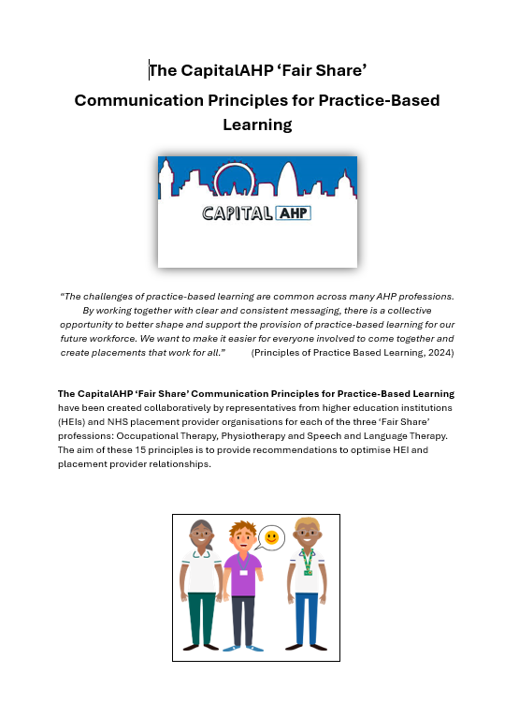
Session outline
Background
Aims
Communication principles
Digital engagement - evaluation
Challenges

Slide 4
Background
The Capital AHP Fair Share model for Practice Placements
designed to provide placement providers with a benchmark for placement offer numbers to support strategic planning for placements across the sector
Launched in 2021
Updated in 2024
Uncertainty and lack of clarity with implementation
The Communication Principles for PBL
aim to support Allied Health profession (AHP) education through recommendations to optimise HEI and placement provider relationships that enhance high quality placement capacity provision using the Capital AHP Fairshare model

Slide 5

Developing the Guiding Principles
Collaborative approach
Communications working group (NHS providers, HEIs representing three Fairshare professions (OT, SLT & PT)
Stakeholder consultation (on-line, in-person)
Identified:
Communication issues
Need to future-proof to avoid single point of failure

Slide 6
Communication issues
Key Issues
Contact issues
Changing AHP workforce
Lack of visibility or access
Process issues

Slide 7
Scoping of alternative communication options
?
Community of practice
Broadcast only WhatsApp
Utilise PMP to best effect
Directory of contacts
Principles
Document
Digital Platform to host resources

Slide 8
Communication Principles
Placement contact information should be simplified to ensure clear lines of communication between HEIs and placement provider organisations.
Active engagement in networking and collaboration opportunities is encouraged to sustain and improve quality and build capacity.
All learners should be provided with a named point of contact on placement to raise any placement-related concerns.
Identified points of contact should be established for Student Data Collection Tool (SDCT) processes.
Placement providers and HEIs must adhere to General Data Protection Regulation (GDPR) principles when handling learner-related information.
Placement evaluation information should be shared regularly.
Clinical or link tutor meetings are essential for placements.
Early identification of placement-related issues is essential.
Clear communication between HEIs and placement providers is expected during placements.
Learners should be empowered to share any relevant information that may affect their learning during placement.
Allocated placements should not be cancelled.
Unused placement offers should be managed effectively.
Learners should be informed of their named practice educator following allocation.
Timely placement allocation with named contacts is advocated.
Accurate and relevant information should be maintained on collaborative placement platforms, to facilitate effective communication pathways.

Slide 9

Communication Principles
15 ‘Communication Principles’ were launched in September 2025 with an accompanying video Capital AHP FairShare Communication Principles Comms video aimed at improving engagement.

Slide 10

Access & Engagement
6 Regional Engagement events
MS Form – 14 responses
Capital AHP Futures Page
YouTube video – 149 views
‘I am a fairly new placement lead (one year in) and I have come from clinical practice so have no experience of the placement process to fall back on. This piece of work helps me understand what is needed and helps solidify what I am doing well, and not so well. As these are best practice guidelines offering a standardised approach, I am sure everyone will benefit immensely and hopefully result in making the whole process more streamlined’.
(Placement Lead, London HEI)

Slide 11
Challenges & Opportunities
Challenges | Opportunities
Dissemination - identifying an easily accessible platform Changing landscape - workforce Increasing number of providers (HEIs) | Social media Scope for national review +/- application Scale-up for other AHP professions Larger scale guidance document

Slide 12


Acknowledgements

