Slide 1



Discover AHP Careers - Developing age-appropriate digital resources to promote AHP Careers
Lucy Dempsey – AHP UG Education lead Charlene Walters – Clinical Lead PT Vivienne Tan – Head of Therapies Shuhana Sharmin – Careers Coorindator Marnie Worthington – Physiotherapy Student Michael Olatunji – Physiotherapy Student T-Level Media Students – Waltham Forest College

Slide 2
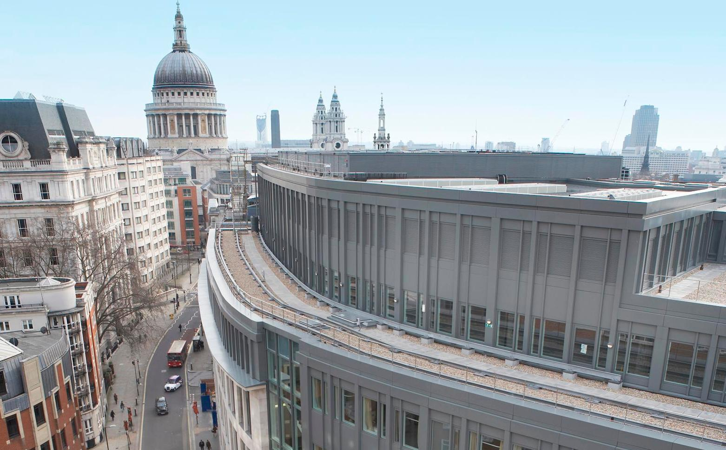
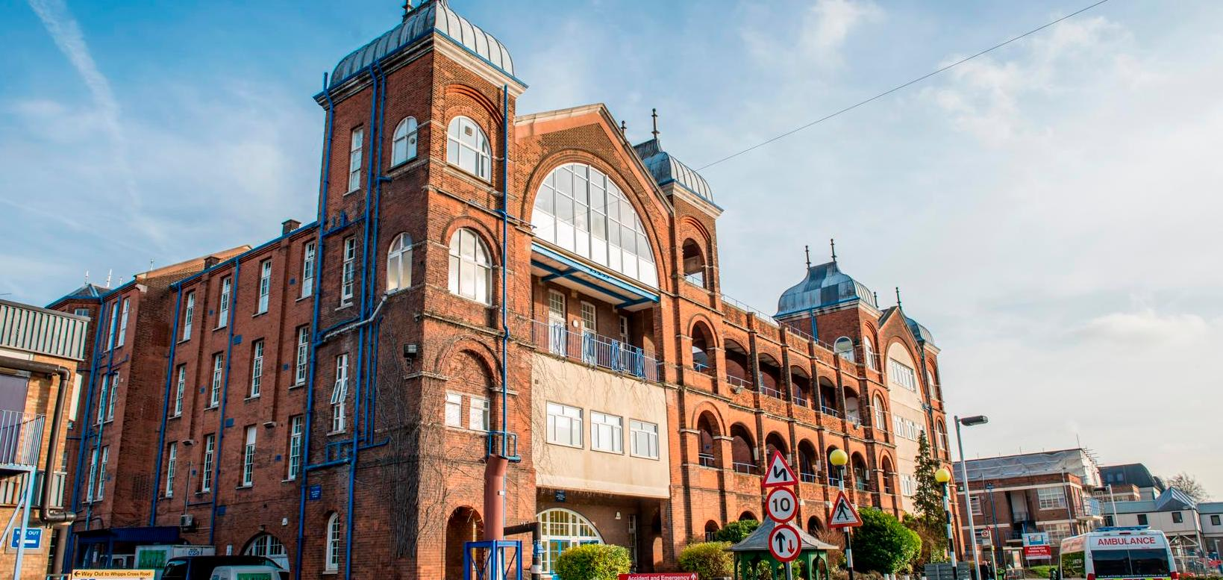
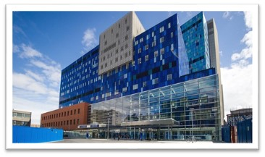
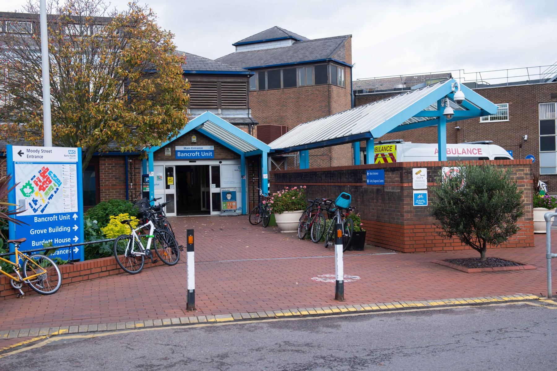
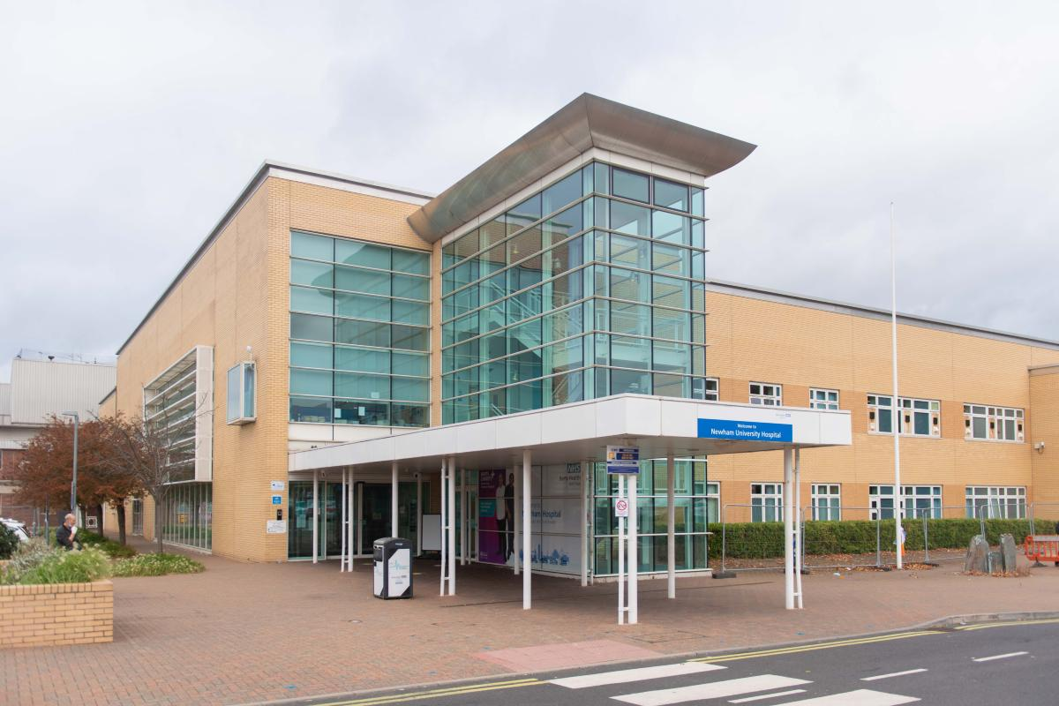
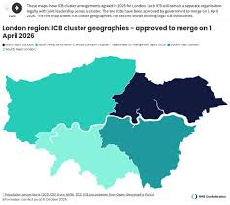
Barts Health NHS Trust
Large acute/ community trust North East London
5 Hospital sites
>20,000 staff
10 AHP professions
Highly diverse, densely populated and socially varied region
Boroughs of Newham and Tower Hamlets are among top 20% most deprived in England
North East London: People and Culture Strategy 2024 – 2028
State of the Sector Report 2025 – NEL VCFSE Collaborative August 2025

Slide 3


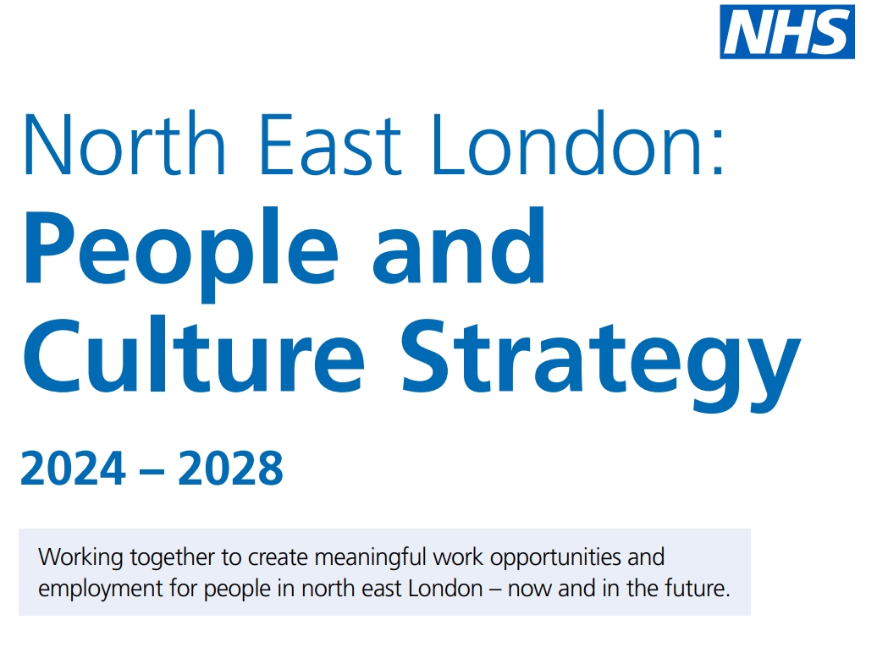


Drivers
Notes:
Within our AHP community we see racial inequality in the underrepresentation of minority ethnicities in our AHP workforce, particularly in decision-making and leadership positions, (13% of AHP are from an ethnic minority background, with their representation ranging from 6.8% to 23.5% for the individual allied health professions.) At senior levels representation is as follows: Band 8c: 8%; Band 8d:12%; Band 9: 17% (August, 2021) as well as educational attainment gaps for AHP students

Slide 4

Healthcare Horizons
Career Events
Parents Engagement
Work Experience
Online Mentoring
Virtual Work Experience Platform
Widening Participation programme
The aim
Address the determinants of health
Engage school and college students in careers
To provide bridges to jobs and training.
37 schools and colleges across NEL

Slide 5
Project Idea
Build resources for AHPs to engage with HH programmes to promote AHP Careers
Utilise leadership practice-based learning opportunity to support
Link with ongoing AHP work experience workstream
Hold resources in centralised, accessible platform for sustainable use

Slide 6
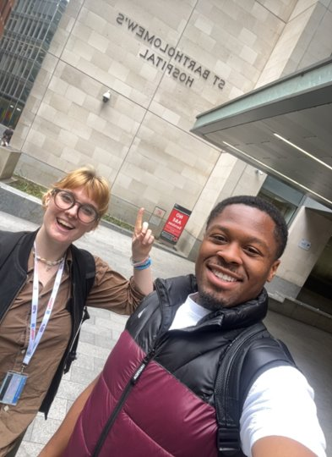
Leadership Placement
Two final year Physiotherapy students from UEL x 6 weeks
Supported by AHP Undergraduate Education Team + Healthcare Horizons
Aims of Placement
Scope awareness of AHP careers amongst local young people in NEL
To develop resources for Barts Health AHPs to promote careers to support widening participation and increase awareness of small and vulnerable professions

Slide 7
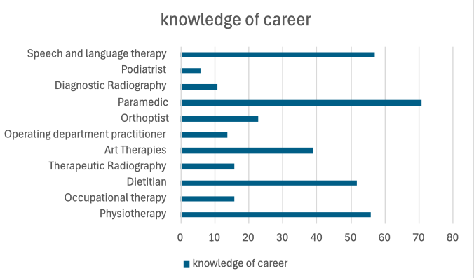
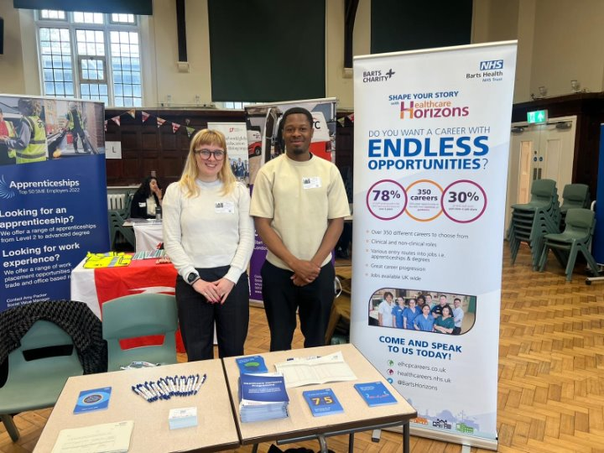
Initial Scoping
Surveyed 100 students Year 7-10 on their awareness of AHP Careers

Slide 8
Resource Development
Utilise AI to generate posters
Record podcast with each AHP group
Develop digital resource accessible via QR code
Consider sustainability of resource

Slide 9
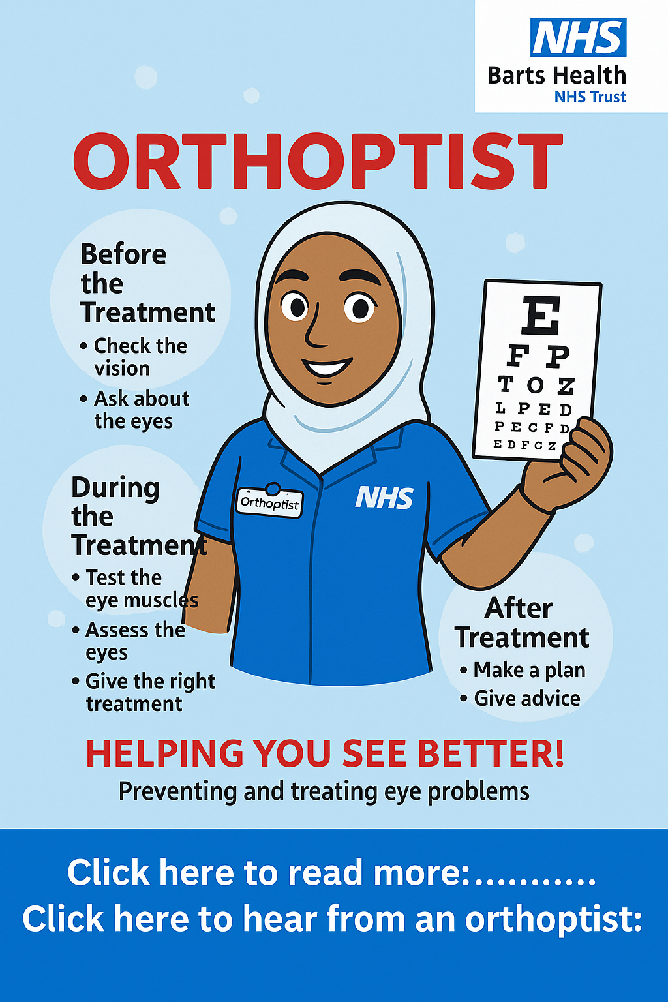
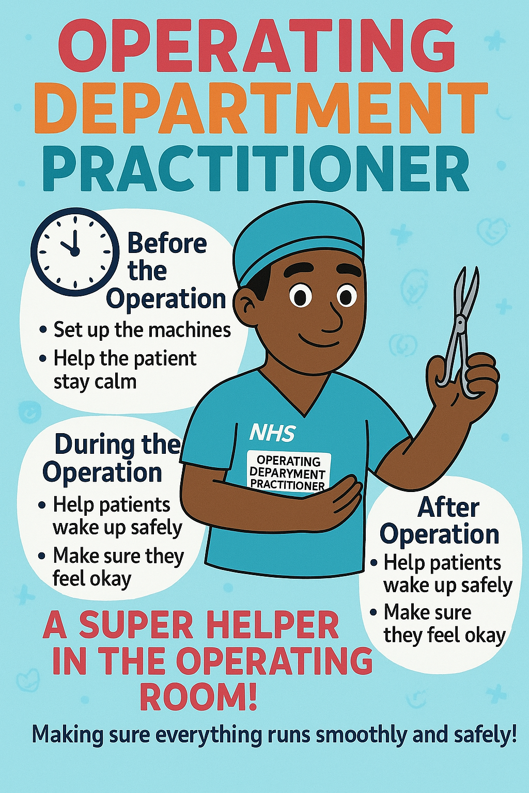
Posters
Diverse and Inclusive
Limited information
Bright and eye catching
No clinical terminology
Ability to reuse with careers events

Slide 10

Podcasts
Used the most asked questions from the careers event
Gave the AHPs flexibility to speak around the questions
Differing lengths of time for each podcast
A podcast for each AHP plus extras
Non-clinical terminology

Slide 11


Final Resource
Easy to use- whole resource
Available through QR code ​
Eye catching and simple

Slide 12



Slide 13
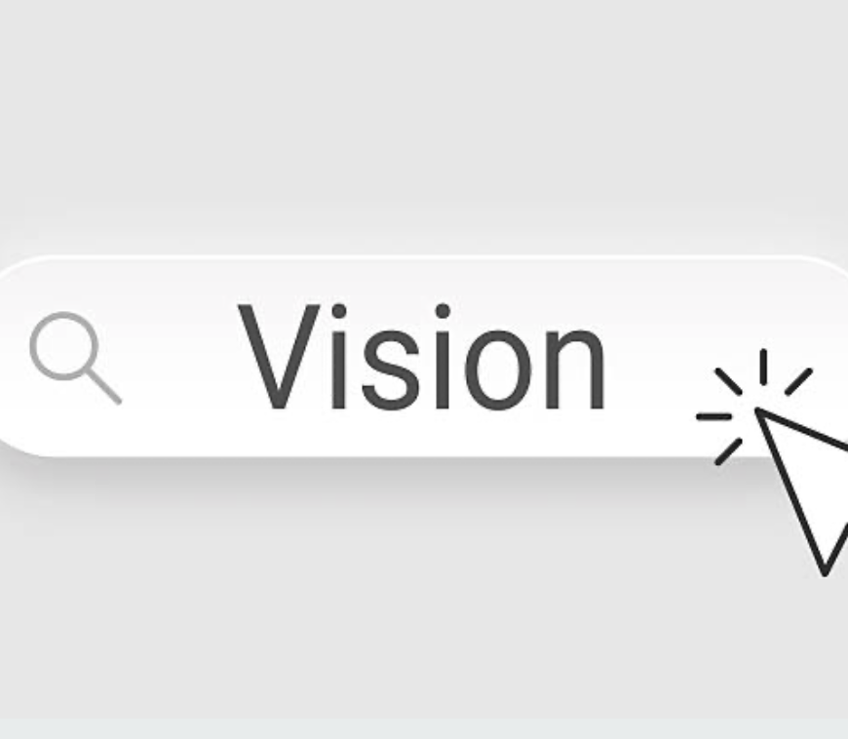
Work Experience Project
To create a comprehensive and inclusive work experience program across Barts Health NHS Trust that offers opportunities for aspiring Allied Health Professionals. Aim to provide diverse experiences across various specialties to inspire and cultivate the next generation of AHPs

Slide 14
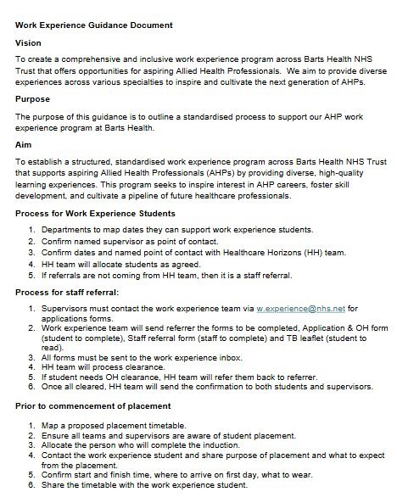




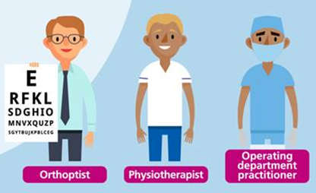
Guidance document produced
Supported 10 students

Slide 15

Comments
Please pass on my sincere thanks to all the staff I had the pleasure of spending time with during my work experience placement last week.
This experience has truly helped confirm my decision to study physiotherapy, and I found it incredibly valuable. The team was patient, knowledgeable, and welcoming, and I’m very grateful for the opportunity to learn from them.
Thank you once again for arranging such a meaningful placement
Thank you so much. As a parent, I feel that xxx has been able to make a truly informed choice after her work experience placement. I wanted to pass on my heartfelt thanks to all the staff who supported and facilitated this opportunity for her.
It was an invaluable experience for xxx as a young person, and she gained so much from it.

Slide 16
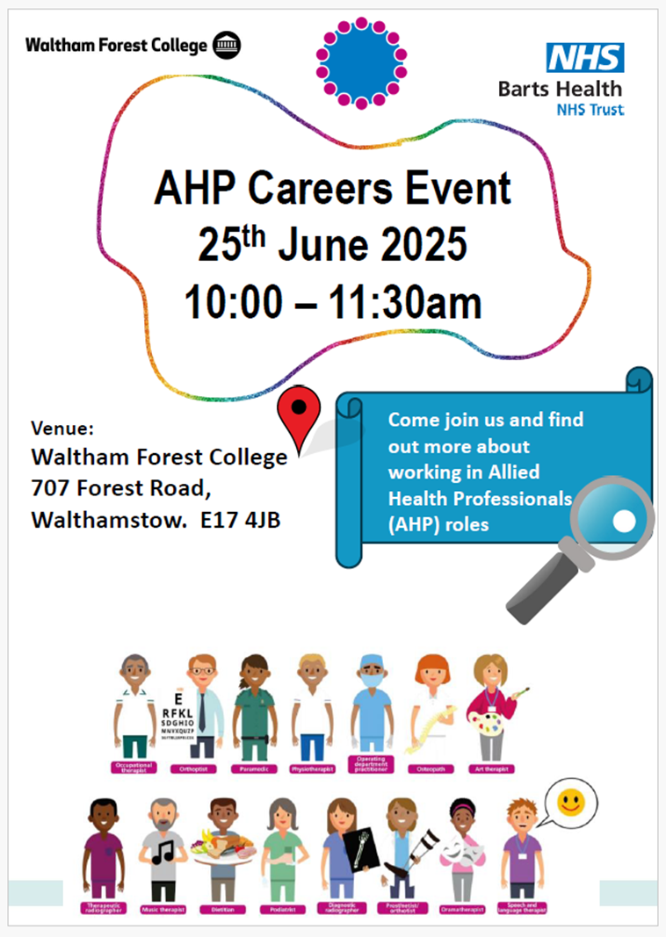

Slide 17
Waltham Forest College
Video produced in collaboration with Media Students
1 representative from each profession attended Waltham Forest College
Outline profession
Their role
What a typical day looks like
NHS T LEVEL Project.mp4

Slide 18
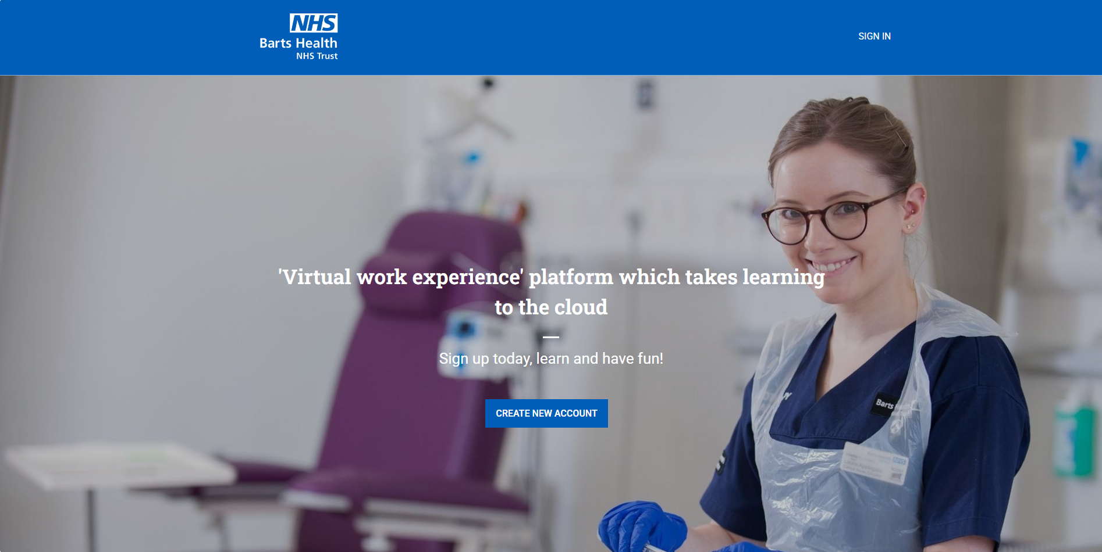
https://healthcarehorizons.thinkific.com

Slide 19
Thank you

