Slide 1


An examination of Forum theatre and computer-based simulation on the recognition and response to clinical scenarios among undergraduate nursing students.
Dr Nita Muir, James Wilson, Dr Carla Rue, Dr Chris Vine.
6/3/26
National Association of Educators in Practice

Slide 2
What do we know: Simulation based learning
Simulation is defined by us an artificial representation of a real-world practice scenario that supports student development and assessment through experiential learning with the opportunity for repetition, feedback, evaluation and reflection. Effective simulation facilitates safety by enhancing knowledge, behaviours and skills (NMC, 2019)
Develop student knowledge, skills and behaviour | Safe learning environment
Enhance Placement Capacity | Enable better preparation for clinical practice
Daneshfar & Moonaghi, 2025

Slide 3

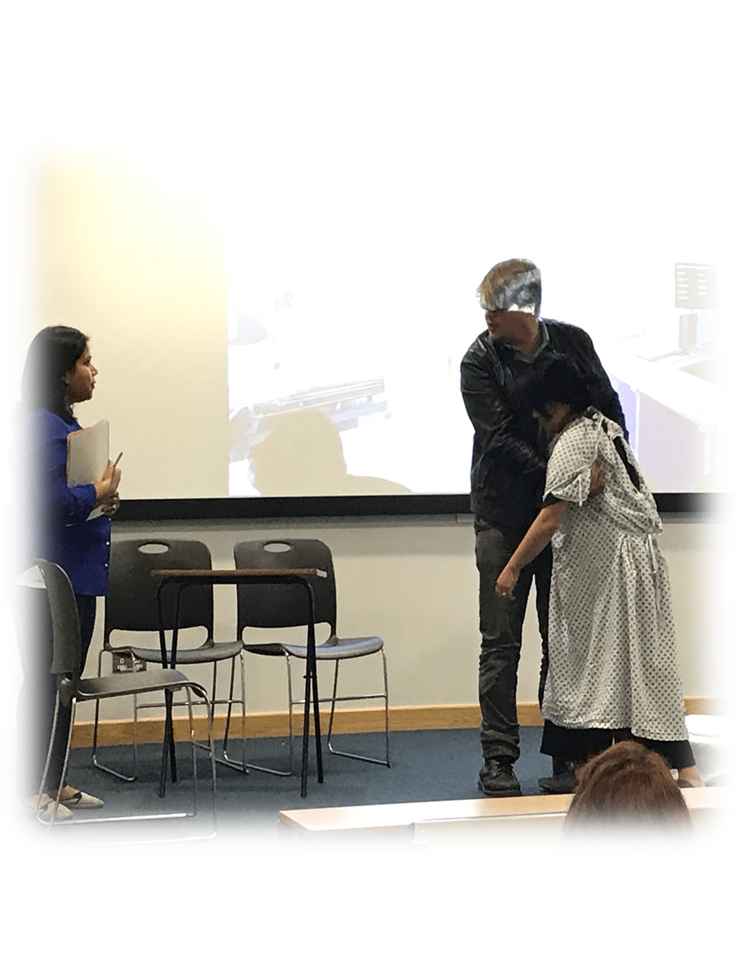


Forum theatre
Problem based learning approach
Students surround actors
Students engage in active scenario’s, exploring different alternative action (stop/start)
Collaborate in evaluation of outcomes

Slide 4
Which Modality?
Forum theatre is an interactive and participatory theatre method. Blends experiential learning, communication training and problem solving in a safe environment
Facilitated by expert faculty
Replicates patient scenario’s through use of actors
Students prepared for entry
Student debrief after exposure
Student participation is expected
Virtual learning accessed via the computers using computer generated models and screen based interface
Present virtual patient scenario's that replicate decision making, procedural experience in digital format
Minimum facilitation
Pre and post briefing integral in software
Provides flexible, scalable opportunities
Strengthen clinical reasoning and recognition skills.
Goodwin, B., & Nestel, D. (2024). Demystifying simulators for educators in healthcare. International Journal of Healthcare Simulation. https://doi.org/10.54531/muif5353

Slide 5
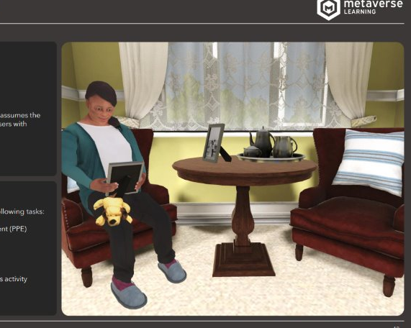
Scenario
The student takes the role of the carer in a care home supporting one of the elderly service users with Alzheimer’s disease to prepare for the day.
Student is required to undertake the following tasks;
Receive the briefing of the condition of the service user
Communicate effectively with the service user
Observe and offer appropriate support
Take the service user to the location of the days activity
Update care note

Slide 6
Examine the impact of two pedagogical approaches, a computer- and manikin-based simulation, on undergraduate nursing students learning outcomes: Facilitated high fidelity simulations vs virtual learning approaches.
The aim of the study to assess impact of two pedagogic approaches on:
Knowledge acquisition.
Task workload – key to understanding how students can perform confidently under pressure
Self-efficacy – Self-efficacy is an individual’s belief in their ability to successfully execute actions required to achieve specific outcomes.

Slide 7
Overview
Methods:
A randomised crossover design was employed with undergraduate nursing students (n = 21).
Participants completed two matched simulation scenarios depicting a care home scenario
One scenario was delivered as a pre-recorded, computer-based simulation, and the other as forum theatre
Both modalities were identical in content and decision-making requirements.

Slide 8
Self‑Efficacy Scale: Challenging Malignant Social Acts
Participants rate their confidence (0–100) in recognising and addressing harmful interactions in dementia care – 100 = Highly certain they can do this
Recognist harmful behaviours (Malignant social acts):
Infantilisation (e.g., babytalk, patronising language)
Ignoring the person or excluding them from conversation
Labelling or depersonalising language
Task focused or objectifying care
Outpacing (communicating too fast)
Withholding choice or autonomy
Treating the person passively during personal care
Respond constructively
Challenging inappropriate language respectfully
Ensuring inclusion and personhood
Adapting communication
Supporting decision making
Providing affirming, person-centred care
Appropriate reflections
Recognising emotional impact of malignant interactions
Reflecting on one's own communication, tone, and body language

Slide 9
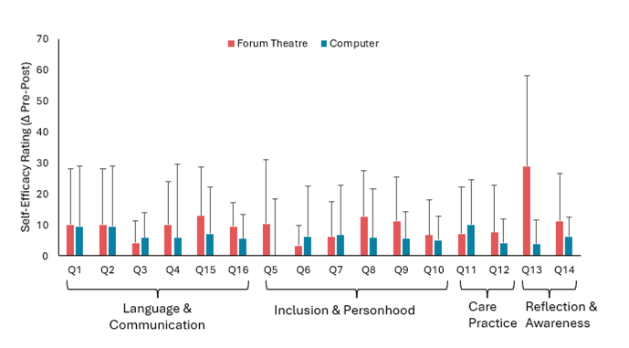
Notes:
For self-efficacy, the scale reflects the change in scores from pre- to post-condition. That’s why there is one bar per condition rather than separate pre and post bars. For example, if someone rated their self-efficacy as 70 before and 80 after, their score would be +10.

Slide 10
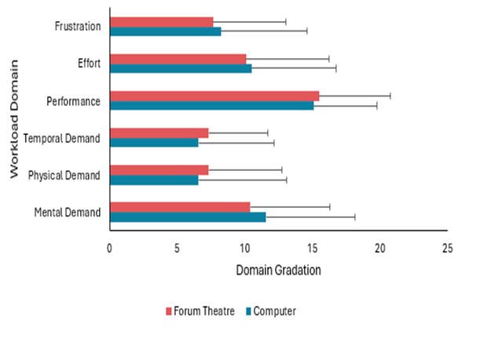
NASATLX Workload Assessment
Participants rate the perceived workload of the session (1–21) across:
Mental demand
Physical demand
Time pressure
Performance
Effort
Frustration
This provides insight into cognitive load and task difficulty.
Notes:
Workload, however, was rated once per simulation (post-condition only), so those bars represent the actual scores rather than a change score.

Slide 11
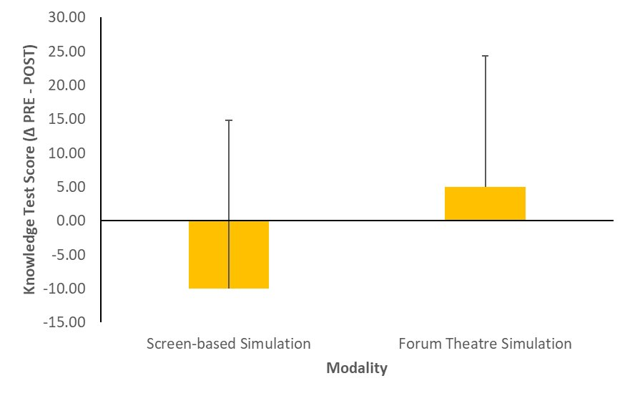
Knowledge Check Questions: Dementia care This one doesn’t come across great, this is due to the small n for each group. For the screen-based simulation 10/12 participants had no knowledge change, but 2 participants had huge decreases (-40 and –80%).
Knowledge Check: Dementia Care
Multiple choice questions assessing understanding of:
The purpose of Kitwood’s theory of personhood
Identification of infantilisation
Definition of objectification
Examples of labelling and withholding
Best ways to challenge malignant social acts (person-centred alternatives)
Notes:
For self-efficacy, the scale reflects the change in scores from pre- to post-condition. That’s why there is one bar per condition rather than separate pre and post bars. For example, if someone rated their self-efficacy as 70 before and 80 after, their score would be +10. The same approach is used for knowledge. The delta (Δ) symbol on the axis indicates change, which is a standard way of presenting this type of dat

Slide 12
Key findings
Knowledge acquisition between two modalities indicates either approach can be used to achieve learning outcomes, however small sample size
Similarities in self-efficacy scores and similarities in individual task workload domains
Therefore, both are broadly effective pedogeological teaching methods, offering flexibility to select or combine approached based on context resources and learner preferences.

Slide 13
Recommendation
Educators need to select simulation modalities based on institutional resource AND learner needs.
Virtual learning is scalable for larger groups, is resource efficient requires less faculty staff and equipment without compromising educational impact.
Explore the best combination of simulation tools based on different learning outcomes.

