Slide 1


An examination of a standard facilitated manikin-based simulation and computer-based simulation on the recognition and response to clinical scenarios among undergraduate nursing students.
Dr Nita Muir, Dr Carla Rue, Dr Chris Vine.
6/3/26
National Association of Educators in Practice

Slide 2
What do we know: Simulation based learning
Simulation is defined by us an artificial representation of a real-world practice scenario that supports student development and assessment through experiential learning with the opportunity for repetition, feedback, evaluation and reflection. Effective simulation facilitates safety by enhancing knowledge, behaviours and skills (NMC, 2019)
Develop student knowledge, skills and behaviour | Safe learning environment
Enhance Placement Capacity | Enable better preparation for clinical practice
Daneshfar & Moonaghi, 2025

Slide 3
Which Modality?
Immersive, high fidelity, manikin based simulation.
Facilitated by expert faculty
Uses programmable robotic manikin simulators
Replicates clinical scenario's
Students prepared for entry
Student debrief after exposure
Provides hand-on experiential realism essential for psychomotor and teamwork competencies
Virtual learning accessed via the computers using computer generated models and screen based interface
Present virtual patient scenario's that replicate decision making, procedural experience in digital format
Minimum facilitation
Pre and post briefing integral in software
Provides flexible, scalable opportunities
Strengthen clinical reasoning and recognition skills.
Goodwin, B., & Nestel, D. (2024). Demystifying simulators for educators in healthcare. International Journal of Healthcare Simulation. https://doi.org/10.54531/muif5353

Slide 4
What do we know: Educational impact of virtual simulations
Virtual simulations can:
Increase student engagement
Build confidence
Flexible (can be done asynchronously)
Increase competence
Encourage reflection during and post debriefing
Virtual simulation is an effective strategy for improving knowledge and confidence in recognizing and responding to the rapidly deteriorating patient among undergraduate nursing students.
Notes:
Nita

Slide 5
Examine the impact of two pedagogical approaches, a computer- and manikin-based simulation, on undergraduate nursing students learning outcomes: Facilitated high fidelity simulations vs virtual learning approaches.
The aim of the study to assess impact of two pedagogic approaches on:
Knowledge acquisition.
Task workload – key to understanding how students can perform confidently under pressure
Self-efficacy – Self-efficacy is an individual’s belief in their ability to successfully execute actions required to achieve specific outcomes. Studies have shown a strong association between self-efficacy and self-regulation.+
Heart Rate Variability – a physiological marker of self-regulatory capacity
In the management of a simulated diabetic emergency.
+Caprara, G. V., Fida, R., Vecchione, M., Del Bove, G., Vecchio, G. M., Barbaranelli, C., & Bandura, A. (2008). Longitudinal analysis of the role of perceived self-efficacy for self-regulated learning in academic continuance and achievement. Journal of Educational Psychology, 100(3), 525–534. https://doi.org/10.1037/0022-0663.100.3.525

Slide 6
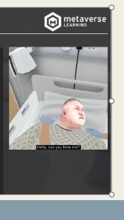
Scenario
Student to assess a 52-year-old man recovering from a right inguinal hernia repair experiencing a grand mal seizure.
He is hypoglycaemic and has a history of hypoglycaemic fits needing airway support. After receiving 50g IV glucose, his consciousness improves. Without checking the blood sugar, he risks repeated seizures.
Task:
Apply ABCDE approach to patient assessment,
Initiate a care plan based on the assessment

Slide 7
Overview
Methods:
A randomised crossover design was employed with undergraduate nursing students (n = 21).
Participants completed two matched simulation scenarios depicting the management of a patient experiencing a diabetic emergency.
One scenario was delivered as a pre-recorded, computer-based simulation, and the other as a facilitated, interactive manikin-based simulation.
Both modalities were identical in clinical content and decision-making requirements.

Slide 8
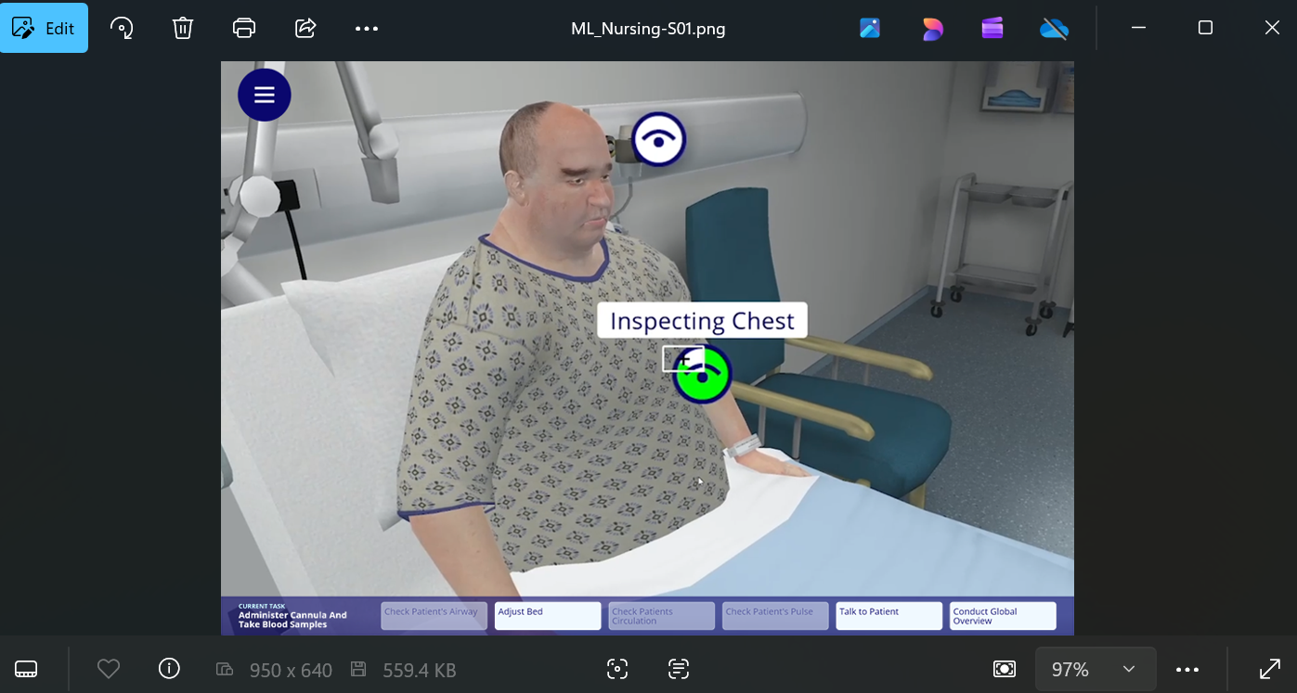
Screen Based Scenario

Slide 9
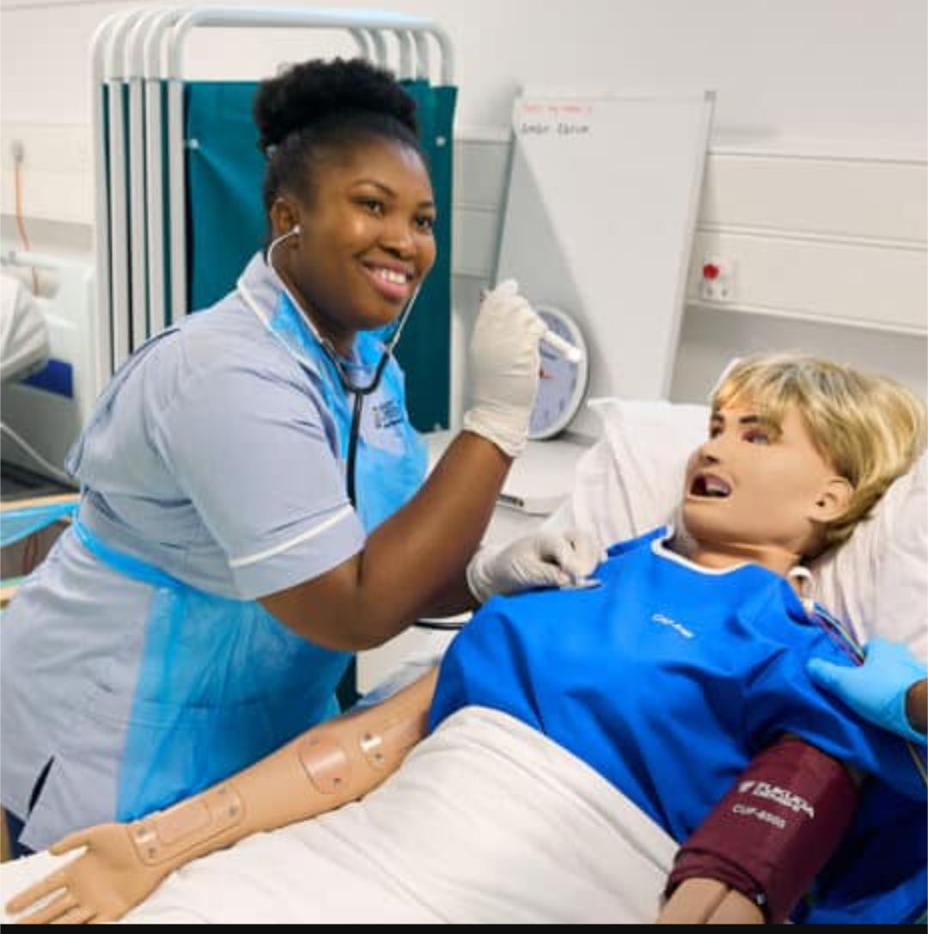
Mannikin based scenario
Using a high-fidelity robotic manikin (CAE, Juno), participants engaged in an interactive manikin-based simulation covering the same clinical scenario and decision-making skills as the computer-based simulation. Scripted cues, physiological changes, and manikin responses were preset and standardised for the four groups.

Slide 10
Self‑Efficacy Scale: Diabetic Emergency
Participants rate their confidence (0–100) on a range of clinical skills, including:
Identifying and responding to absent pulse or breathing.
Recognising low blood pressure.
Identifying and treating hypoglycaemia.
Using ACVPU and checking blood glucose with a glucometer.
Administering oral glucose.
Monitoring patients after hypoglycaemia.
Recognising and managing airway obstruction.
Conducting an A–E assessment
0 = Cannot do at all
50 = Moderately certain can do
100 = Highly certain can do

Slide 11
Cardiac Assessment & Response
Breathing Assessment & Response
Circulatory Assessment & Response
Hypoglycaemia Assessment & Response
Overall Clinical Assessment

Slide 12
NASA‑TLX Workload Assessment
Participant rates perceived workload (1–21 scale):
Example
Mental demand: 10
Physical demand: 1
Time pressure: 1
Performance success: 19
Effort: 5
Frustration: 1
Notes:
For self-efficacy, the scale reflects the change in scores from pre- to post-condition. That’s why there is one bar per condition rather than separate pre and post bars. For example, if someone rated their self-efficacy as 70 before and 80 after, their score would be +10. The same approach is used for knowledge. The delta (Δ) symbol on the axis indicates change, which is a standard way of presenting this type of dat

Slide 13
Knowledge Check Questions: Diabetic Emergency
Multiple choice questions
Priorities in A–E assessment for suspected hypoglycaemia.
Manual heart rate benefits.
Meaning of ACVPU.
Oxygen delivery choices based on saturations.
First action for airway obstruction.
Signs least associated with hypoglycaemia.
Meaning of SBAR in communication.

Slide 14
Key findings
Similarities in knowledge acquisition between two modalities indicates either approach can be used to achieve learning outcomes
The proposed link between self-efficacy and self-regulatory capacity as not reflected. Only the manikin based elicited significant changes in autonomic regulation. This suggest that in the short-term that this immersive experience enhances perceived confidence in ability whilst under strain.

Slide 15
Outcomes
Educators need to select simulation modalities based on institutional resource AND learner needs.
Virtual learning is scalable for larger groups, is resource efficient requires less faculty staff and equipment without compromising educational impact.
Manikin based facilitated simulation influences learner fatigue and accessibility but reflects the time-pressured, hands-on nature of real clinical taks.

