Slide 1




IMPPaCT MODEL
Innovative Model Promoting Patient/Person Centred Care In Care Homes Through Training/Education
By Priya Anand

Slide 2
ACKNOWLEDGEMENT
WY AHP Faculty
University of Bradford
Students from different AHP Professions
Care home managers and care staff members
Long arm supervisors from different AHP professions

Slide 3
What is an IMPPaCT Model?
Multi-professional initiative embedding student-led learning in care homes.
Co-developed by WY AHP Faculty and HEI’s in Yorkshire
Focuses on delivering education around Falls prevention and Malnutrition to care staff members

Slide 4

SUPPORTING RESEARCH
NICE guidelines (2025) emphasize falls prevention in older adults.
Contemporary research highlights integrated, community-oriented education models (Jackson et al., 2022; NHS England, 2019).
Multi-professional learning environments improve patient/person-centred outcomes and professional identity (Mohammed, Anand & Ummer, 2021).

Slide 5

OPERATIONAL STRUCTURE
PROJECT LEAD
STUDENTS
CARE HOME MANAGER
LONG ARM SUPERVISOR
3 stages of the model
Needs Analysis stage
Education delivery stage
Evaluation stage
½ a day a week
Support assessment paperwork and student support
Coordinating
Set up weekly check ins
Supporting training delivery content with students
On site supervision and support for managing care staff expectation

Slide 6

KEY FEATURES
PLACEMENT
Long arm supervision & Peer supervision
STUDENT
Hybrid working
Students co-create practical, evidence-based toolkits
SERVICE DEVELOPMENT
Project Lead guides discussions to align with learning outcomes.
CARE HOME
AHP visibility in community sector
Encourages shared responsibility for patient/person centred outcomes
Care staff Skill development & Retention
Helps meet CQC Targets for Care home
Aligns with NHS 3-shifts
Interprofessional collaboration
Reducing hospital admissions
Mitigates liability by avoiding resident involvement.
Different AHP profession perspective on clinical needs.

Slide 7

IMPLEMENTING PEER & LONG-ARM SUPERVISION
Peer Supervision:
Structured weekly reflective sessions among students.
Use peer learning logs for shared insights
Long-Arm Supervision:
Remote clinical oversight
Clear communication protocols for frequency and escalation.
Ensure integration with placement goals and competency requirements.

Slide 8

CHALLENGES AND PROPOSED SOLUTIONS
Barriers:
Aligning HEI academic calendars with care home schedules
Variable interest and hesitancy from care homes and students
Allocating care staff into training sessions
Solutions:
Proactive communication and stakeholder engagement
Simplify key messages and enhance interaction during training sessions
Use feedback mechanisms for continuous improvement

Slide 9
Does the model work? FEEDBACK ANALYSIS

Slide 10
QUANTITATIVE OUTCOMES FROM THE PILOT & JAN PLACEMENT
STUDENTS
Number of students completing placement- 6 (Pilot) + 7 ( Jan)
HOURS
Amount of placement hours gained across different professions- 1,050 hours ( Pilot) +1,650 ( Jan )
CARE STAFF
Number of care staff members trained- 30 (pilot) + 20 (Jan)
HEI
Number of HEI’s involved- 4
TRAINING SESSIONS
Number of training sessions delivered - 20

Slide 11
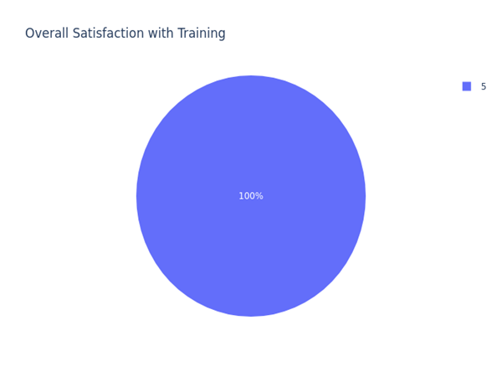
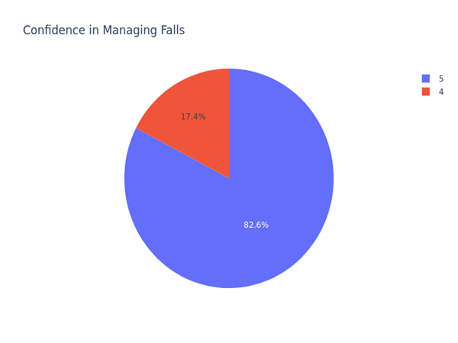
STAFF SATISFACTION AND CONFIDENCE LEVELS
Metric | High | Moderate | Low
Satisfaction | 100% | 0% | 0%
Confidence | 85% | 15% | 0%

Slide 12
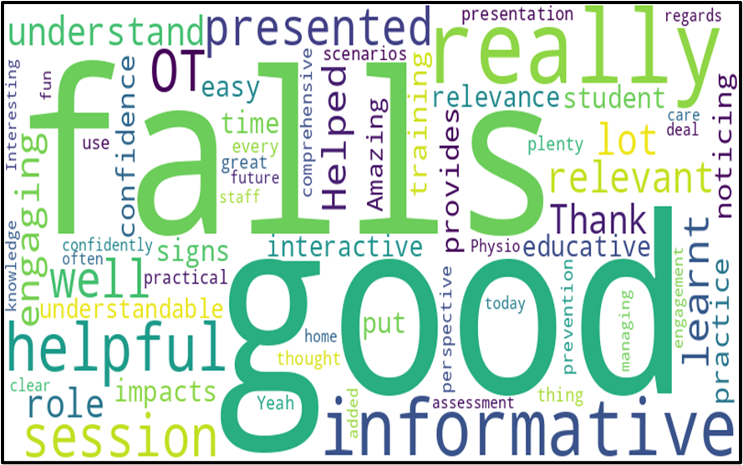
QUALITATIVE THEMES: CARE STAFF FEEDBACK
RELEVANCE
-Helped me understand the role of both OT and Physio regarding Falls assessment
-It was very good and well presented. Very relevant to our roles at the home as we deal with falls often.
CLARITY
-Very well presented and clear
-It was really understandable and good for me
CONFIDENCE
-Presented really well and confidently. Good fun too
-Very informative and easy to understand, provides me with confidence to put these into practice
ENGAGEMENT
-Very informative and engaging session
-Presented really well and confidently. Good fun too
PRACTICALITY
-Having such session would be very helpful in future too for care staff , it has helped me a lot today
-It was very helpful and informative. Amazing presentation
Notes:
Care staff reported sessions were relevant and practical.
Some of the key themes identified in the feedback were in regard to relevance of the awareness shared , clarity of info shared, confidence developed, engagement levels and practical value of training

Slide 13
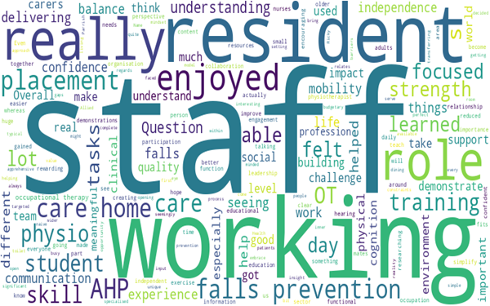
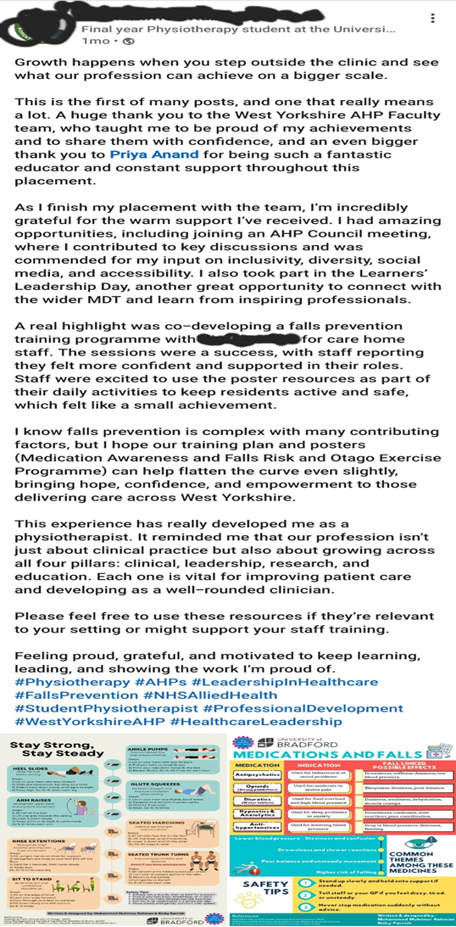
QUALITATIVE THEMES : STUDENT FEEDBACK
Confidence
Interprofessional Collaboration
Communication
Education
Leadership
Practical Experience
‘‘Really enjoyed this placement, helped me understand the roles of different healthcare professions’’
‘‘ Was able to identify the significant challenges the care staff members have when managing resident care and how we can contribute and support them in their roles’’
‘‘ Helped me develop education and researching skills, something which might be difficult in a clinical placement setting’’

Slide 14

FUTURE DIRECTIONS
Scaling Across Regions
Plans focus on expanding the IMPPaCT model's reach to multiple regions to broaden its impact in social care.
Integrating Additional Disciplines
Incorporating more AHP and healthcare disciplines will enhance mode’s comprehensiveness and collaboration.
Enhancing Digital Resources
Improving digital tools supports remote learning and accessibility for wider audiences.
Integrating Research
Collating data on impact on staff retention, student confidence ,falls prevention in care homes and hospital admissions to help with research data collection

Slide 15
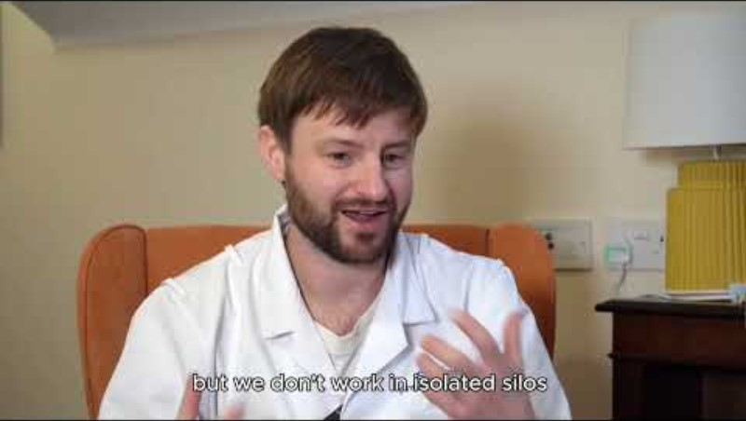
IMPPaCT Model - Video
Video Link: https://www.youtube.com/watch?v=pUXs316LhI4

Slide 16
References
Jackson, S., Roberts, C. and Sarah, D. (2022). Evidence-based Handbook to Practice Placements for Allied Health Professionals Evidence-based Handbook to Practice Placements for Allied Health Professionals. [online] Available at: https://www.hee.nhs.uk/sites/default/files/documents/Evidence-based%20Handbook.pdf.(Accessed 21 August 2025)
Mohammed, C.A., ANAND, R. and Ummer, V.S. (2021). Interprofessional education (IPE): A framework for introducing teamwork and collaboration in health professions curriculum. Medical Journal Armed Forces India, [online] 77(1), pp.16–21. doi:https://doi.org/10.1016/j.mjafi.2021.01.012. (Accessed 21 August 2025)
National Health Service England (2019). NHS Long Term Plan. [online] NHS England. Available at: https://www.longtermplan.nhs.uk/ (Accessed 21 August 2025)
NICE (2025). Overview | Falls: Assessment and Prevention in Older People and in People 50 and over at Higher Risk | Guidance | NICE. [online] Nice.org.uk. Available at: https://www.nice.org.uk/guidance/ng249 (Accessed 21 August 2025)
NIHR (2024). Falls in Care homes : A brief for policymakers (online). Available at: https://arc-em.nihr.ac.uk/sites/default/files/uploads/downloads/Policy%20Brief%20-%20Falls%20in%20Care%20Homes%20A%20brief%20for%20Policymakers%202025_0.pdf ( Accessed on 21st August 2025)

