Slide 1



The International Care Collective Podcast
Samuel Elliott-Olechnowicz
Creator and Host
Senior Multi-Professional Practice Educator
University Hospitals Sussex NHS Foundation Trust
Contact:
Samuel.elliott@nhs.net or ICC@uhsussex.nhs.net

Slide 2
Learning Outcomes
Aims of todays session:
1
Understand the core purpose and scope of the ICC within the wider ecosystem.
2
Recognise and appreciate the contributions of diverse staff from international healthcare systems, understanding how their shared skills and knowledge enhance practice within the NHS.
3
Podcasting as a new way of teaching / educating learners.

Slide 3
What Is the International Care Collective?

Slide 4

What is the International Care Collective?
Notes:
Video Promotion

Slide 5

Podcast Overview
let's look at the podcast’s foundation.
🎯 Mission Statement
Whenever we speak about International Recruitment (IR) in the NHS, most of us will have the thought that this is for Nursing.
For the last 2 years, I have been leading on IR for AHP’s, Healthcare and Biomedical Scientists and most recently International Medical Graduates (IMG’s).
I wanted to give all professions a voice when it comes to IR.
🌍 Scope
Given the current climate across the globe, now is an important time for these amazing stories of sacrifice, resilience and importantly successes.
Staff from across the world not only help the NHS with staffing shortages but add immense value with their skills and knowledge in other healthcare systems.
How?
Innovation bids from #StayandThrive available for International recruitment and retention QI initiatives
Submissions chosen by #StayandThrive Team
To report back to the community of action on completion of project

Slide 6
Goals & Success Measures
Having established our mission, let's define how we measure success.
Podcast Goals
Exceed 500 subscribers within first year
Exceed 100+ Video Viewing / Audio Streaming Hours
Share the journey stories of staff from all professions joining the NHS from Overseas.
3936
Subscribers on YouTube
Target: 500
377.2
Video Viewing / Streaming Hours
Target: 100+
How?
Weekly releases with midweek promotional videos
Responding to feedback and comments
Utilising social media platforms

Slide 7
Podcasting as Teaching Resource / Pedagogy

Slide 8
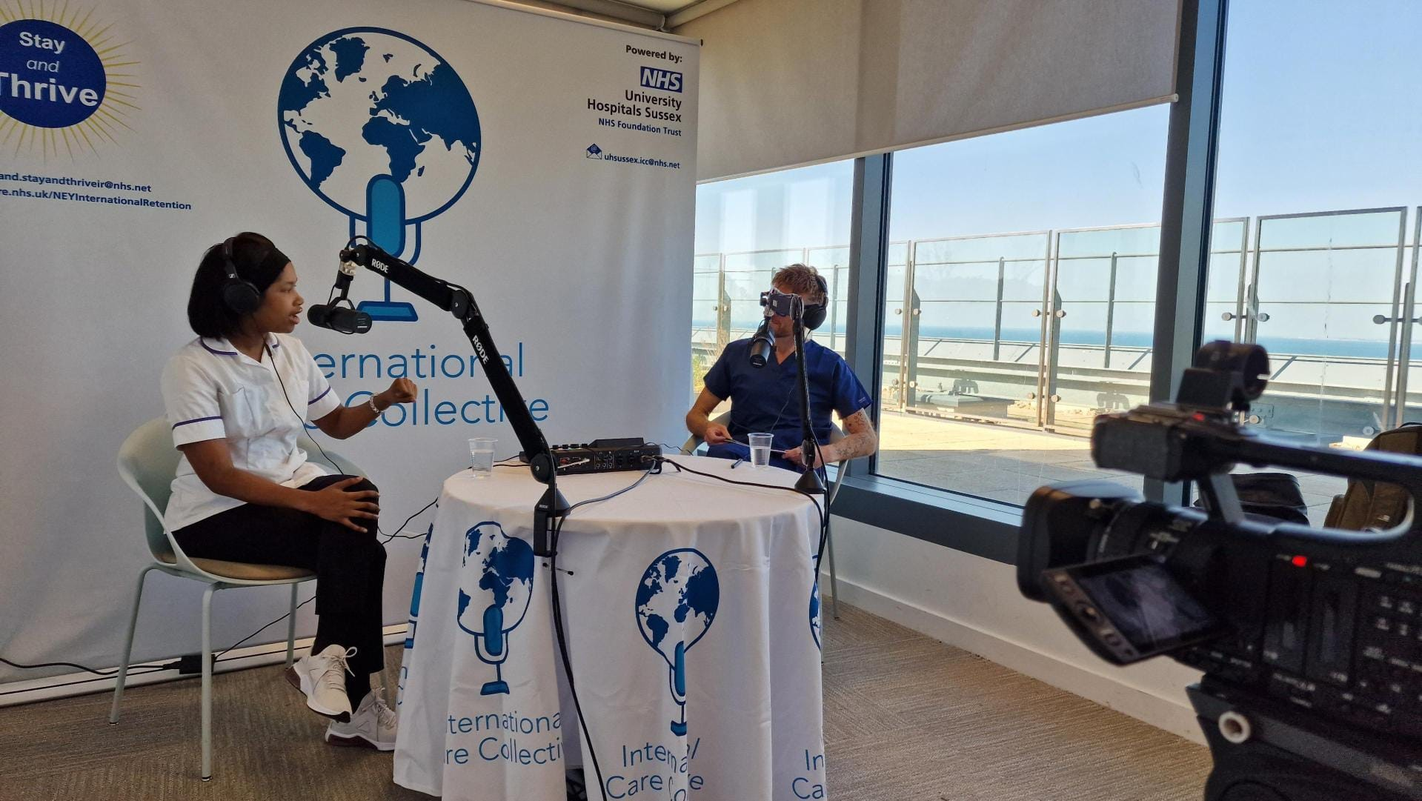
Podcasting as a Teaching Resource
Can we evolve our teaching methods?
Podcasting activities have gathered popularity in the twenty-first century for pedagogical activities. This has been due to the COVID-19 pandemic and universities around the world in maintaining the social distancing rule. (Adu, Abu Ziden & Ismail, 2021)
The ultimate benefit of storytelling, is the special status that stories have regarding their memorability, derived through
their narrative structure and the emotional investment they elicit from their audience (Landrum etal, 2019)
The Fox-Singer Framework outlines six key constructs that support podcasting as a pedagogical practice in social work education. It’s not about adding podcasts just to seem tech-savvy – it’s about aligning content with transformative learning theory, relationship-based practice, and experiential education.
Notes:
As a human race, we continue to evolve. Why are we not evolving our learning pedagogies, but also our workplace environments? If we wish to employ/entice the youth of today into careers in healthcare, we should be adapting to what is of interest at the current time.

Slide 9
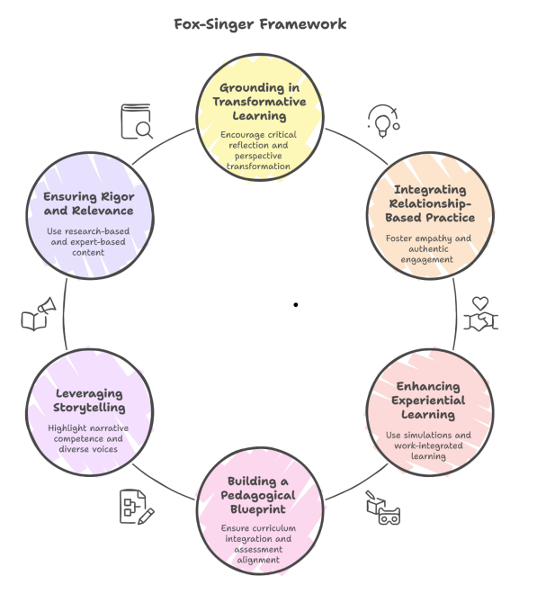
Podcasting as a Teaching Resource
Can we evolve our teaching methods?
Here’s a brief look at the six components:
Transformative Learning – Use podcasts to introduce disorienting dilemmas and support critical reflection and perspective transformation.
Relationship-Based Practice – Foster empathy and trust through audio stories; encourage students to create their own episodes as a form of relational learning.
Experiential Learning – Simulate client interactions or field scenarios through podcasts, then build assignments around role-play or case analysis.
Pedagogical Blueprinting – Integrate podcasting into the curriculum and assessment plan with clear objectives—not as an afterthought.
Storytelling & Lived Experience – Prioritise narratives from marginalized communities to teach narrative competence and justice-oriented listening.’
Rigor & Relevance – Choose content grounded in research or community-defined expertise and continuously evaluate podcasting’s pedagogical impact.
(Singer & Fox, 2025)

Slide 10
Diaspora Networks

Slide 11
Diaspora Networks
Thoughts and Questions?
My role gives me the privilege of supporting many professions — and it’s shown me something important:
Why does it take a cross‑professional role to truly understand what others do?
If we work together every day, why do we still know so little about each other’s roles, journeys, and expertise?
Across the UK, diaspora networks often mirror this same pattern:
We support each other, but mainly within our own professions.
“Diaspora communities can be a powerful source of external development aid to their origin countries. Their contributions take many forms, including remittances (money transfers between individuals), charitable donations, partnerships, skill transfers, policy advising, and other forms”
(Taslakian et al, 2022)
Diaspora healthcare professionals are health diplomats, moving between health systems with ease and confidence in their skills and knowledge.
(Bond, 2024)
Takeaway?
The NHS must centre inclusion and race equality in its leadership and decision-making, ensuring the UK’s health system is fit for the future, benefitting fully from the wealth of knowledge and expertise in our diverse healthcare workforce.
(Global Health Partnerships, 2023)

Slide 12
Diaspora Networks
🎯 Thoughts
We come from different cultures and backgrounds, yet many of our experiences — migration, belonging, settling into the National Health Service (NHS) — are shared.
We all share the human experiences of hope, challenge, transition, and community.
If these are universal, are we unintentionally silo‑ing ourselves?
Are we not people before we are professionals?
Suggestions?
Possible ways forward:
Broader diaspora networks that unite people through shared culture and identity, not just professional titles.
Profession-specific sub‑groups within those networks for tailored support without fragmenting communities.
Cross‑professional storytelling spaces (events, panels, podcasts, mentoring) to help us truly understand each other’s roles and journeys.
Shared onboarding pathways for internationally educated staff, promoting early cross‑professional connections.
Collaborative learning sessions where different professions explore each other’s scope, challenges, and contributions.

Slide 13
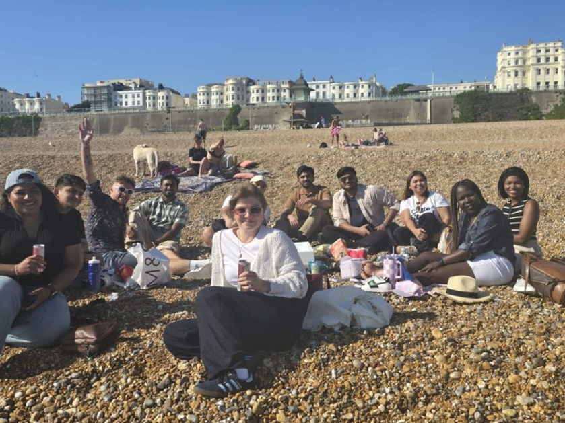
Diaspora Networks
Inclusive or exclusive?
What do you see here?
It may not seem much, but what you're seeing here is people not just from across our Trust, but from across the globe and across all professions. You see here Nurses, Physios, OTs, Diagnostic Radiographers, Therapeutic Radiographers, Biomedical Scientists, and Dietitians just sitting down and getting to know each other. Breaking down those silo barriers and seeing each other as people.
This is what community is, and this is what international recruitment can be.

Slide 14


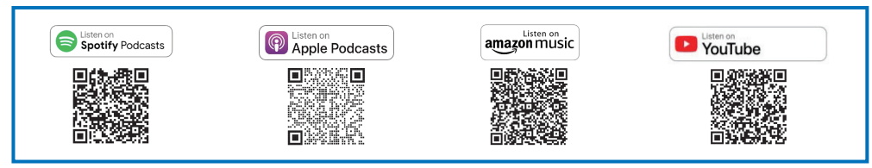
Season 2 – Coming Autumn 2026!
Scan the QR Codes to follow us and subscribe on your chosen stream and YouTube
Contact: uhsussex.icc@nhs.net

Slide 15
Thank You For Listening!
Contact: uhsussex.icc@nhs.net

Slide 16
References

Slide 17
References
Adu, E.I., Abu Ziden, A. & Ismail, A.B. (2021) ‘Podcast acceptance for pedagogy: the levels and significant influences’, Heliyon, 7(3), e06442. doi:10.1016/j.heliyon.2021.e06442.
Landrum, R. E., Brakke, K., & McCarthy, M. A. (2019, August 15). The Pedagogical Power of
Storytelling. Scholarship of Teaching and Learning in Psychology. Advance online publication.
http://dx.doi.org/10.1037/stl000015
Singer, J.B. & Fox, M. (2025) ‘Podcasting Pedagogy: The missing piece in Higher Education podcasting’, Media and Learning Association. Available at: https://media‑and‑learning.eu/subject/av‑technologies/podcasting‑pedagogy‑the‑missing‑piece‑in‑higher‑education‑podcasting/ (Accessed: 12 January 2026).

