Slide 1

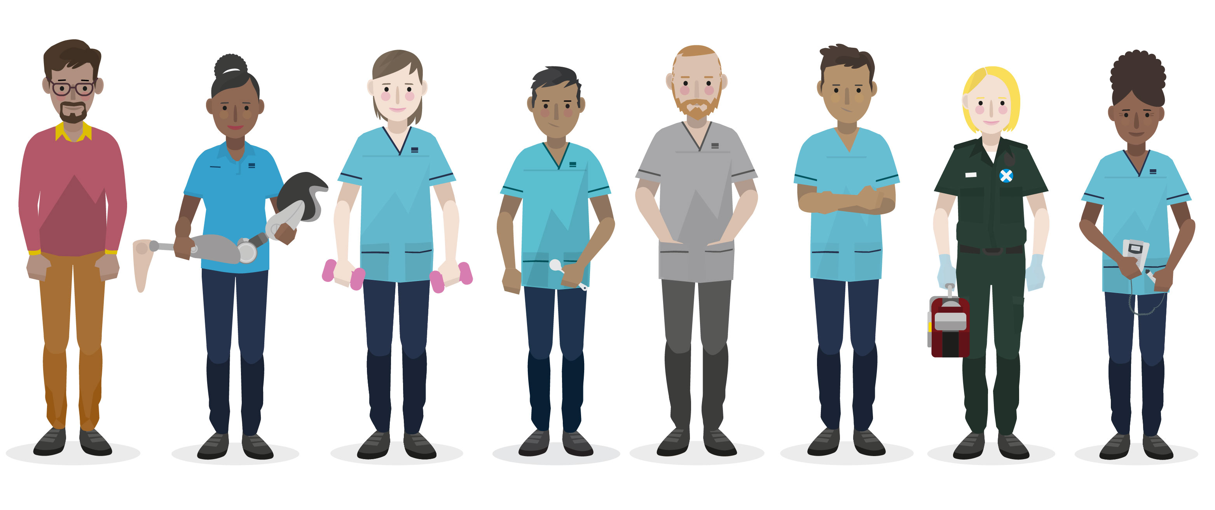
The NAEP Conference Friday 6th March 2026
Leveraging Digital Platforms to Embed
Long Arm Supervision in Practice‑Based Learning
Sarah Nicol - Practice Education Lead at NES Supporting AHP PrBL (Practice‑Based Learning)
Notes:
My name is Sarah Nicol, Practice Education Lead with NHS Education for Scotland in the NMAHP Practice Based Learning Team.
The focus of my work is to increase awareness and engagement of alternative placement models, specifically Long Arm Supervision aligned with QSPL.
I’m going to use the next few minutes to walk you through how I have used digital technologies to support education and learning to promote Long Arm Supervision.

Slide 2
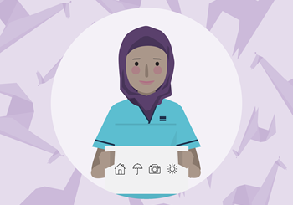
AHP Long Arm Supervision
Where supervision is provided by an experienced Health and Care Professions Council (HCPC) registered practice educator who is not based at the same location as the student or students.
Notes:
LAS is when supervision is provided by an experienced HCPC registered practice educator who is not based at the same location as the learner.
An example of this could be an Occupational Therapy student completing a placement in an outdoor education centre being supervised remotely by an Occupational Therapist from a different health board.
Day‑to‑day support would be provided by an on‑site staff member, who oversees the student’s activities and acts as their mentor.
Together, the student, on‑site mentor and practice educator would agree clear learning objectives aligned to the assessment framework.
In regular reflective supervision sessions with the PE, the student would demonstrate their developing knowledge, skills and learning.
The great thing about Long Arm Supervision (LAS) is that it enables flexible, diverse placement experiences that build student confidence and autonomy, while also expanding placement capacity and strengthening partnerships across services and communities.
So what’s the problem?

Slide 3

So what is the problem?
  Low Awareness & Confidence
  Dispersed, Unclear Resource
  Accountability Concerns at a Distance
Notes:
during my early scoping activities, I discovered something important:
The model itself wasn’t the barrier — the barrier was knowledge, confidence and skills.
Practice educators wanted the best for their learners
But were reluctant due to uncertainty about accountability and a perception about LAS being second‑best or risky.
It became clear that simply producing traditional resources wasn’t going to have the desired impact - information alone doesn’t change culture and I needed to inspire and influence fellow AHP’s
So the question became:
How do I demystify LAS, build confidence, and create a shared understanding across all Scottish AHP profession, settings and sectors?
And digital was the answer!
reach educators wherever they are
guidance visible and easy to access
normalise the model through examples and conversations
create consistency across different professions, sectors and settings
Digital wasn’t the goal — it was the most effective way to engage and inspire.
So I develop a suite of coordinated digital tool to increase LAS awareness and confidence.

Slide 4
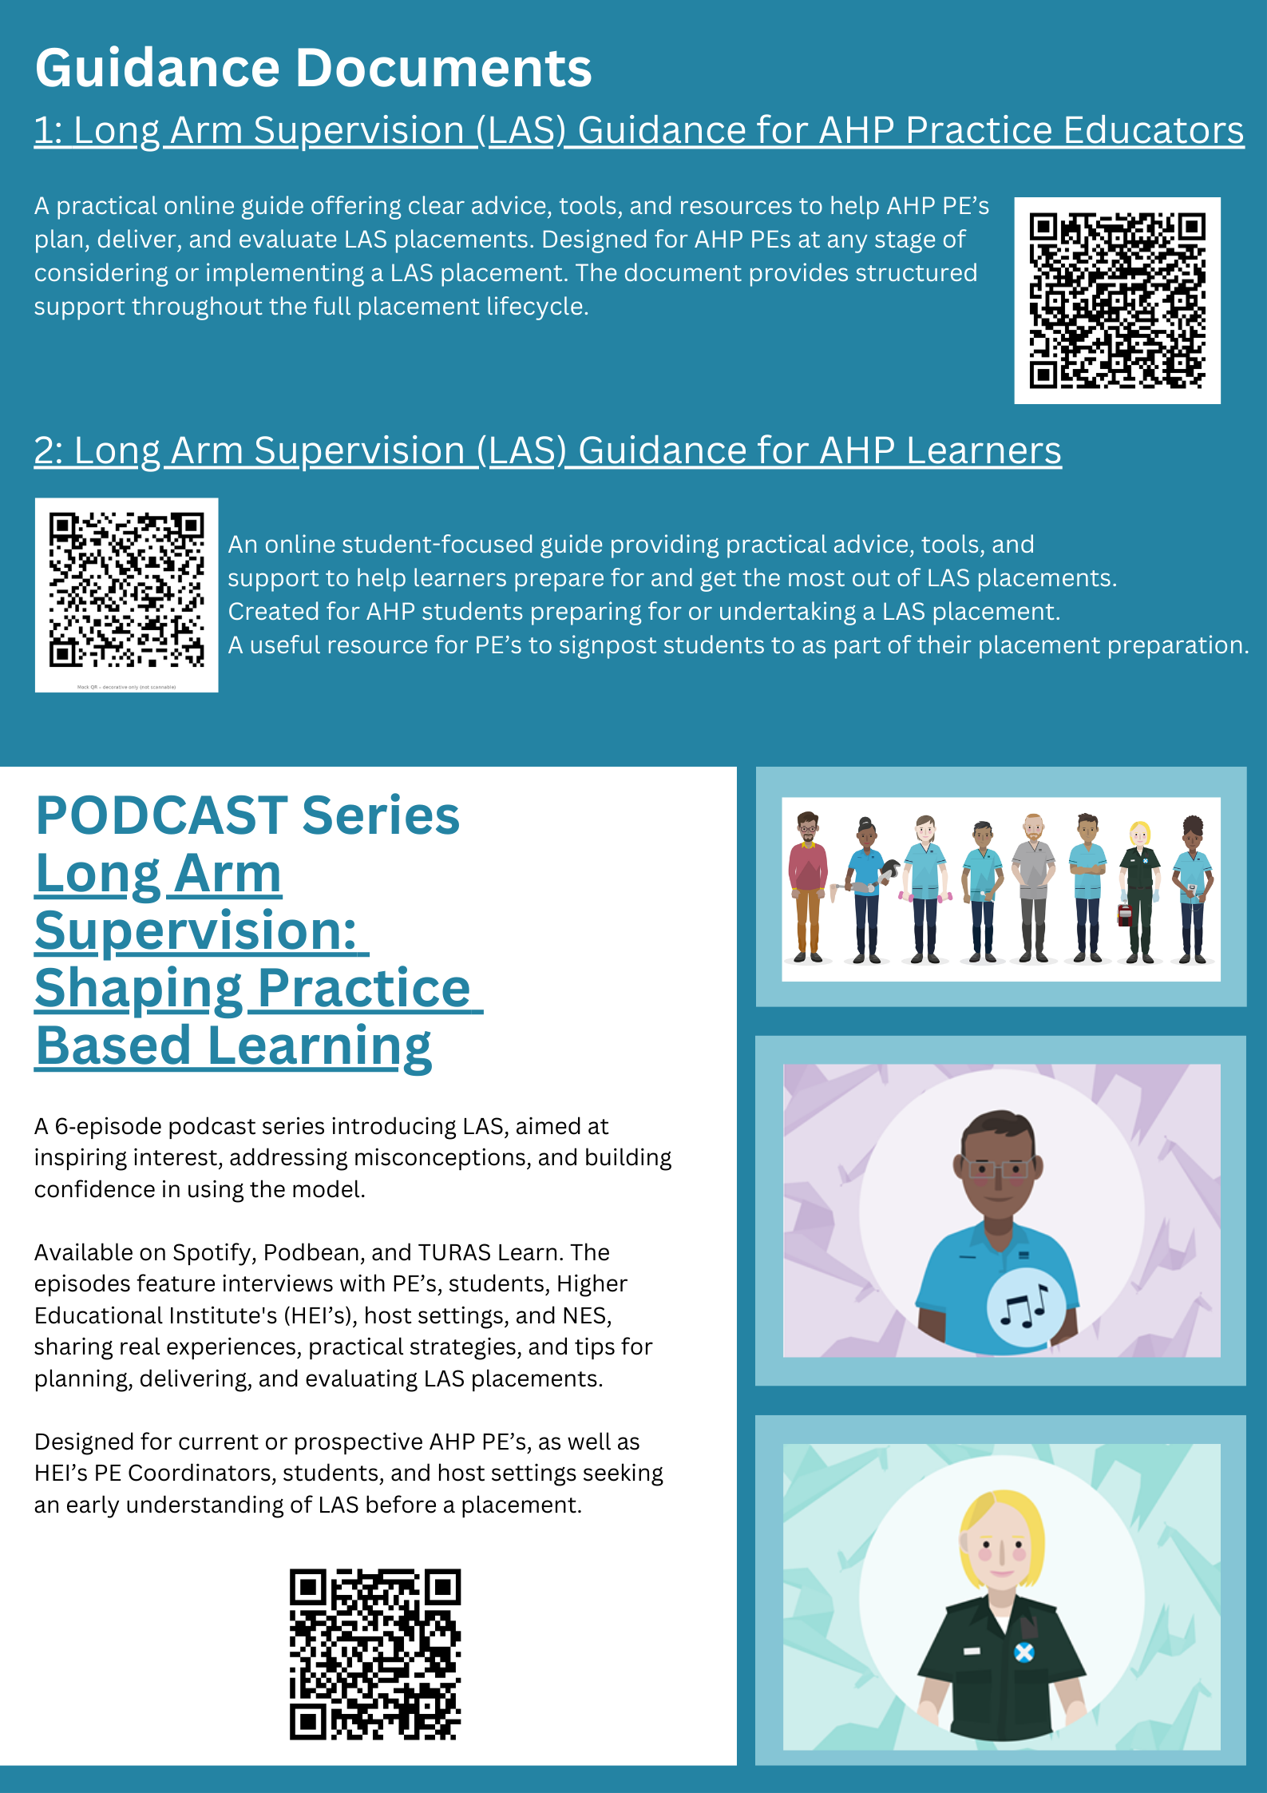
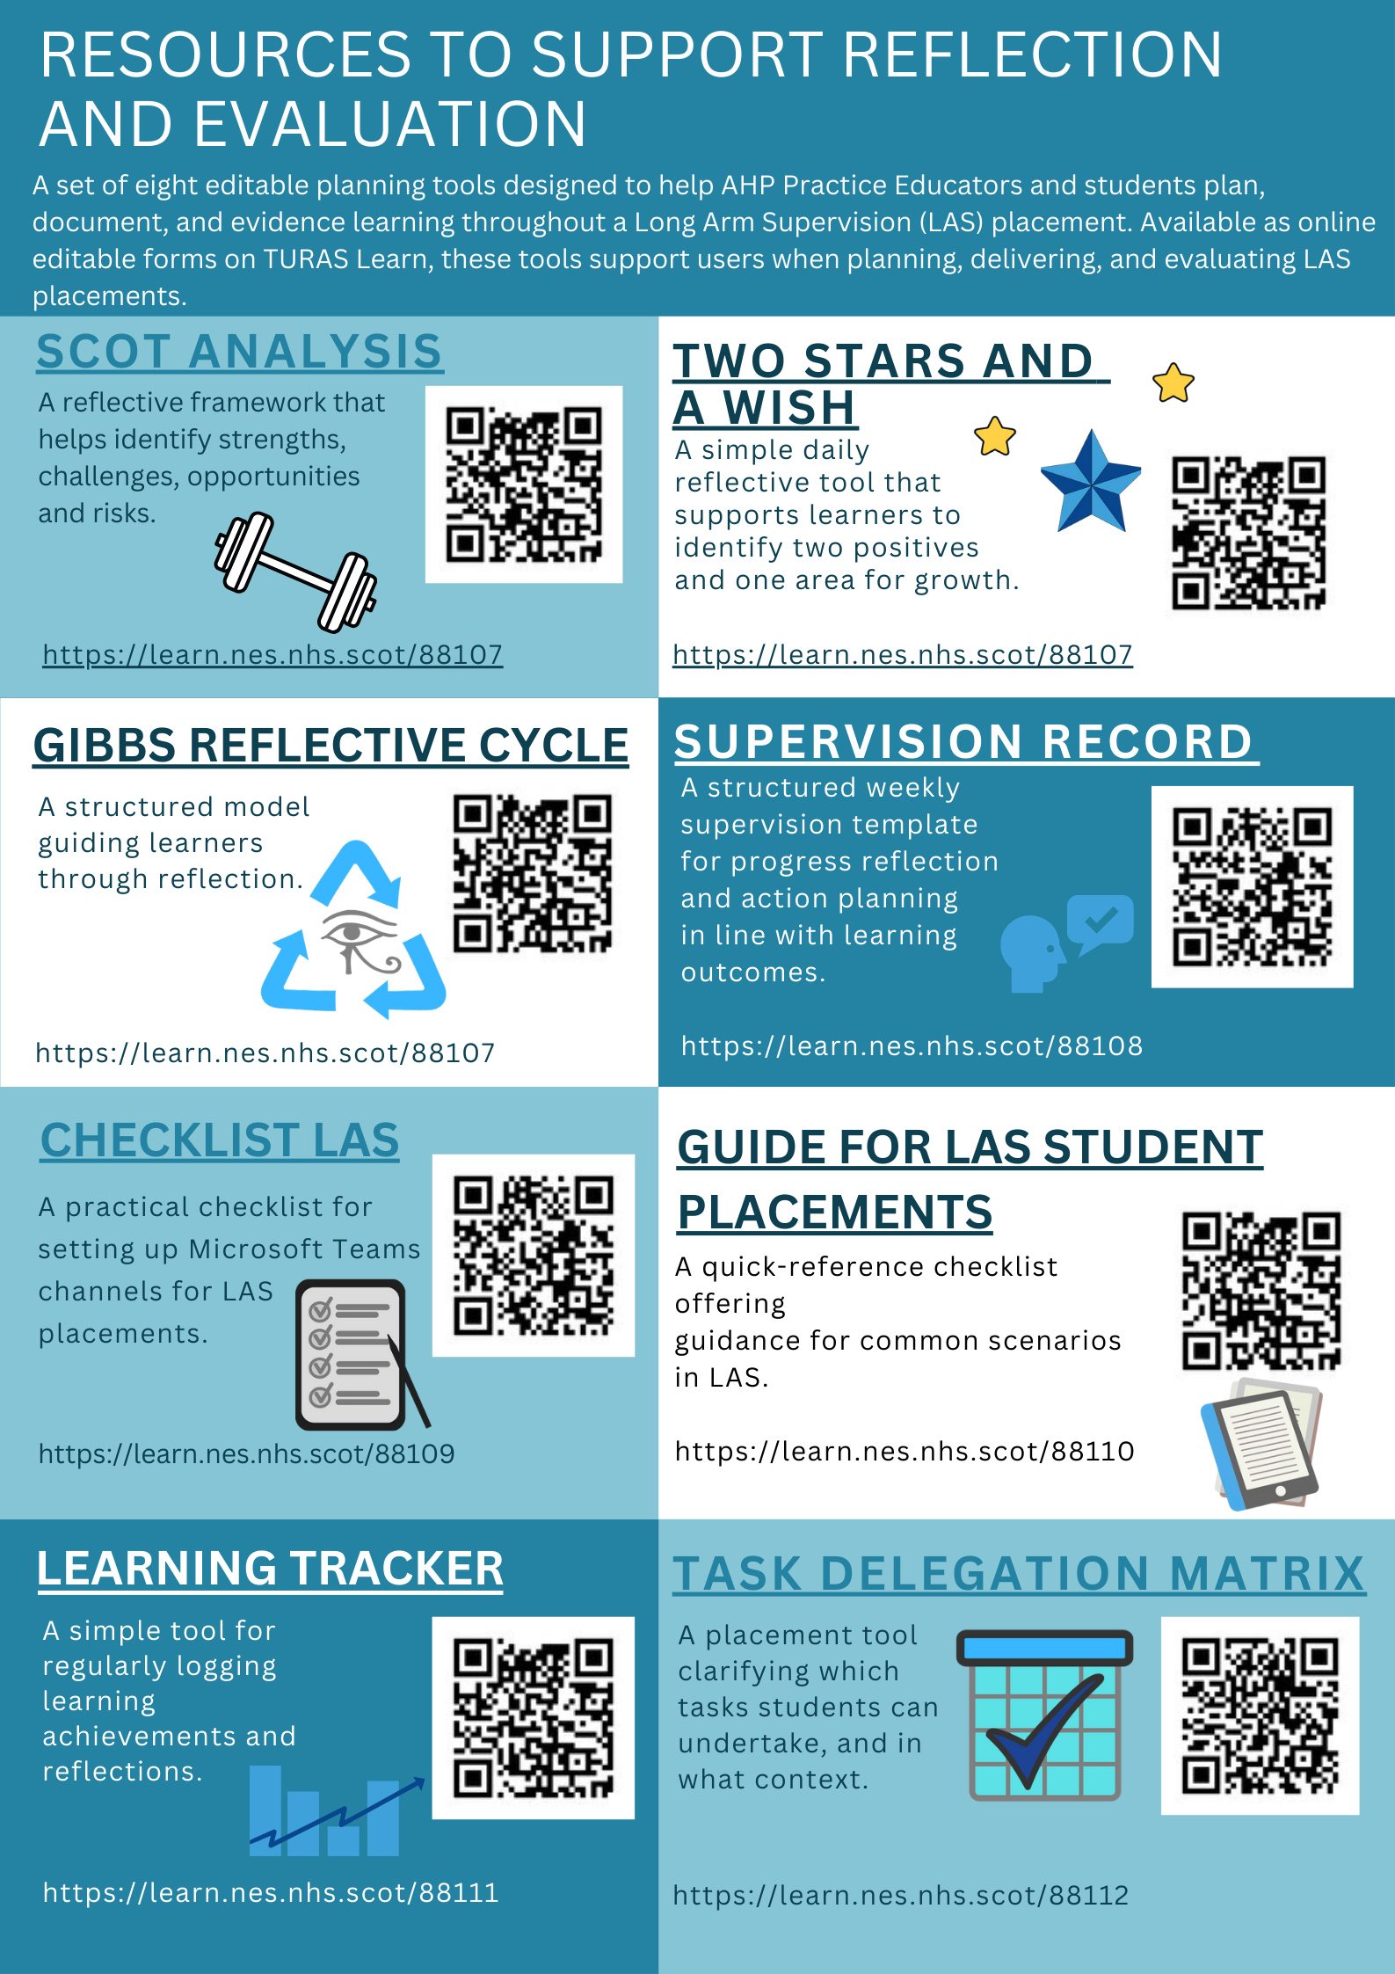
Enabling learning: the impact of digital access
Notes:
The slide is very busy so please don’t try to read it. The links to all resources are at the end of this presentation.
So, what were these tools….. Part of my work has been to collate resources together into an infographic so that all the information is easily accessible and in one place. I used digital tools, such as QR codes and hyperlinks, to increase access. The infographic lists what the resources is, who it is for and where to find it.
The first resource linked is a dedicated landing page on NHS Education for Scotland’s Webpage — this is a “one front door” for all guidance, tools, and templates.
The work here was about Consolidating, streamlining, and updating resources.
With the aim of reducing confusion, increasing consistency, and supporting staff in any setting.
This places equitable learning within reach — regardless of geography.
The tools identified within this infographic create the digital infrastructure for LAS support.
Let’s have a look at two of these resources in more detail.

Slide 5
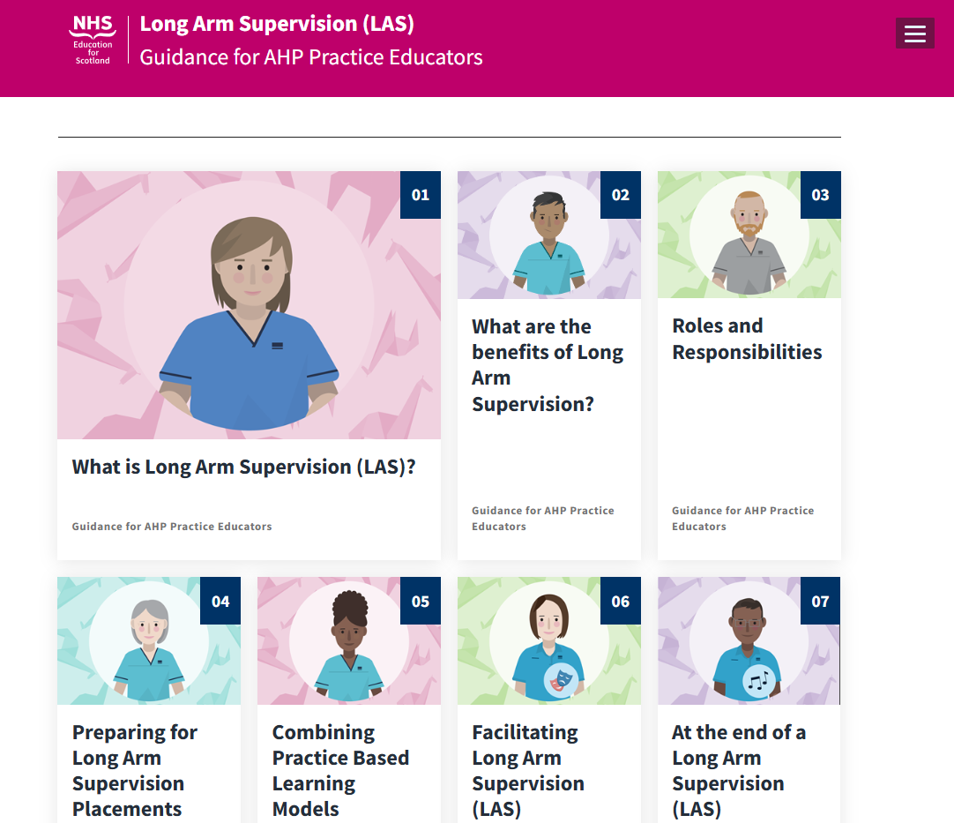
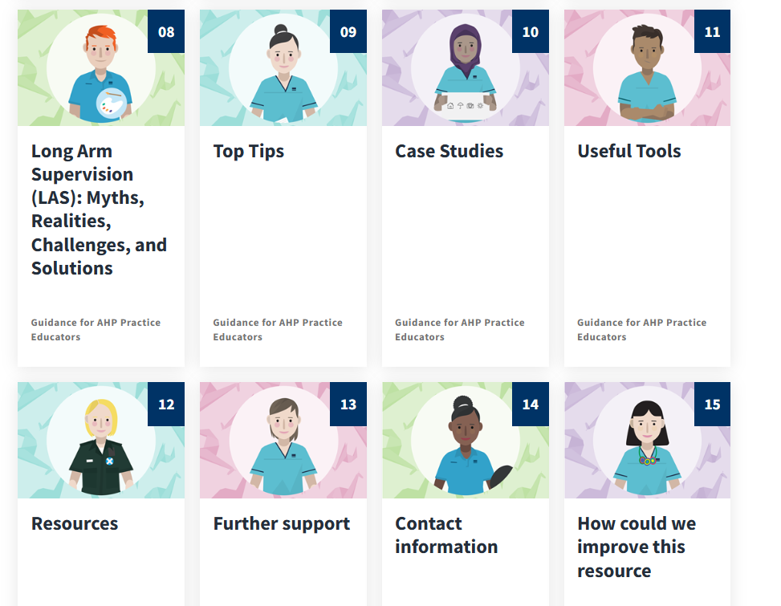
Long Arm Supervision: Guidance Documents for Practice Educators
Notes:
Here is a screen shot of Digital Guidance Document for practice educators. Hosted on a platform called UMBRACO
It consists of 15 tiles
Role‑specific & provides clarity on accountability, expectations, and placement flow.
Responds to educator concerns about “How do I supervise safely at a distance?”
In the useful tools section (tile 11), there are resources which are downloadable and editable including
Supervision records
Reflective templates
Task delegation matix’s
Learning trackers and check list.
The aim of this work was to use digital technology to make LAS support accessible and consistent, and to relieve pressure on practice educators.
There is also a companion document for learners that is currently with the web design team

Slide 6

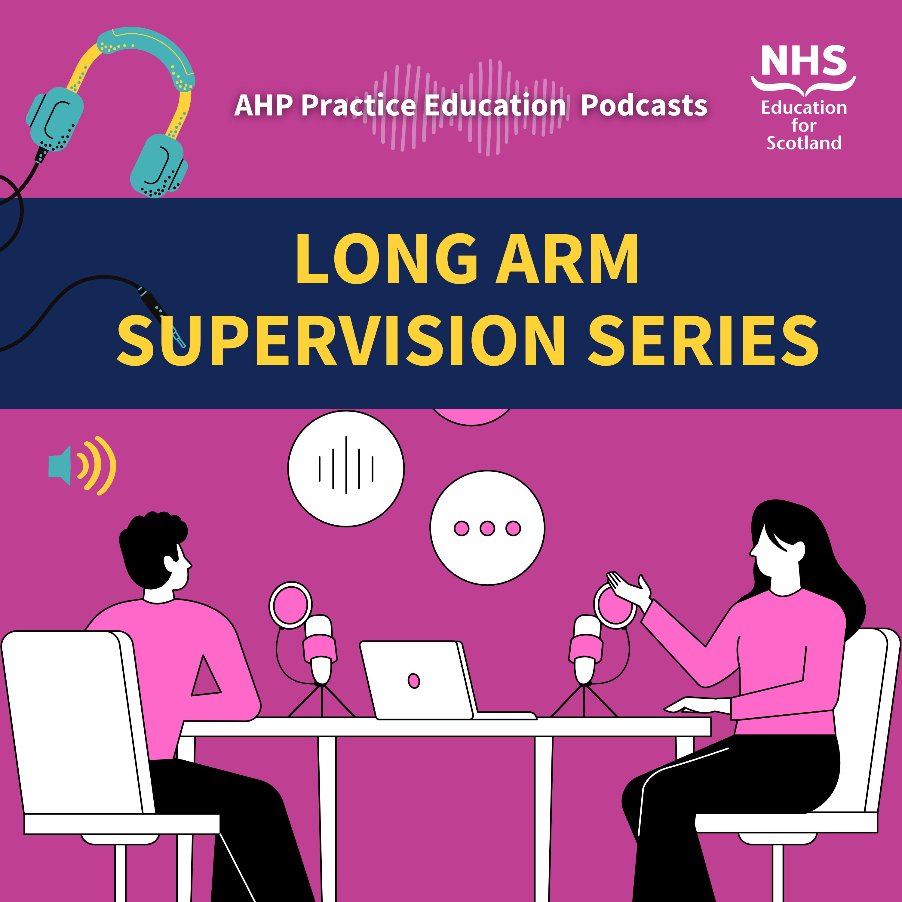


Long Arm Supervision:
Shaping Practice‑Based Learning
Notes:
The next digital resource I want to highlight is my podcast series:
Long Arm Supervision: Shaping Practice‑Based Learning Available on Podbean & Spotify,
6 – 30min episodes – Interviewed based with practice educators, learners, HEIs, NES, and host sites.
I choose Podcasting to create belonging
To humanises LAS through real voices and stories.
Makes learning “on‑the‑go” and inclusive of busy professionals – computer of phone - on the commute, walking lunch,
Creates a sense of community even for isolated or remote learners.
Different learning medium to suit different learning styles
This is digital belonging.
How did I do it
I recorded the material through 19 individual teams calls.
and edited the 17hours of material down to 3 using ‘Audacity’ free sound engineering programme.
So what did I learn?
Start early, plan episode structure prior to recording, test that structure on a dummy episode – this would have allowed me to coordinate contributors into episodes and allow me to reduce my number of interviews to 6 (1 for each episode as opposed to 1 for each contributor) - This would have also of allowed discussion between contributors.
I learnt the importance of listening to podcast examples and the work would not have been possible without linking with people who have expertise in this area – TEL (tech enabled learning) team.
I learnt how to build in accessibility (captions/transcripts) – if you can secure admin support.
Evaluation feedback from the podcasts revealed that they didn’t just inform — they changed perceptions, improved confidence, and created momentum.
Awareness of LAS and related resources increased
96% of respondents reporting interest in further learning and increased readiness, confidence, and intention to offer LAS placements in the future.
This is the real power of digital connection.

Slide 7
Impact
Increased Knowledge and Capacity
Improved Confidence & Adoption Readiness
Better Access & Visibility
System-Level Impact
Notes:
So what has the impact of this work been?
We’ve seen strong improvements in learning outcomes — 99 AHPs engaged in the CPD session, providing excellent feedback with a 4.7 / 5 star rating, Participants reported a meaningful increase in knowledge and confidence. More than 90% felt able to apply learning immediately, and two‑thirds told us they expect to change practice as a result.
Importantly, we’re now seeing movement in the areas that matter for adoption. Awareness of LAS resources has increased, confidence to plan and deliver is starting to rise, and the proportion of participants who feel likely to support or offer LAS placements has more than doubled.
We’ve also seen a noticeable uplift in traffic to the Turas page and the podcast series after the session, reflecting clearer understanding of where the resources are and how to use them in practice.
All of this contributes to wider system‑level goals — expanding placement capacity, increasing consistency, and strengthening educator confidence through more unified guidance. These early gains show that the resource suite is helping create the conditions for reliable, scalable adoption of LAS across boards and settings.

Slide 8
Supported and Visible Learners
Consistent Learning
Accessible and Equitable Resources
Connected Educators
Enabled Digital Platforms
Notes:
But What this means for learning & belonging?
I have learnt that when digital platforms enabled:
Learners feel supported, visible wither a greater sense of belonging
Resources are accessible and equitable, extending learning into environments previously out of reach
Educators are connected which supports both learning and learners
Learning that is consistent and available in a wide variety of formats to suit more learning styles and modern ways of working,
With this in place - LAS becomes not just feasible — but sustainable — across a shifting health and care system.
To continue enabling learning and belonging, we must keep building digital ecosystems that connect, equip, and empower our future workforce.
Digital technologies offer flexibility, inclusivity, and better opportunities aligned to contemporary learning environments.
In our shifting health and care landscape, where workforces are dispersed and stretched, digital technologies aren't just helpful — they are essential tools for enabling learning and belonging.

Slide 9
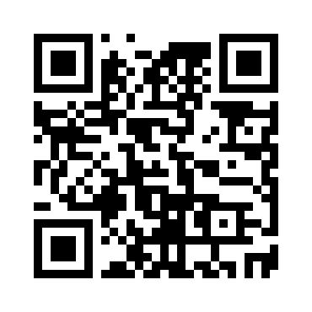
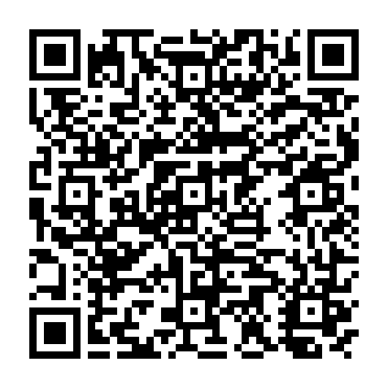
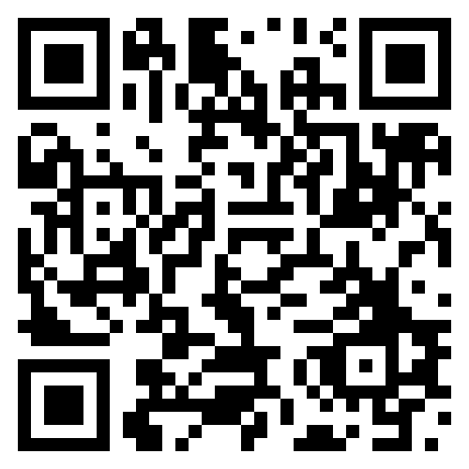
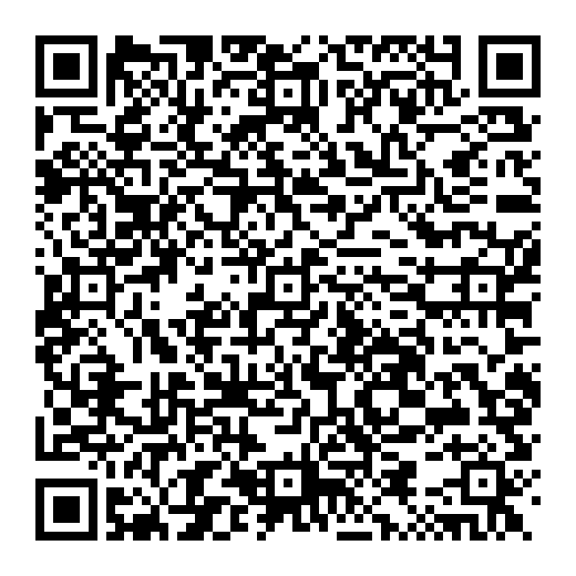
LAS Resource Infographic
Long Arm Supervision (LAS) Guidance for AHP Practice Educators
Long arm supervision: shaping practice-based learning podcast
TURAS AHP Long Arm Supervision page
sarah.nicol@nhs.scot

